Slide 1
Microsoft Dynamics SL 2015 & 2018: Web Apps

Slide 2
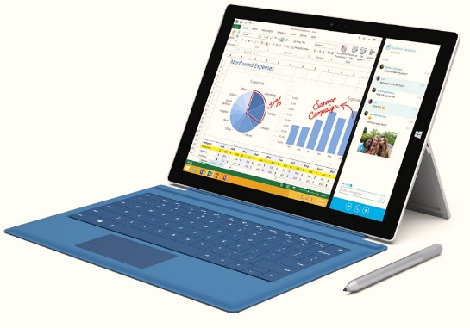
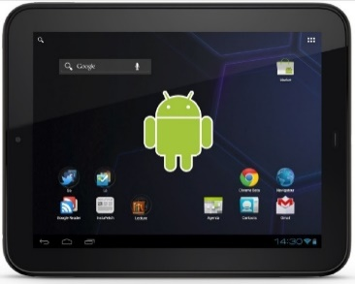
Microsoft Dynamics SL Web Apps
Microsoft Surface
Apple
Android
DEVICES
WORK
Web Apps Web Services
Notes:
Microsoft Dynamics SL has created Web Apps using HTML5.
HTML5 web based screens provide access to Microsoft Dynamics SL on the devices you use, desktops, tablets and phones, no matter the brand.
In addition Microsoft Dynamics has released the Business Analyzer App that runs on different platforms.
I provides access to SQL Server reports, links to Management reporter and Excel reports.

Slide 3
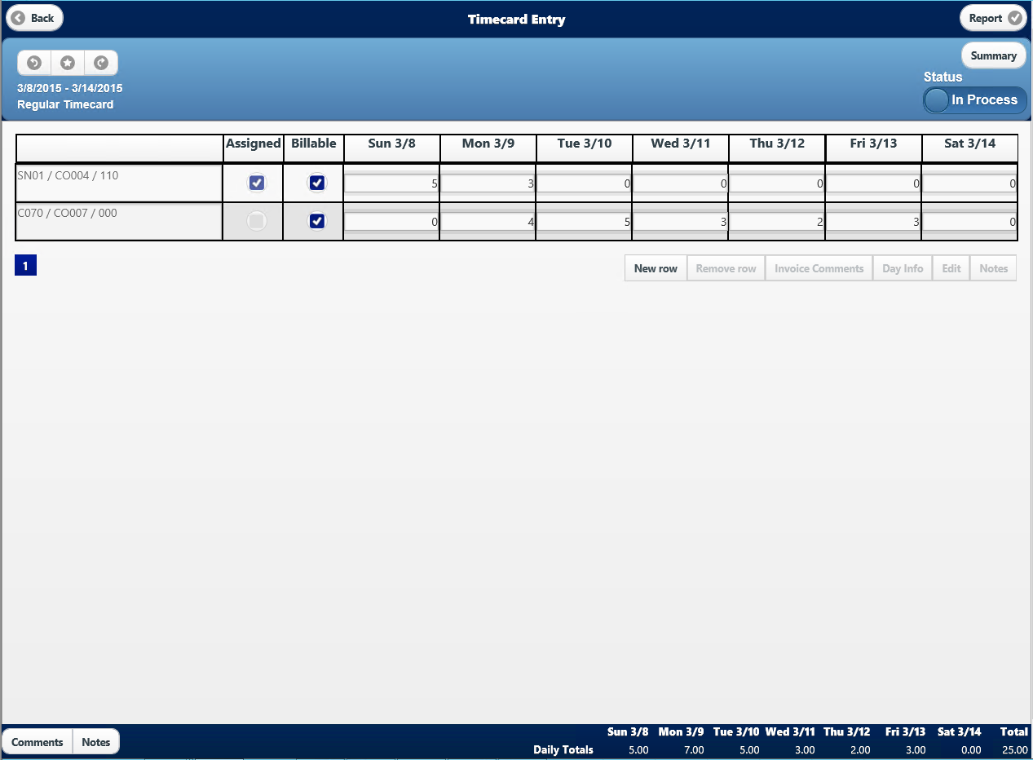
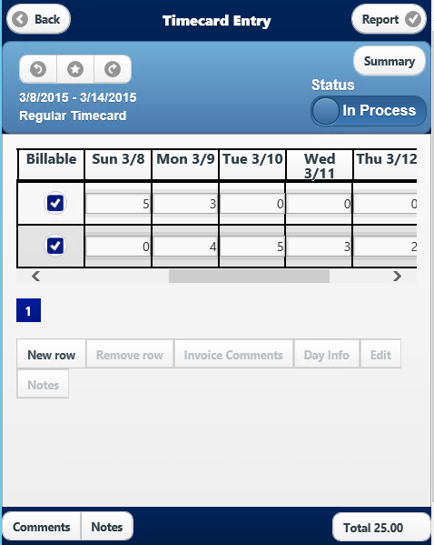
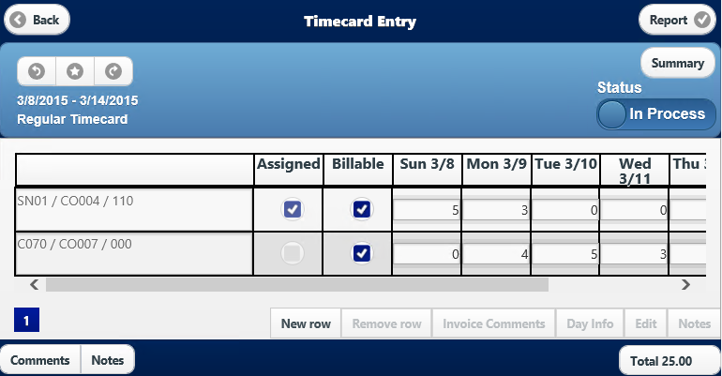
Responsive Technology
Desktop
Notes:
Responsive technology means that end users will be able to use Web Apps on different devices.

Slide 4
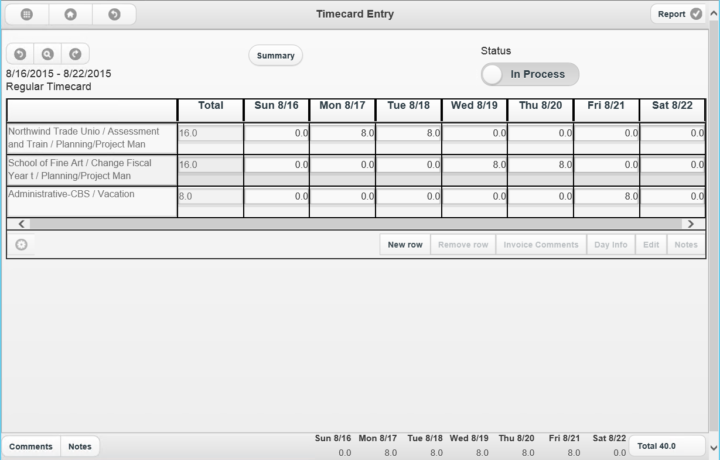
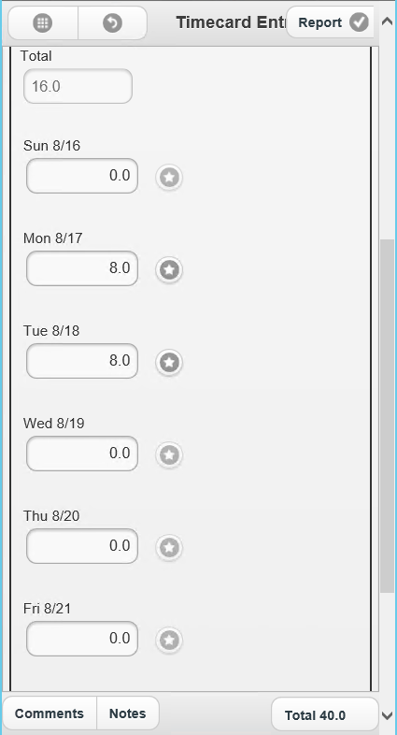
Responsive Technology – Grid/Form View
Time Entry – Grid View
Time Entry – Added Form View
Notes:
Web Apps are built to run on the devices you use. The grid interface is great for data entry on desktop and larger devices.
The screens use responsive technology which means they will adjust when moving to smaller devices.
We have received great feedback that phone users would like to change the interface to be in a form view for ease of entry.
In the past, we would have had to wait until a new release to address this need.
I’m happy to announce that less than 4 months, we have a new Hot Fix released that addresses this very need.
A new form view has been added to the Time Entry & Expense Entry!
We are happy to announce that we have released a new form view button has been added to the screen.
It will change from a grid to a form view which may be preferable for smaller devices.

Slide 5
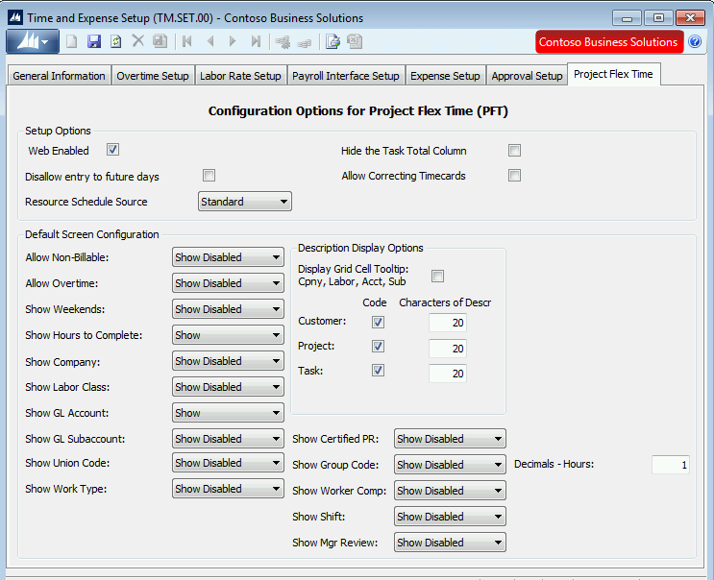
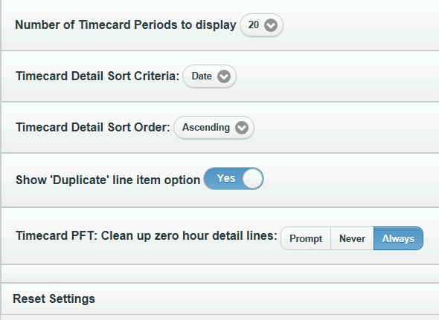
Built In Customizing
In SL In Web Apps
Web Configuration file

Slide 6
Microsoft Dynamics SL Web Apps
Hot Fixes
&
New Features
Releasing approximately
once a month

Slide 7
Microsoft Dynamics SL 2018 Web Apps
Project Time Entry
Project Maintenance
Employee Utilization Module
Reporting
(Web SL reporting)
Project Timesheet Entry
Employee and Resource Maintenance
Resource Planning
by Project &
by Resource
Quick Query
ad-hoc query
Project Expense Entry
Employee Position/Rate
Maintenance
Vendor, Customer & Payroll employee Maintenance
Item Request Entry & Approval
Project Approvals & Delegation: T&E, Invoice, Budget
Project Analyst
Inventory Lookup
Payroll & Advanced Payroll Timecard Entry
Timecard Status
Project Charge Entry
Project Change Order
External Links to Websites
Notes:
Microsoft Dynamics SL has a long history of focusing on Project based companies.
<click> The major features used by Project managers and Project employees are available today.
<click> New project features have been added to assist Resource managers with scheduling.
<click> Reporting and requesting features needed by managers and employees have been added.

Slide 8
Enhancements

Slide 9
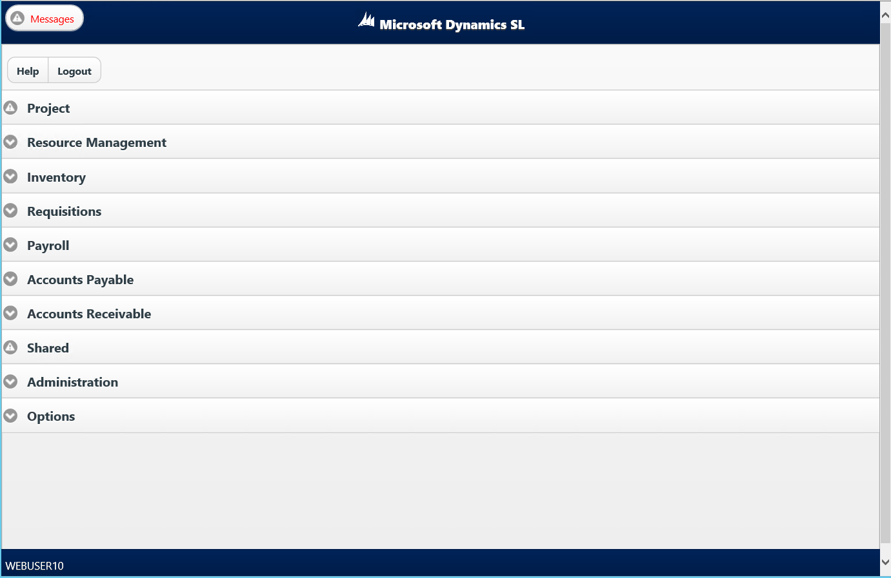
Menu Interface

Slide 10
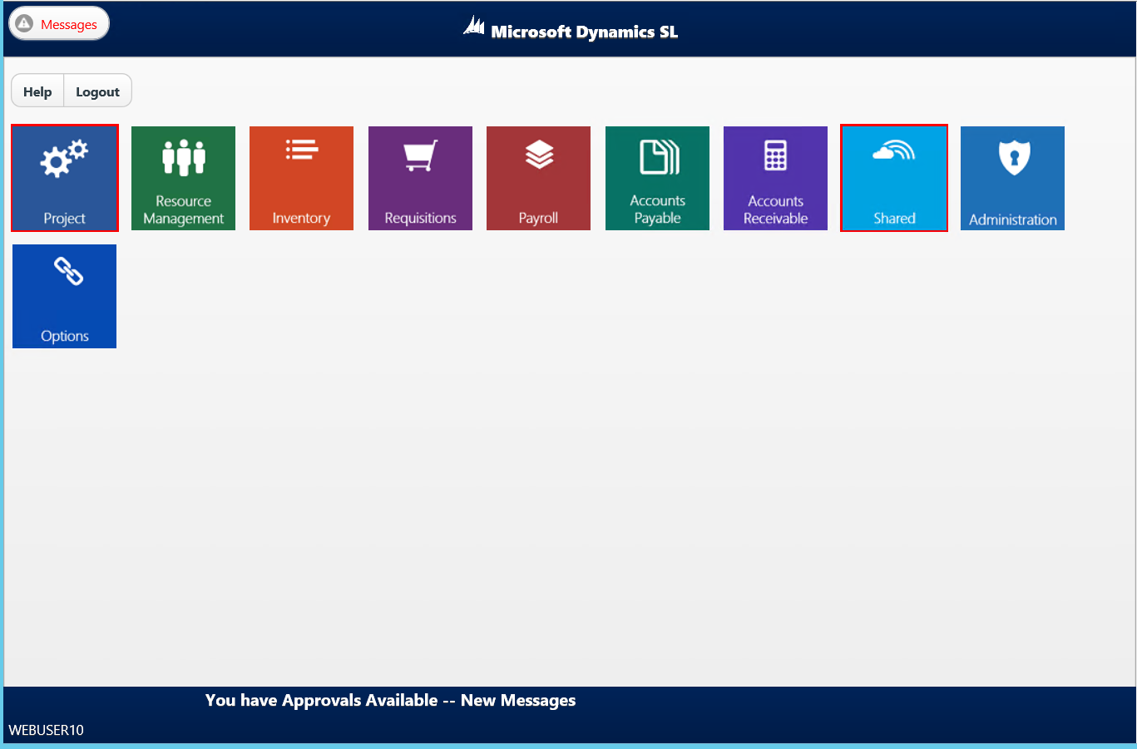
Menu Tiles

Slide 11
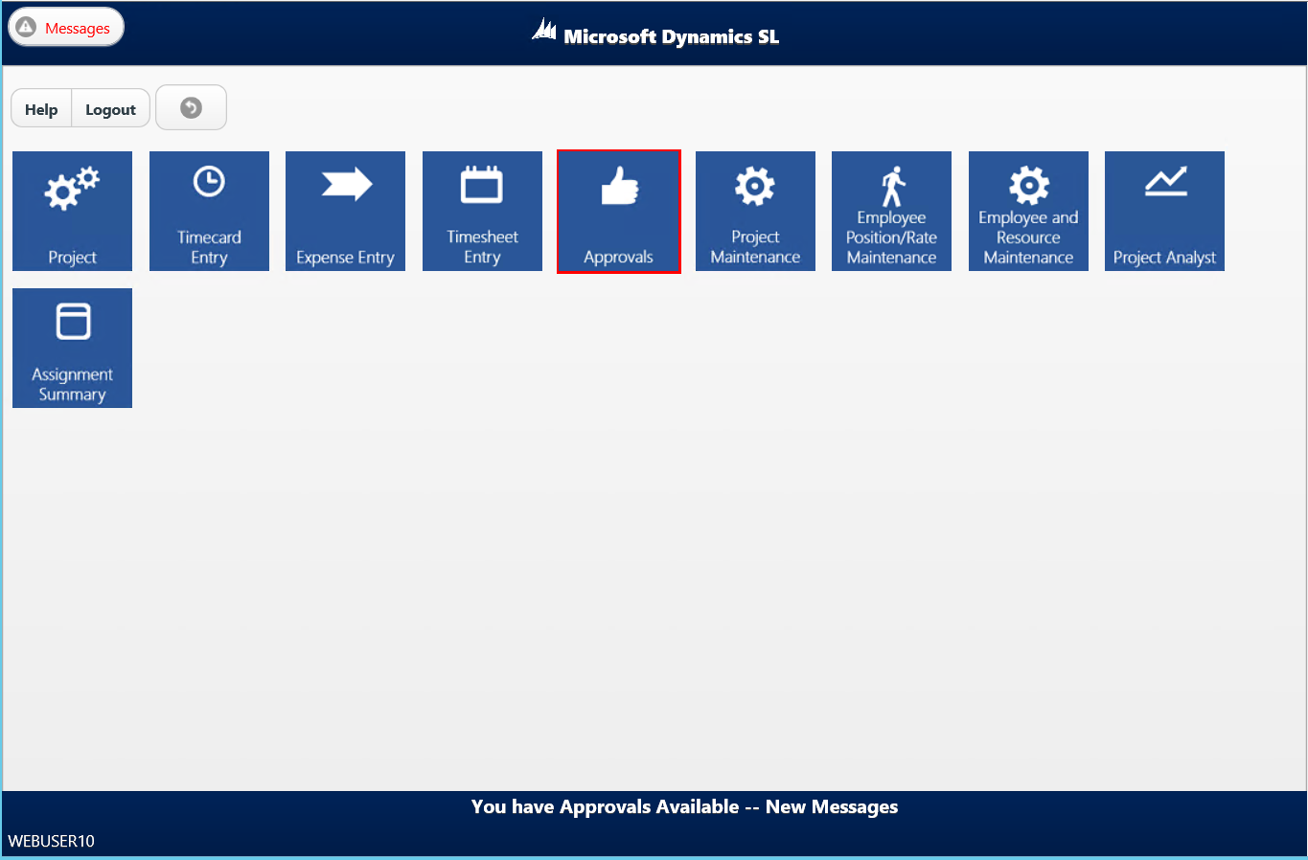
Menu Tiles

Slide 12
Add your own Tiles
The existing tiles can be replaced with custom tiles

Slide 13
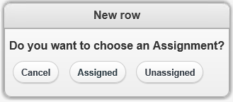
Timecard Entry: Reduce the clicks needed to enter time
Removed the New row submenu
The submenu allowed the selection of adding Assigned or Unassigned projects.
Unassigned did not properly represent

Slide 14
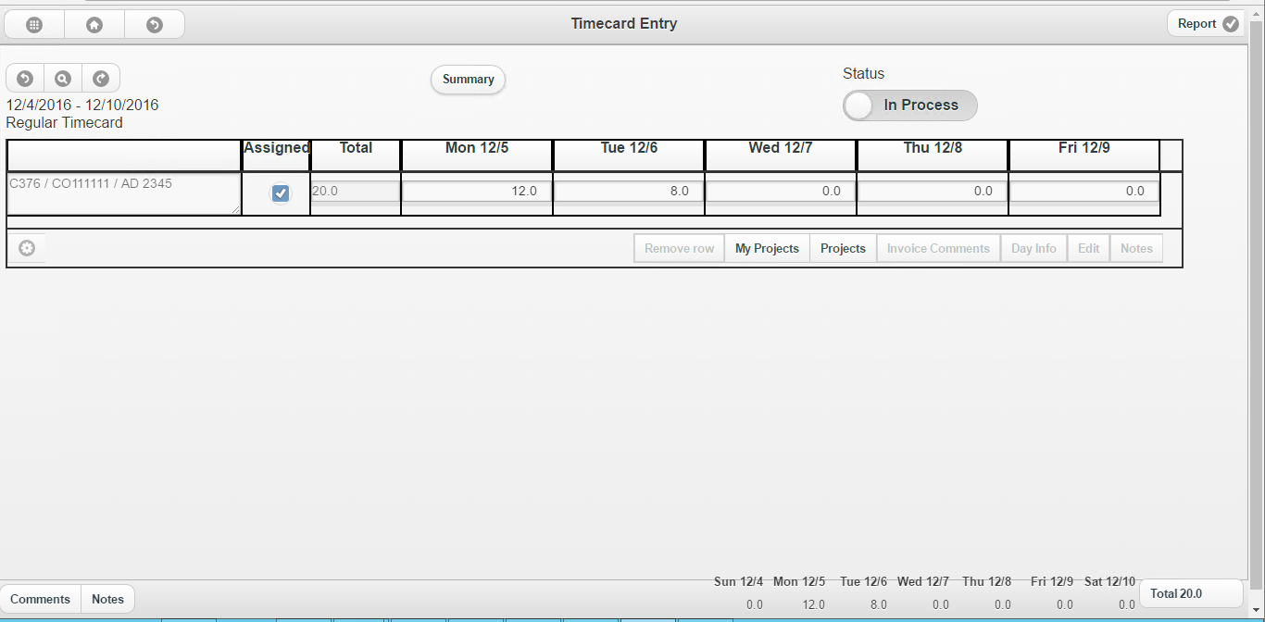
Reduce the clicks needed to enter time
Replaced the New row button and the submenu with two buttons on the main Timecard Entry screen:
My Projects
Projects button

Slide 15
Buttons
My Projects
Clicking the button opens the list of Projects that have been assigned to a user.
This is the same screen accessed by the previous Assigned button
Projects
Clicking the button opens the interface to search for a Project and Task.
This is the same screen accessed by the previous Unassigned button.

Slide 16
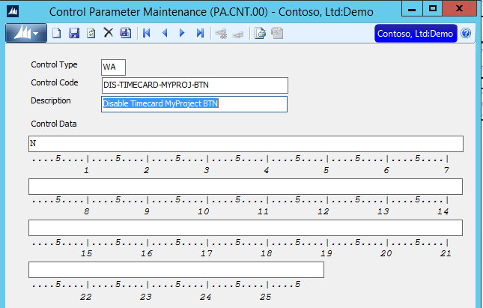
Want to hide the My Projects button?
Disable Timecard My Project button
N (default)
No, don’t disable the My Project button on the Timecard Entry screen. Display the My Project button on the Timecard Entry screen.
Y
Yes, disable the My Project button the Timecard Entry screen. Do not display the My Project button on the Timecard Entry screen.

Slide 17
Want to hide the Projects button?
Disable Timecard Project button
N (default)
No, don’t disable the Project button on the Timecard Entry screen. Display the Project button on the Timecard Entry screen.
Y
Yes, disable the Project button the Timecard Entry screen. Do not display the Project button on the Timecard Entry screen.

Slide 18
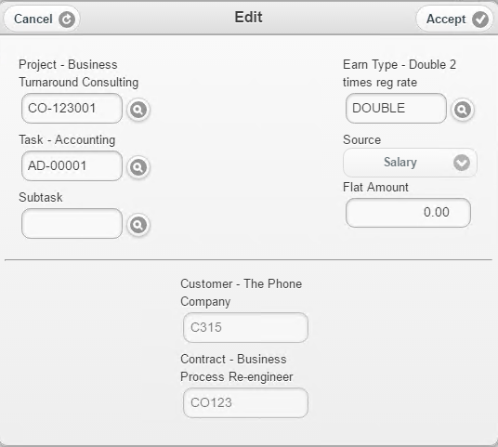
Viewing Customer Information
Display on the Project lookup/edit screen

Slide 19
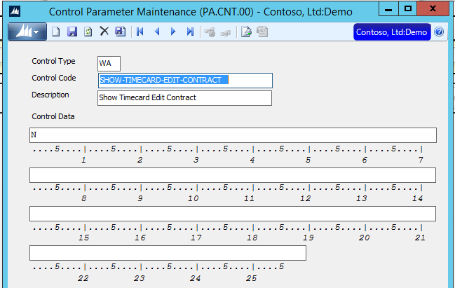
Viewing Customer Information
Show Customer value on Timecard Edit Screen
Default value is N – Do not display

Slide 20
Viewing Contact Information
Display on the Project lookup/edit screen

Slide 21
Viewing Contract Information
Show Contract value on timecard edit screen
Default value is N – Do not display

Slide 22
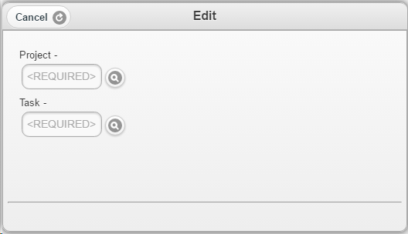
Supports viewing only Project and Task

Slide 23
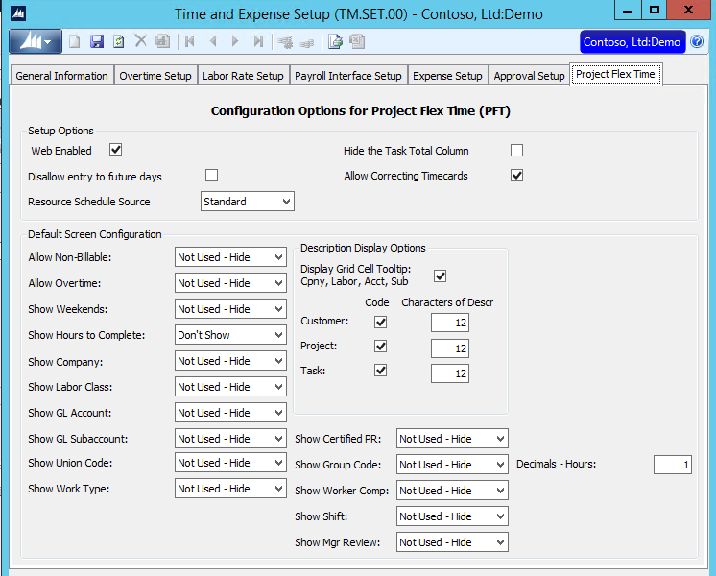
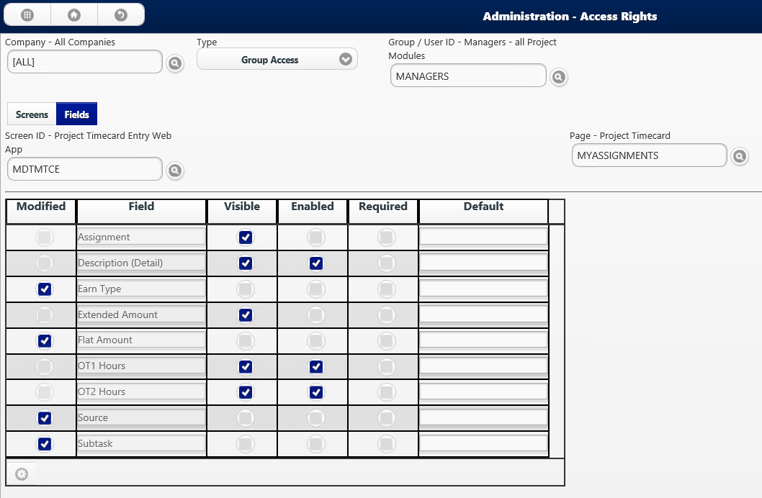
Supports viewing only Project/Task
Where to turn on/off fields

Slide 24
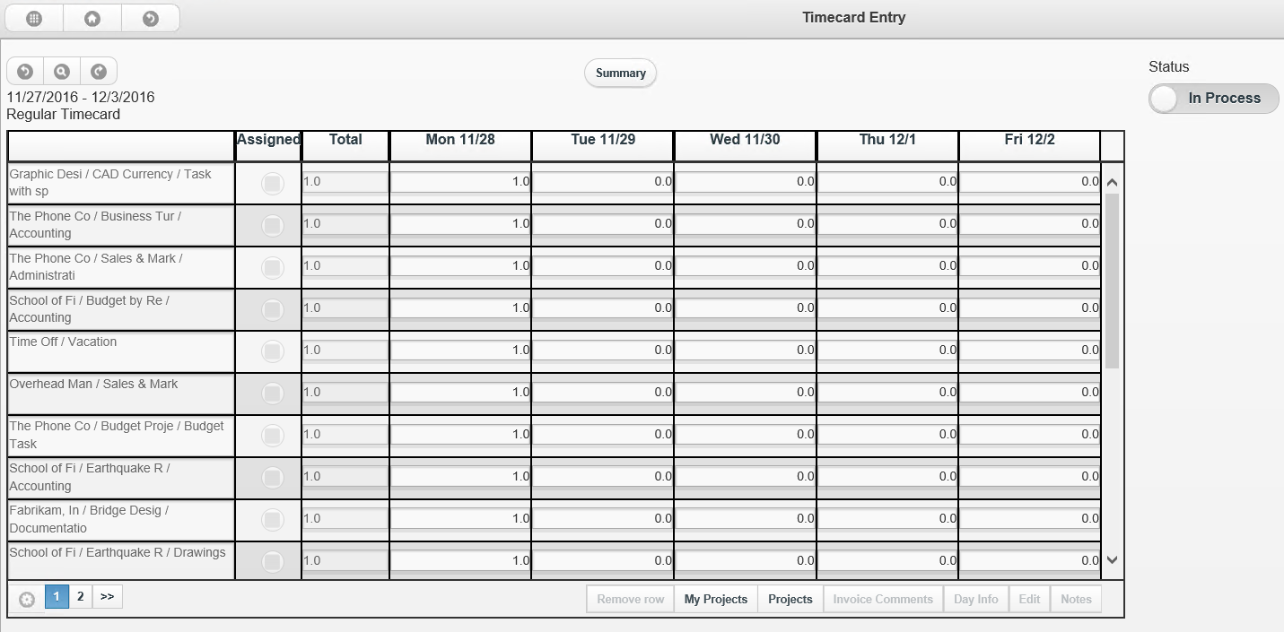
Number of lines to display per page
Supports from 1 – 35 lines per page

Slide 25
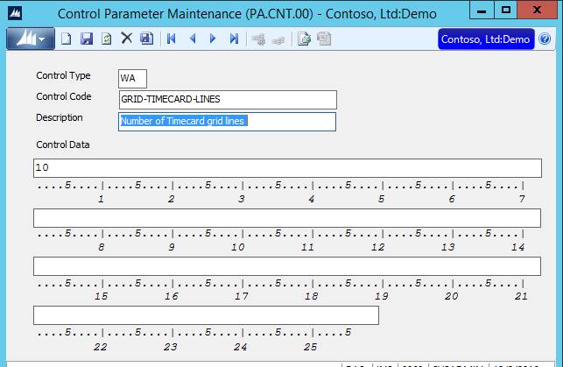
Number of lines to display per page
Supports from 1 – 35 lines per page
Enter Control Data between 1 and 35

Slide 26
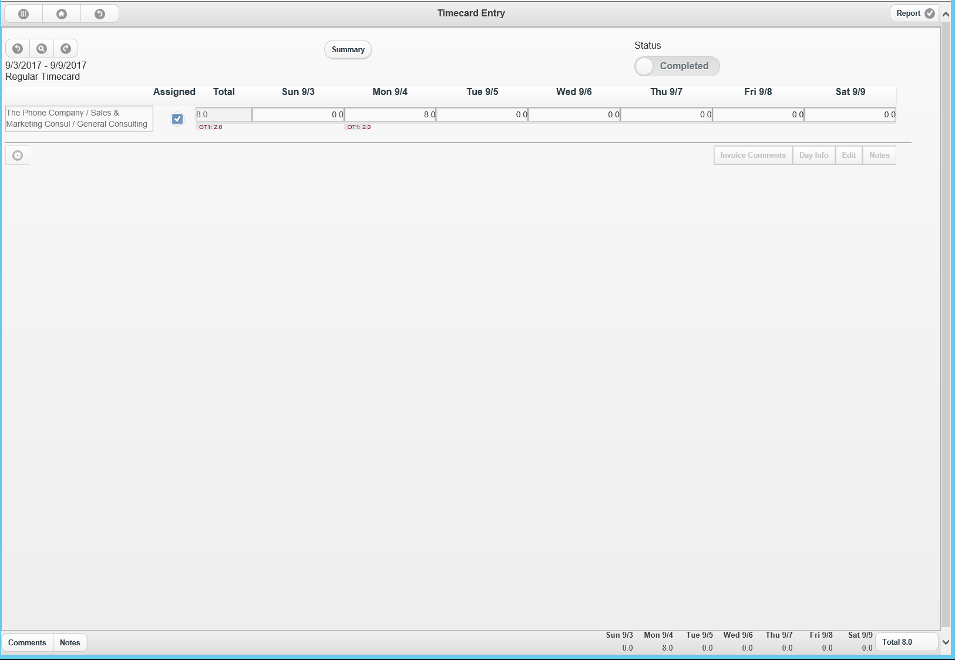
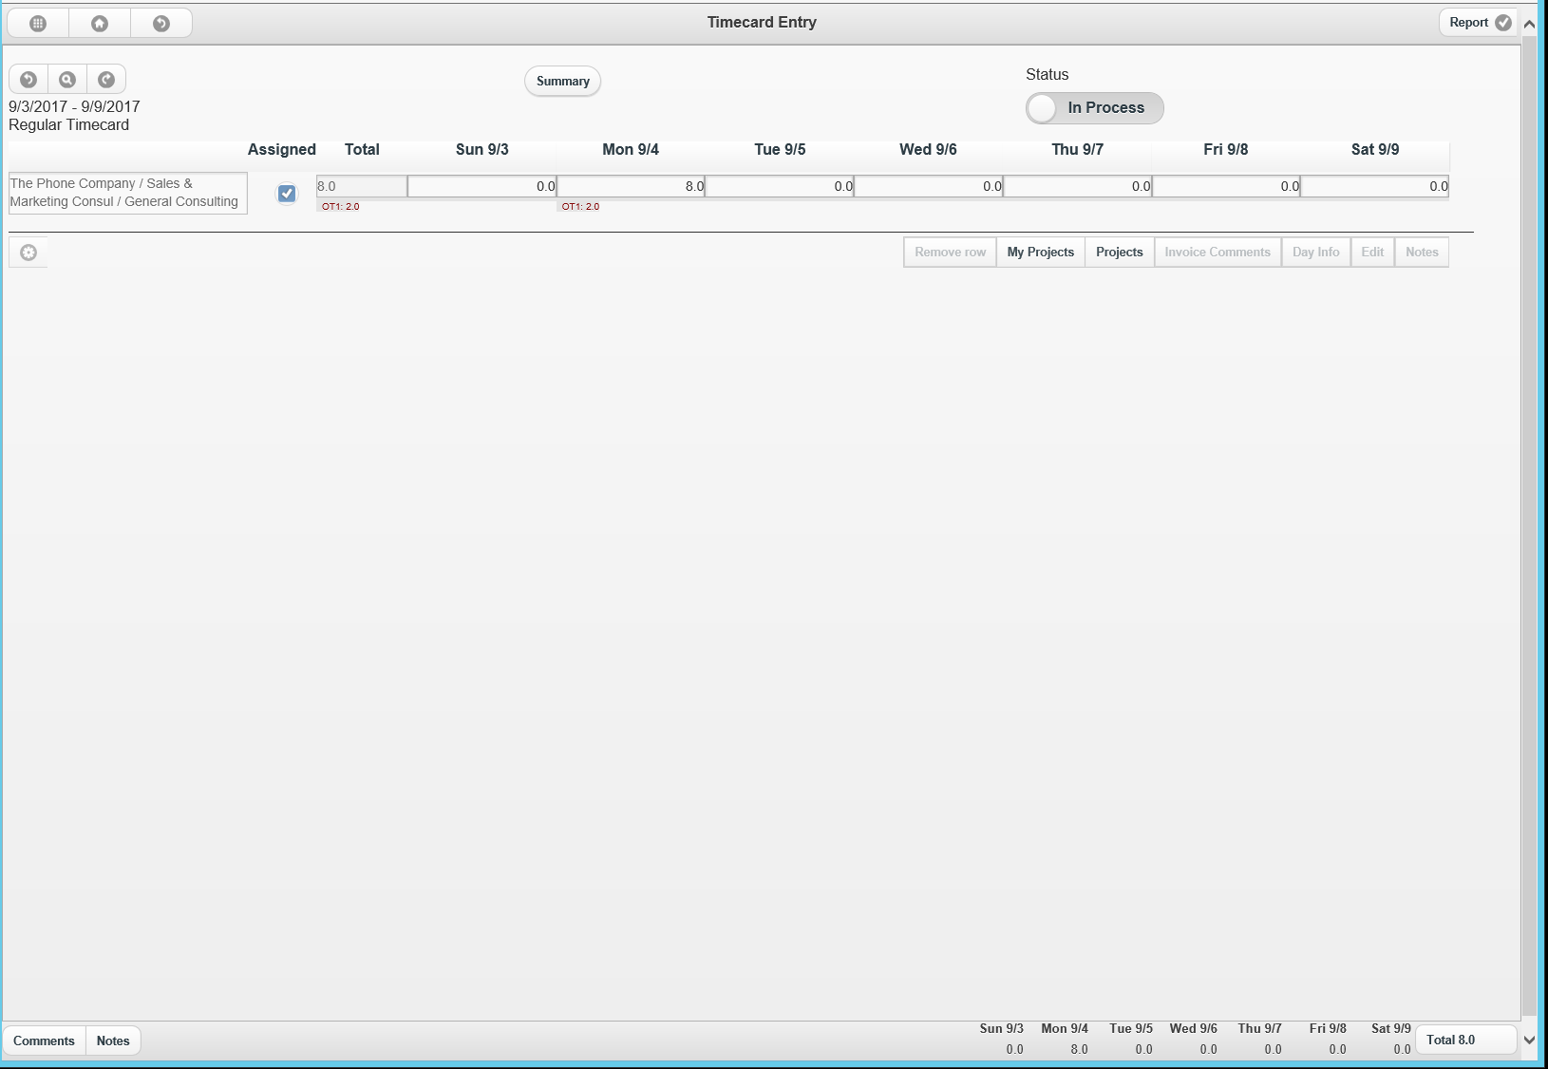
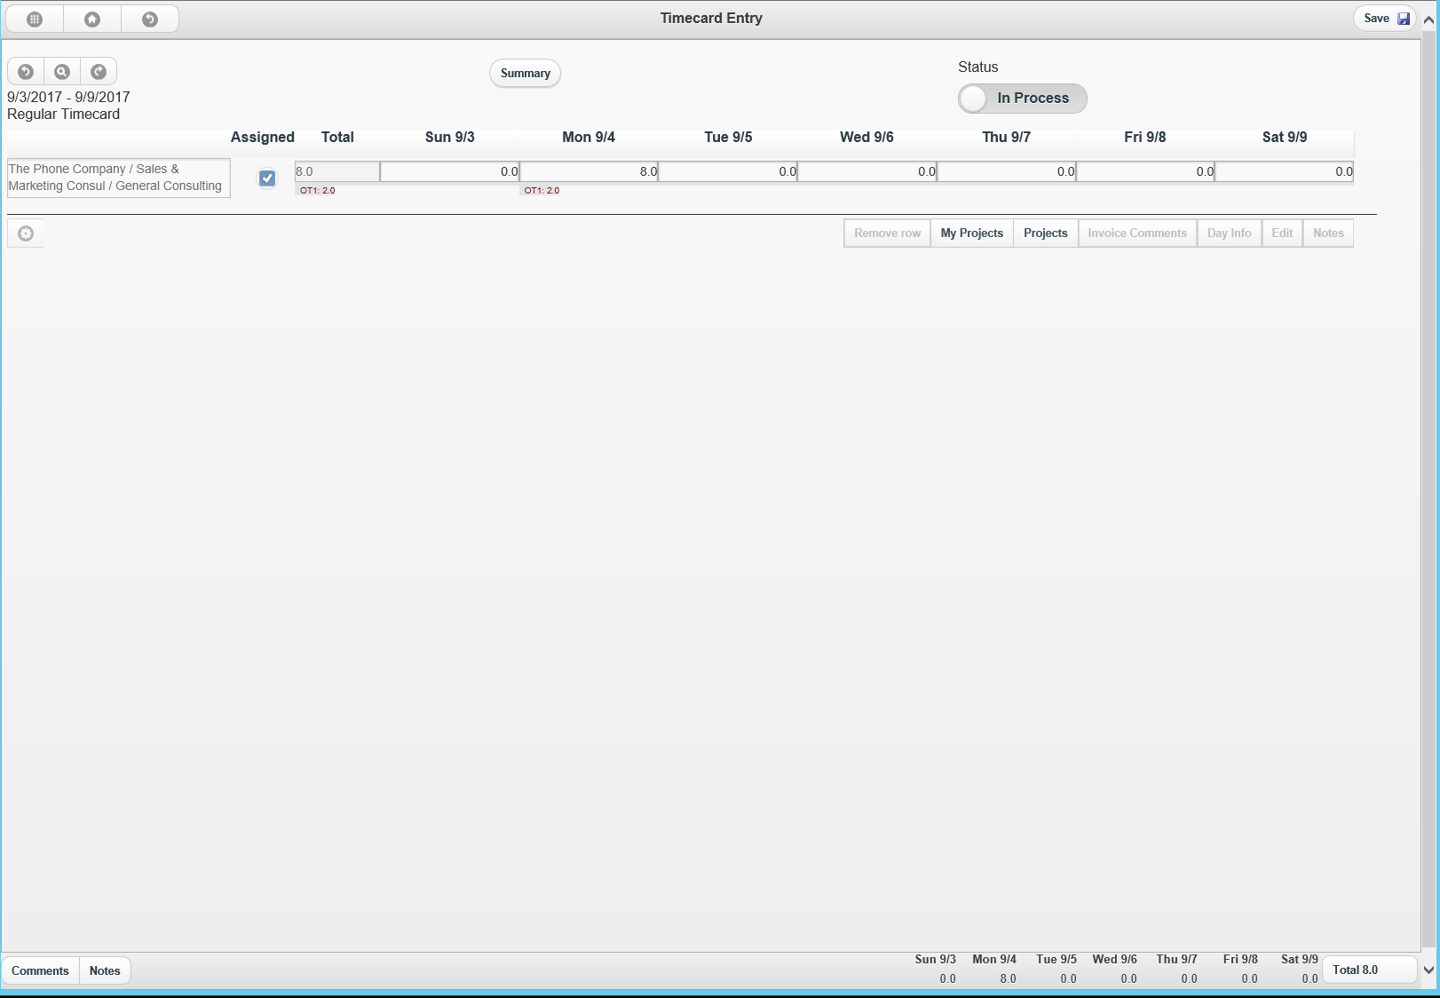
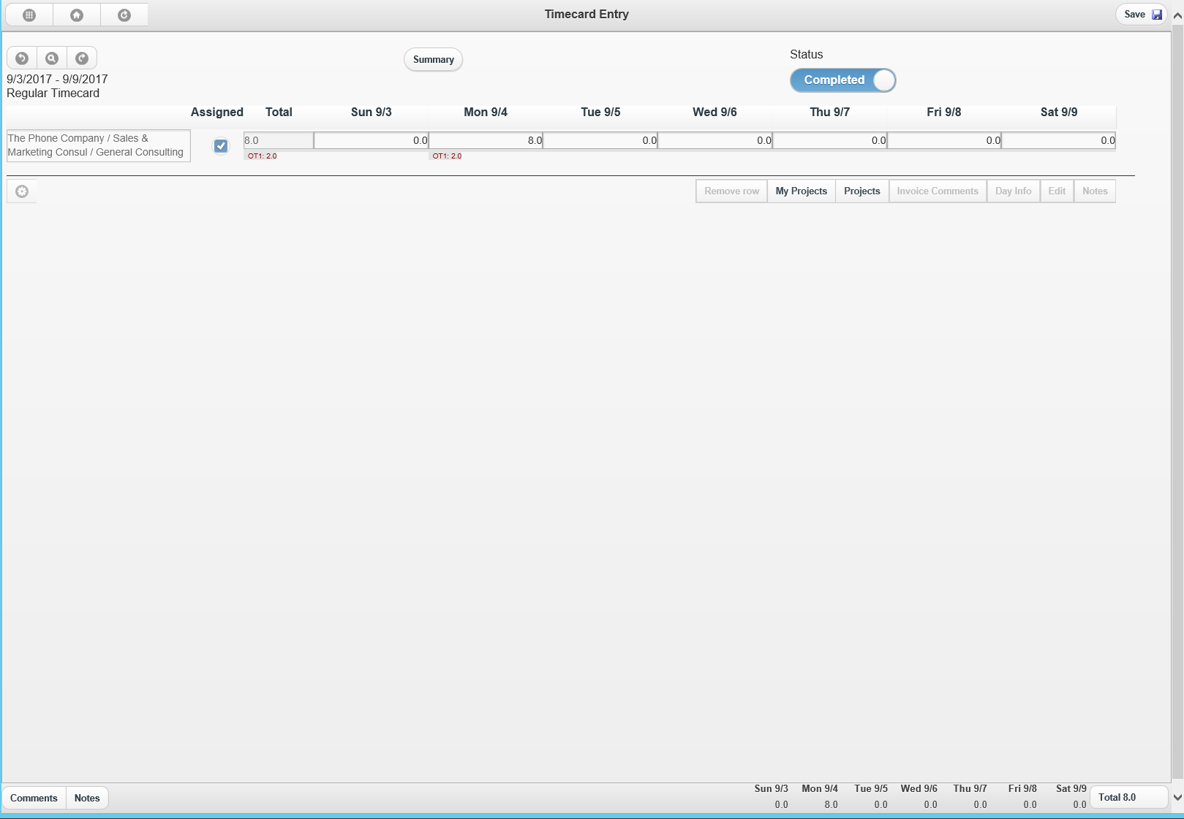
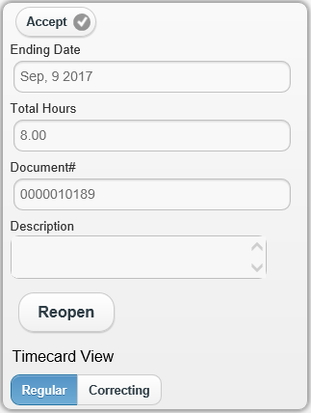
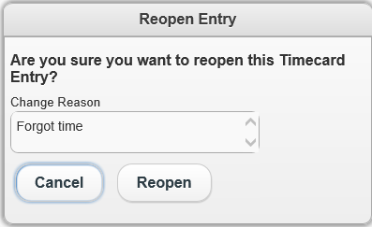
Reopening Completed Timecards
Only available before it is reviewed
Communicator message sent to approver
listing reason for reopening Timecard

Slide 27
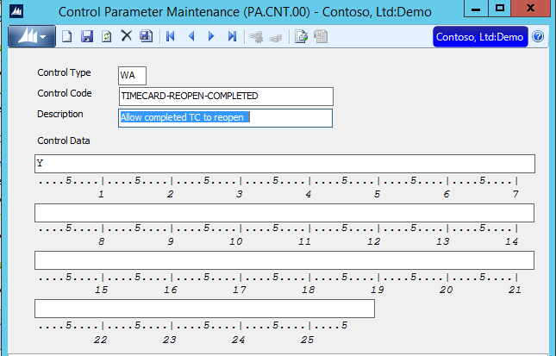
Recalling Timecards before approval

Slide 28
Timecard Entry Login Warning

Slide 29
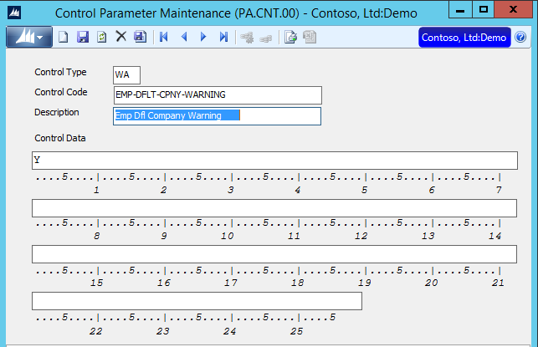
Timecard Entry Login Warning

Slide 30
Timecard Deleting Lines
Timecard Zero Hour Deletion
Default code will be to NEVER delete the lines
Note: Used to default to ALWAYS delete

Slide 31
Timecard Invoice Comments & Notes
New Interface to view and enter Invoice Comments & Notes

Slide 32
Timecard Entry – Duplicating Timecards
When Open or History screens are open
The duplicate icon will automatically display where possible
Removing the extra step of clicking the Action icon

Slide 33
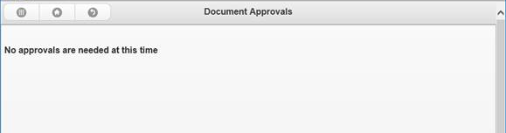
Document & Line Item Approval
When no items need approval the following message displays

Slide 34
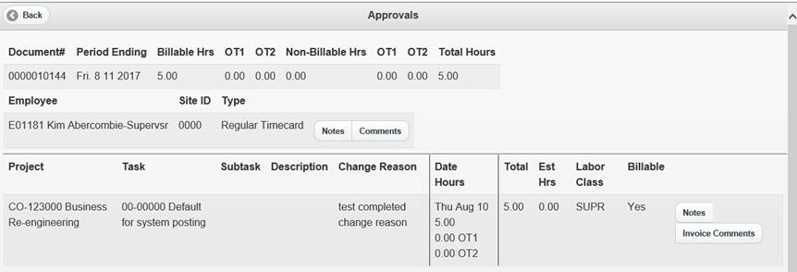
Add Change Reason to Approval Screens

Slide 35
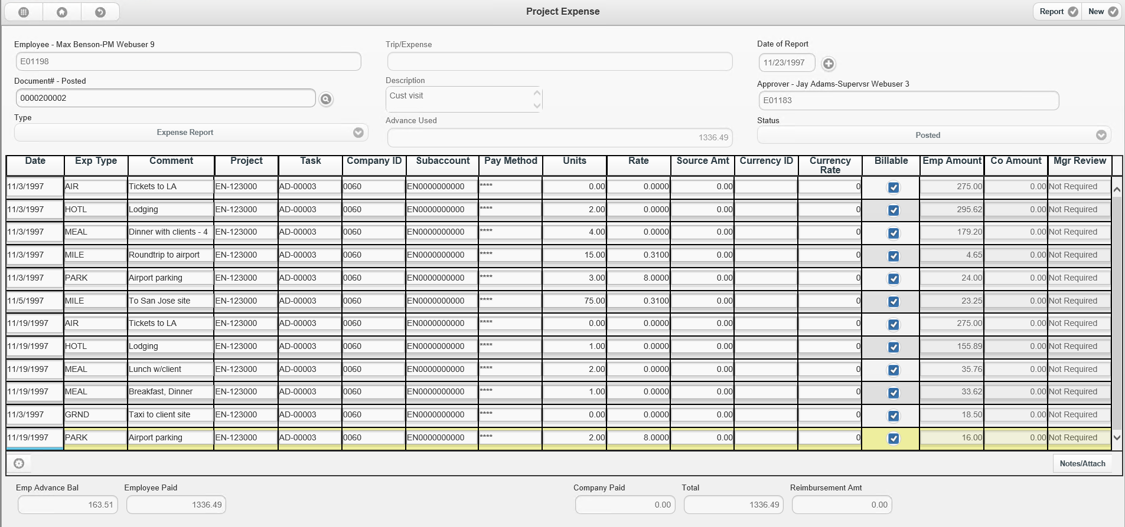
Expense Entry: Number of lines to display per page
Supports from 1 – 35 lines per page

Slide 36
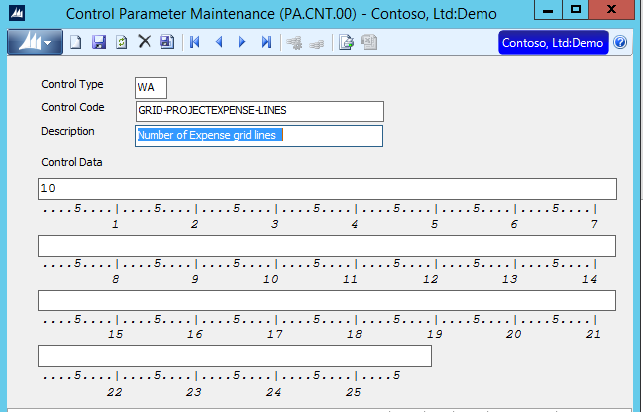
Number of lines to display per page
Supports from 1 – 35 lines per page
Enter Control Data between 1 and 35

Slide 37
Lookup field includes Expense Report Date
The lookup list for the Expense reports entered into the system now includes the Expense Report Date.
The date can be selected to allow searching for an expense document entered on a specific date.

Slide 38
Impersonate Users
Enter time for others
It is now possible for a user, such as an administrative assistant or department head, to enter expenses for other users.

Slide 39
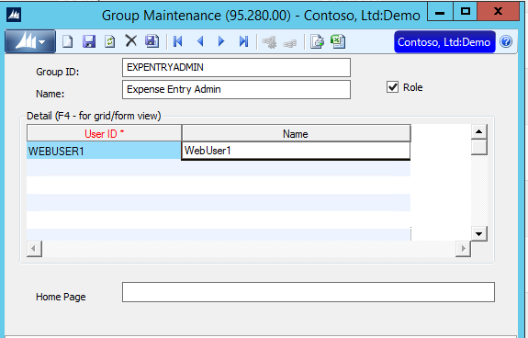
Impersonate Users
How to turn on?
Add user to new group: EXPENTRYADMIN
Give user access to Web Apps Expense entry

Slide 40
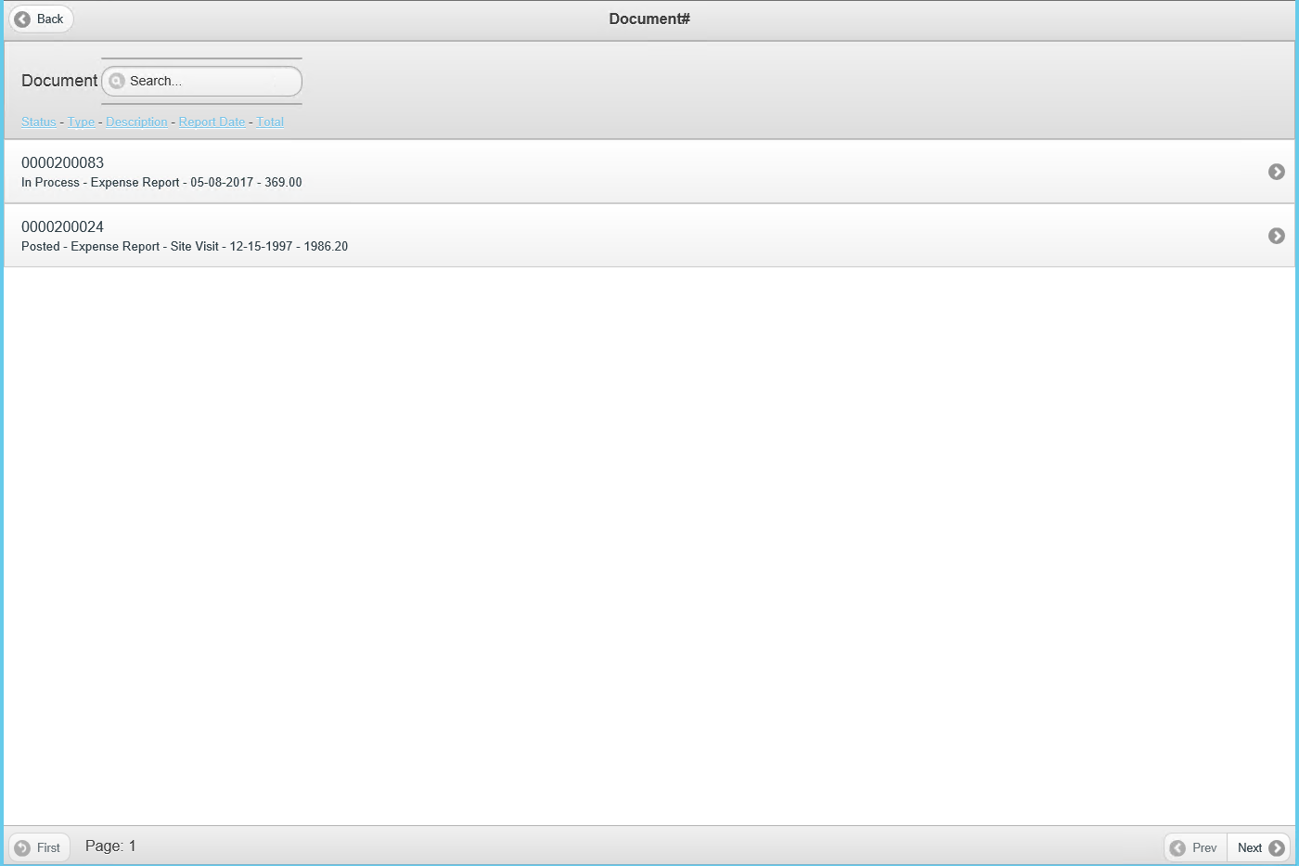
Expense Entry Lookup on Amount
View Total Expense Report amount
Search by Expense Report amount

Slide 41
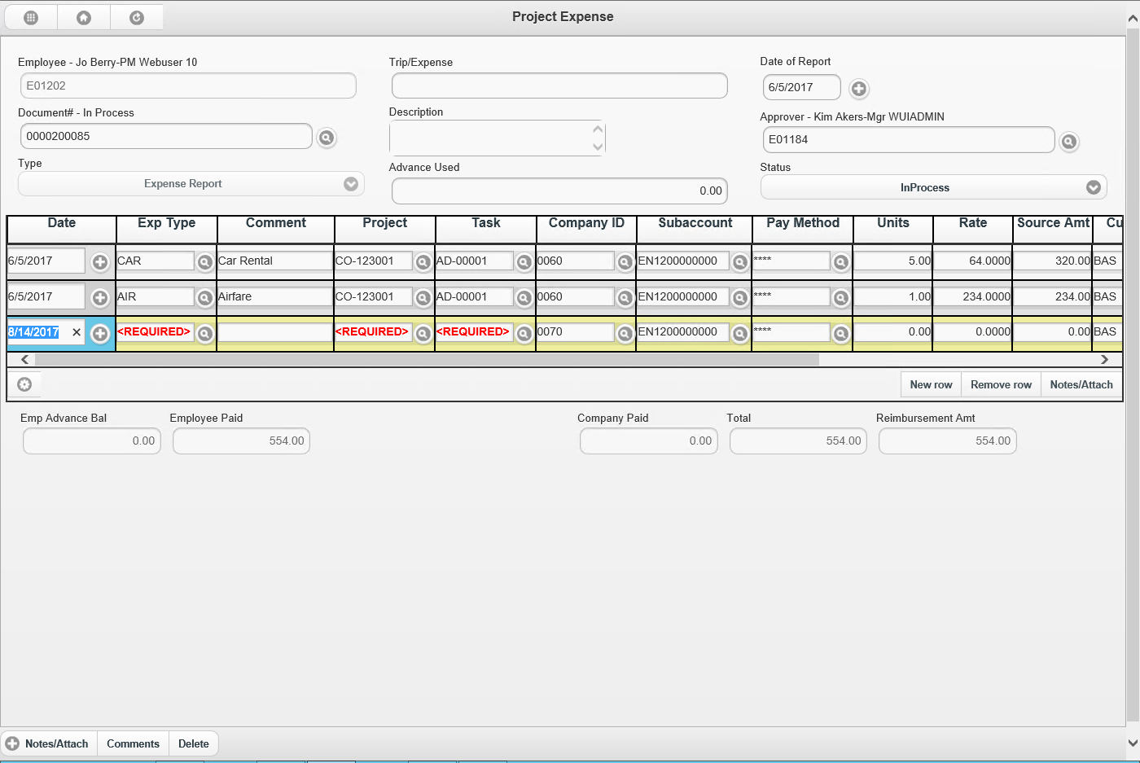
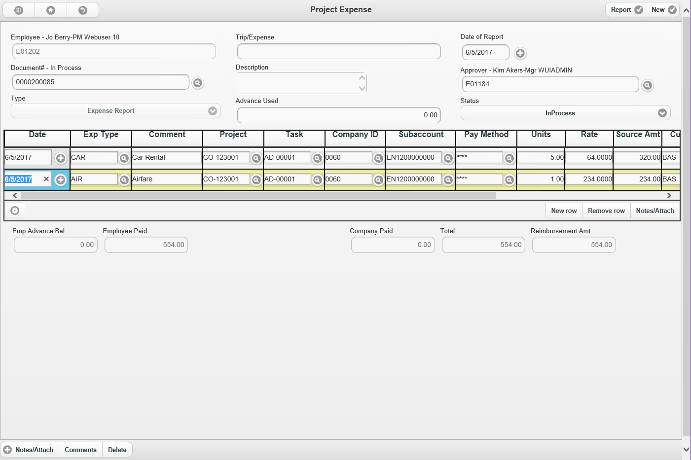
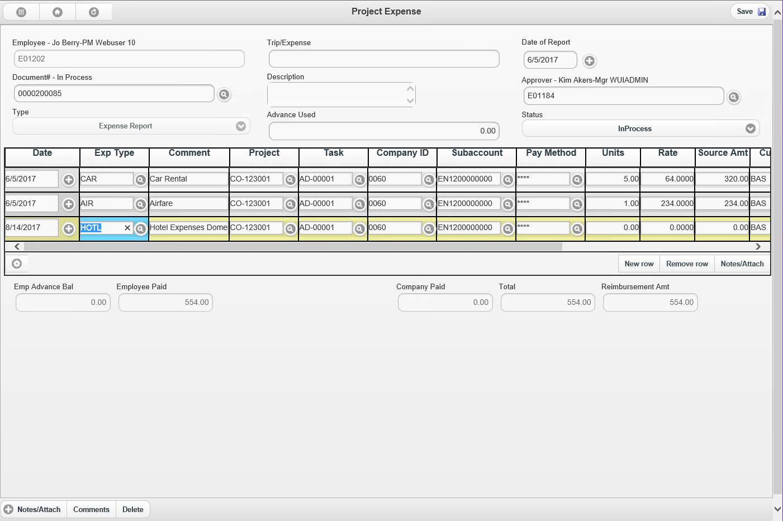
Auto populate Project & Task

Slide 42
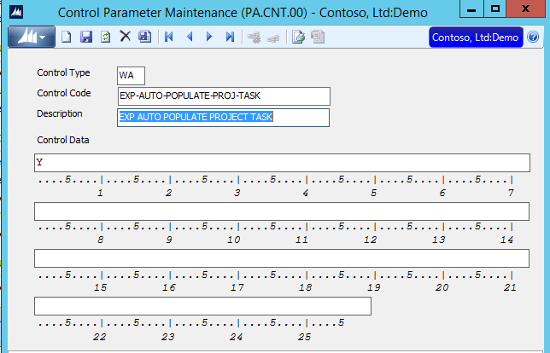
Auto populate Project & Task

Slide 43
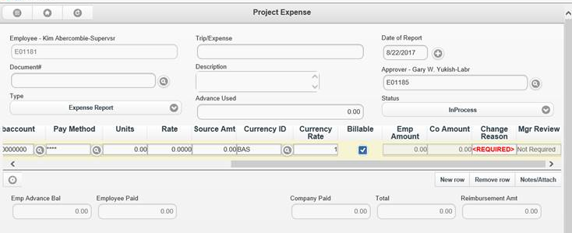
Add Change Reason to Expense

Slide 44
Rejected Timecards
Rejected Timecards are now highlighted in Red

Slide 45
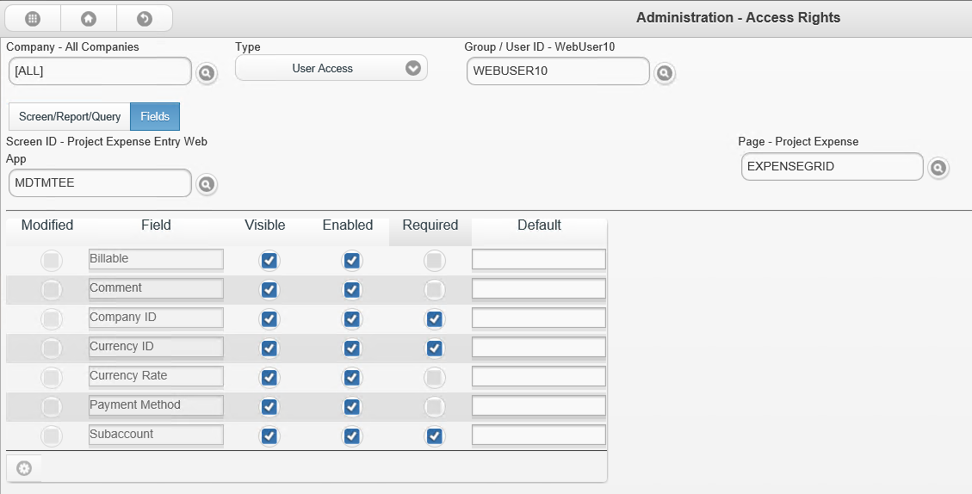
Hide Expense Fields

Slide 46
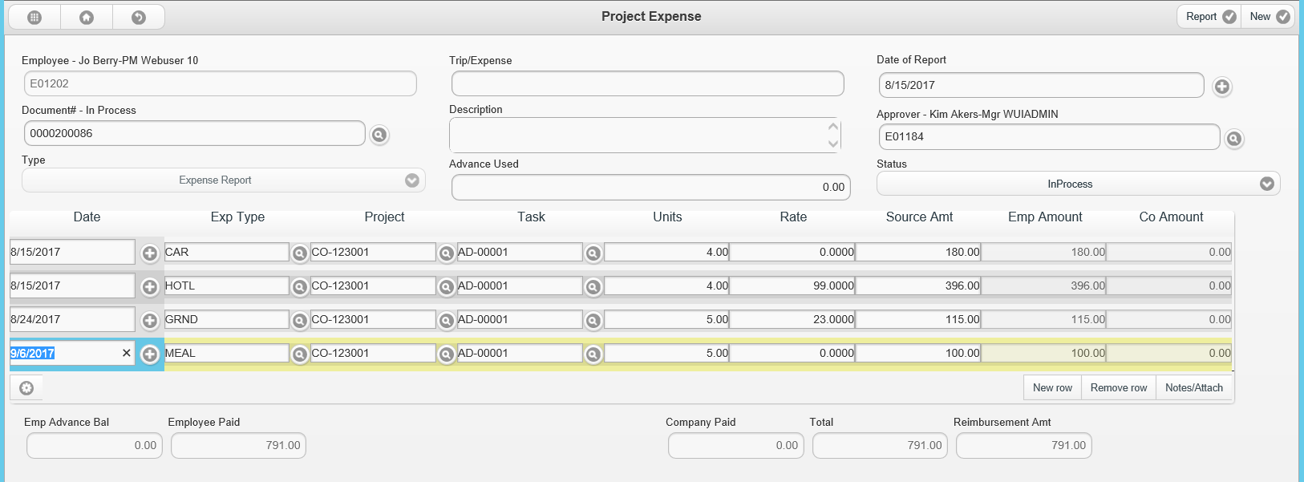
Hide Expense Fields
t

Slide 47
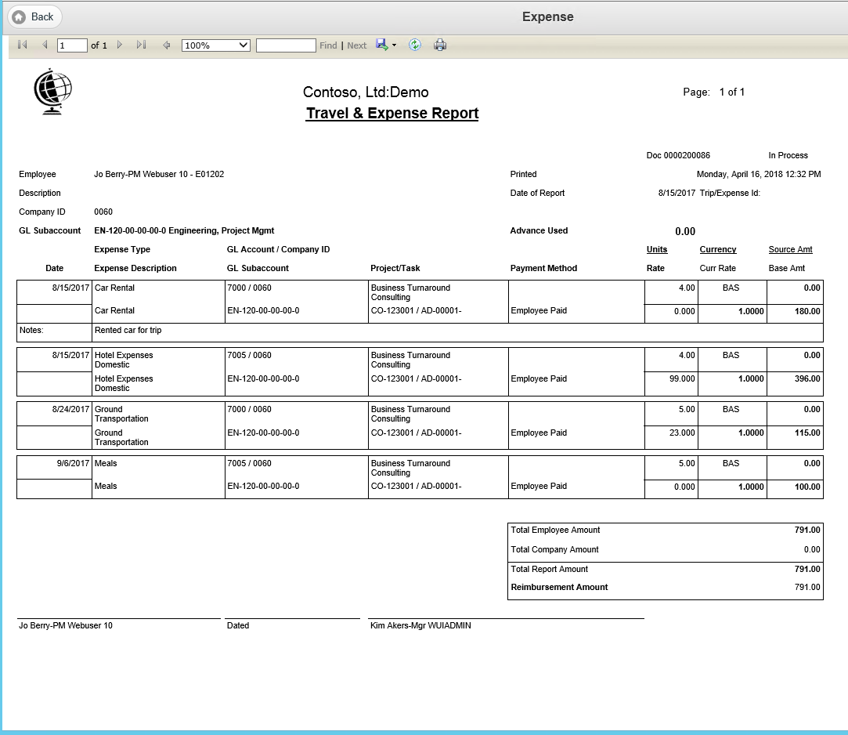
Expense Report prints notes

Slide 48
Document Approval and Line Item Approval
Consistent interface

Slide 49
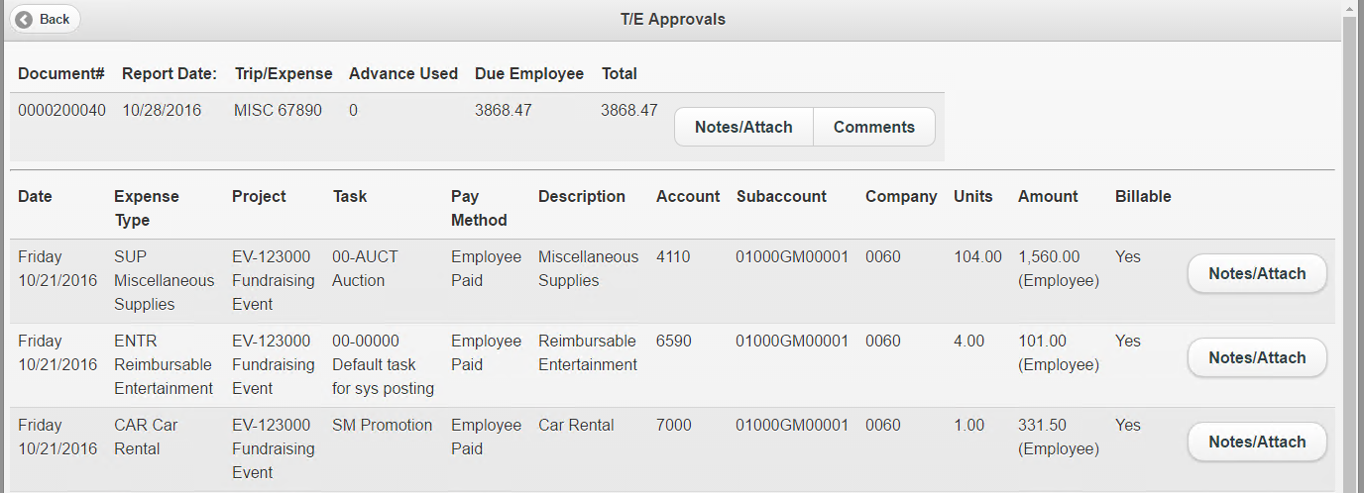
Approval Added Fields
Due Employee

Slide 50
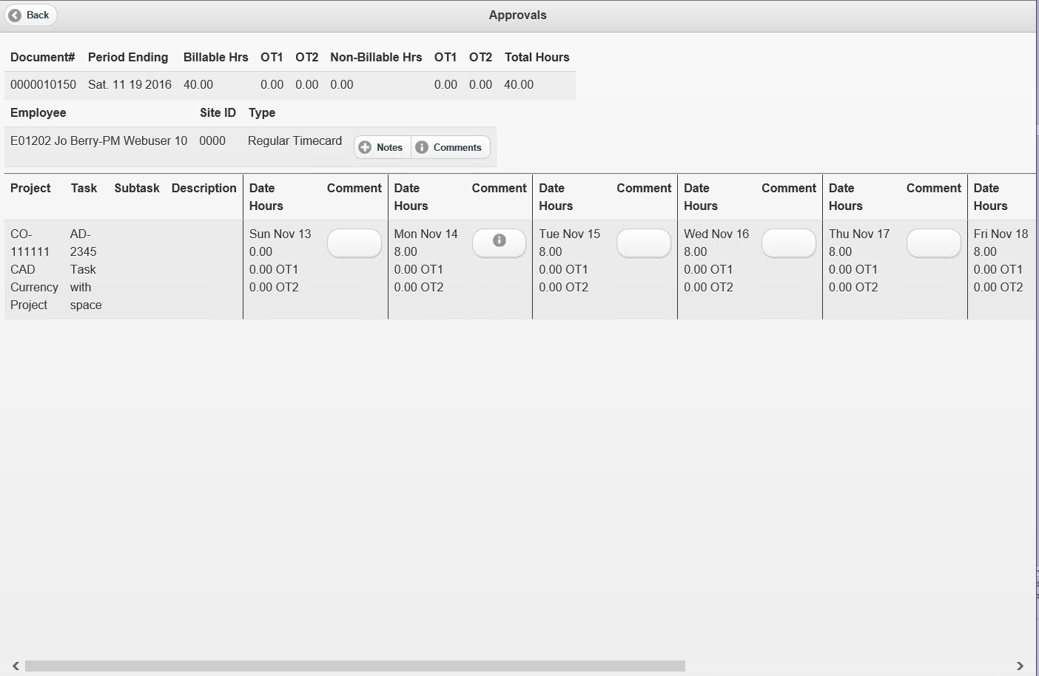
Document Approval Layout

Slide 51
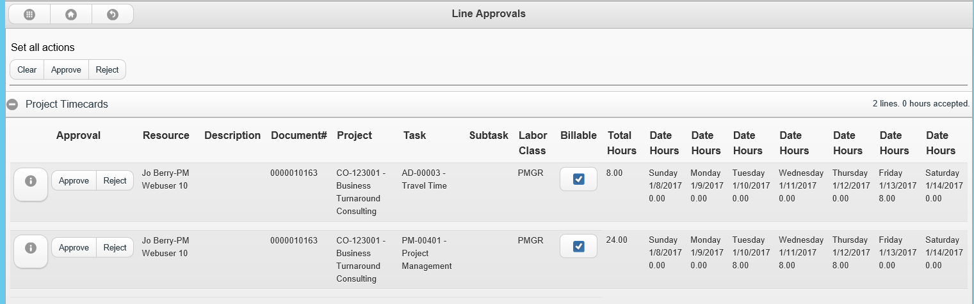
Line Approvals – Total Hours

Slide 52
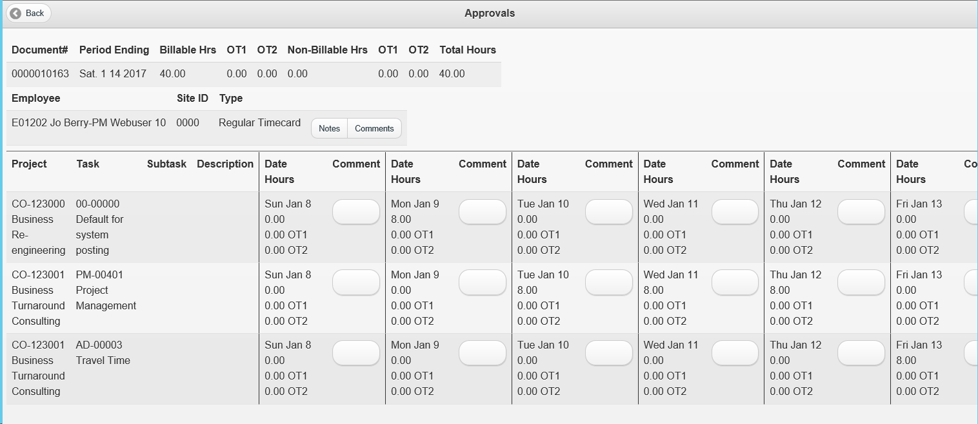
Line Approvals - Details

Slide 53
Budget Edit displays all Budget Types at one time
The Original + CO (change order),
EAC (estimate at complete)
Original budgets
Now displayed at one time in the grid and are editable

Slide 54
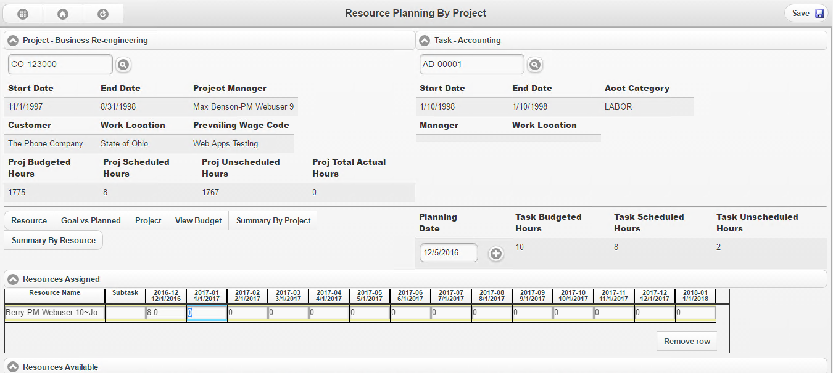
Resource Planning by Project
Added Project Total Actual Hours

Slide 55
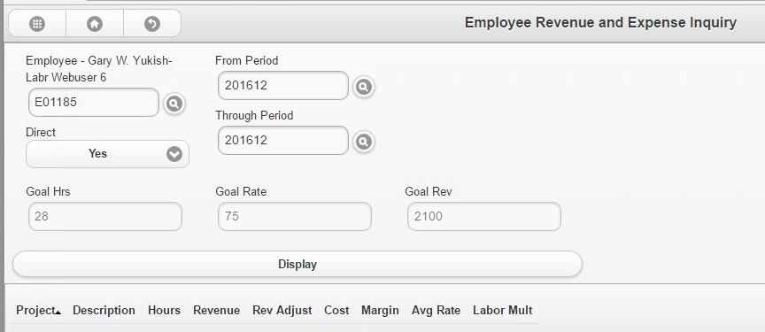
Employee Revenue and Expense Inquiry
Added Goal values

Slide 56
Employee Project Revenue and Expense Detail Inquiry
Added Goal fields

Slide 57
Assignment Summary by Resource
Added Planned hours

Slide 58
Assignment Summary by Project-Task
Added Planned hours

Slide 59
Resource Planning Line Items

Slide 60
Resource Planning Line Items

Slide 61
Resource Assigned Current Grid Total

Slide 62
Copying Planned Hours to Actual

Slide 63
Copying Planned Hours to Actual

Slide 64
Planned vs Actual Hours Inquiry

Slide 65
Planned vs Actual Hours Detail Inquiry

Slide 66
Project Analyst–Unbilled Summary-Billing Detail Inquiry
Status displays full value, not just a letter

Slide 67
Project Analyst – Project Net Profit
Account Category Sort order

Slide 68
Project Analyst – Project Net Profit
New Remaining field
Variance - EAC minus the Original Budget.
New Remaining field –
Original Budget minus the Project to Date + Commitment.

Slide 69
Quick Query – General Ledger
Journal transaction quick query
Added: Period to Post
Removed: Period Entered

Slide 70
Communicator
Message sort order by created date
Most recent message at the top

Slide 71
Administration Label change
Label: Screen/Report/Query
Note: Previously listed screen only

Slide 72
Required Field
Default Color is Red
The Font is Bold
Setting to change color in Web Config

Slide 73
New Web Apps

Slide 74
Customer Maintenance

Slide 75
Vendor Maintenance

Slide 76
Employee Maintenance

Slide 77
External Links
Links

Slide 78
External Links
Links

Slide 79
Web Apps 2018

Slide 80
New Login Screen
t

Slide 81
Timecard – Skip submenu

Slide 82
Print to multiple users
Print to multiple users
Print to groups
Notes:
Use Project Change Orders (CN.COP.00) to enter and maintain change orders for a project.
Changes can be made to financial data (changes in the budget), date information (change in duration), or reference information.
Change records are stored in the Project Change Order master table (PJCOPROJ).
Change orders at this level usually represent a change in the agreement with the customer or owner, although internal-only changes may also be entered.
If interfaced to Flexible Billings, this program automatically adds the change order information to the billing format of the construction billing at the desired location.
If the Currency Manger module is installed and Activate Multi-Currency Entry is selected in CM Setup (24.950.00) the currency buttons on the application toolbar are enabled.
The amounts appear by default in the subcontract currency. The Change Currency button allows you to toggle between subcontract currency and base currency.
Following are the field descriptions for Project Change Orders (CN.COP.00).

Slide 83
Project Lookup – Common

Slide 84
Project Lookup – Recent

Slide 85
Timecard Status
Communicator
Message
Email
Message

Slide 86
Vendor & Customer – Quick Send

Slide 87
Invoice Comments
Reduce Clicks
Save & Back button

Slide 88
Limt Timecard Corrections
New limit field
Corrections look
to field to enable
Timecard correction
Web only

Slide 89
Tooltip information
Timecard Tooltip information

Slide 90
Project Charge Entry
Enter transactions directly into the Project and Accounting tables
Charges or Revenue
From other interfaces:
AP
AR
non labor T&E
Notes:
Use Project Charge Entry (PA.CHG.00) to enter transactions directly into the Project Management and Accounting tables.
These transactions are generally charges or revenue activities that have not been captured automatically via an interface, such as from Accounts Payable or Accounts Receivable, or from labor transactions in the Time and Expense for Projects module.
This screen may also be used to load the balance forward amounts during initial implementation.
The transactions are input as a batch.
Some of the fields shown in the sample screen are ID fields that can be used to capture site-specific, project-related information.
See the description for transaction ID fields as some fields are reserved for system use.
The application toolbar currency buttons are activated when Activate Foreign Currency Project Management is selected in Project Controller Setup (PA.SET.00), PC Options and Setup tab. Once a currency is selected for the batch, only projects with that currency can be selected on charge entries.
When data is entered using rates set up in Standard Rate Entry (PA.RAE.00) the rates found are converted to the project currency to calculate the Amount.
Following are the field descriptions for Project Charge Entry (PA.CHG.00).

Slide 91
Project Change Orders
Maintain Change Orders
Financial data (changes in the budget)
Date information (change in duration)
Reference information
Notes:
Use Project Change Orders (CN.COP.00) to enter and maintain change orders for a project.
Changes can be made to financial data (changes in the budget), date information (change in duration), or reference information.
Change records are stored in the Project Change Order master table (PJCOPROJ).
Change orders at this level usually represent a change in the agreement with the customer or owner, although internal-only changes may also be entered.
If interfaced to Flexible Billings, this program automatically adds the change order information to the billing format of the construction billing at the desired location.
If the Currency Manger module is installed and Activate Multi-Currency Entry is selected in CM Setup (24.950.00) the currency buttons on the application toolbar are enabled.
The amounts appear by default in the subcontract currency. The Change Currency button allows you to toggle between subcontract currency and base currency.
Following are the field descriptions for Project Change Orders (CN.COP.00).

Slide 92
Built-In Customizations
Control Parameter Maintenance
Screen used to turn on/off Project features
Projects – Control Parameter Maintenance

Slide 93
Web Apps Control Code List
Grid Buttons
Grid Description
Buttons: My Project & Project
Duplicate – Use Employee Labor class
Company Warning – Logging into non default company

Slide 94
Web Apps Control Code List
Expense – Auto populate Project & Task
Grid lines to display:
Expense Entry
Resource Assigned
Resource Available
Timecard Lines

Slide 95
Web Apps Control Code List
Timecard Project
Show Contract
Shows Customer
Timecard – Reopen Completed TC
Timecard – Skip Menu
Timecard Status lines

Slide 96
Web Apps Control Code List
Timecard – Reopen Completed Timecard
Timecard – Skip Menu
Timecard Status lines

Slide 97
Recap
Web App enhancements
Web Apps 2018 enhancements
New Web Apps enhancements?
Contact v-jsuwyn@Microsoft.com

