Slide 1
Microsoft Dynamics SL And Power BI

Slide 2
Agenda
Power BI – How to learn more
SL Announcements
SL Power BI Dashboard – Walk through
Questions & Answers

Slide 3
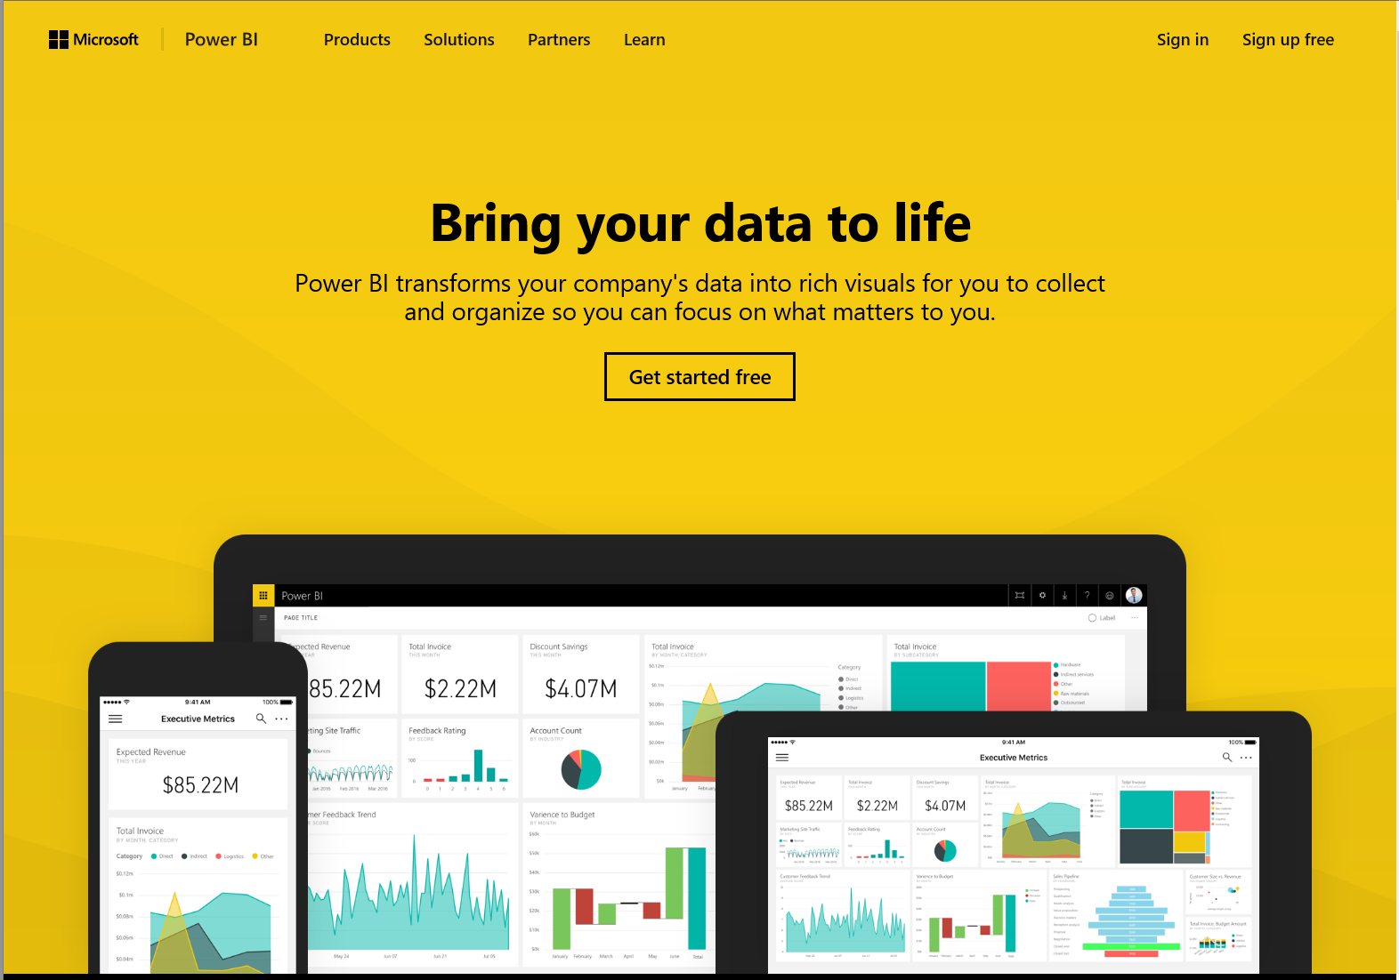
Microsoft Power BI
Power BI is a suite of business analytics tools to analyze data and share insights.

Slide 4
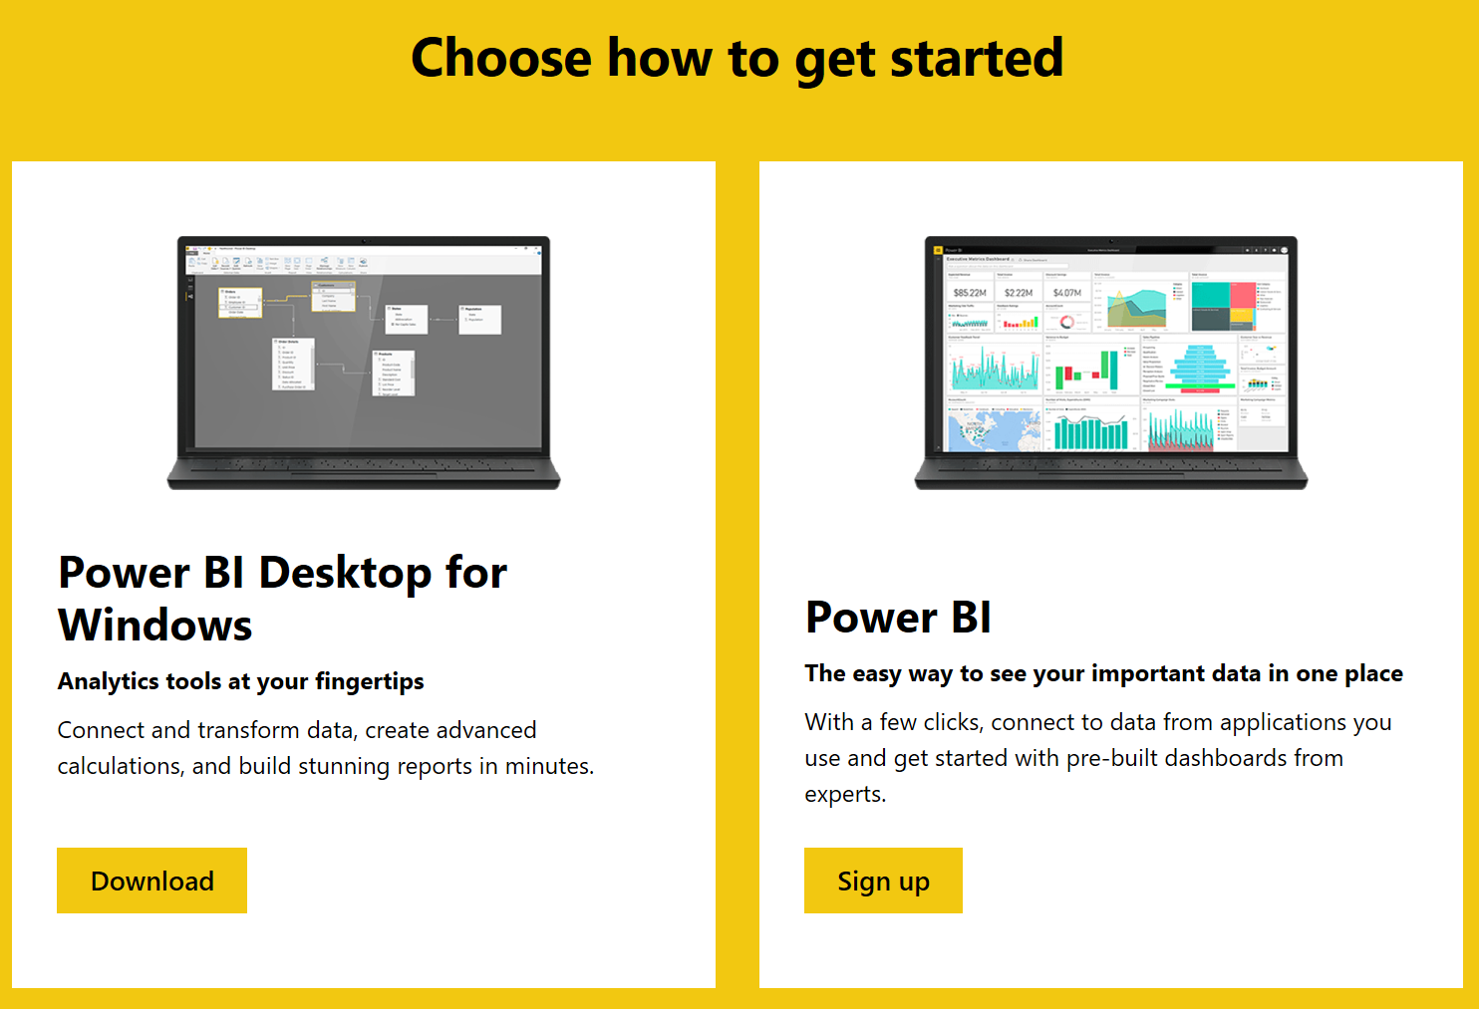
Download - Desktop
https://powerbi.microsoft.com/en-us/

Slide 5
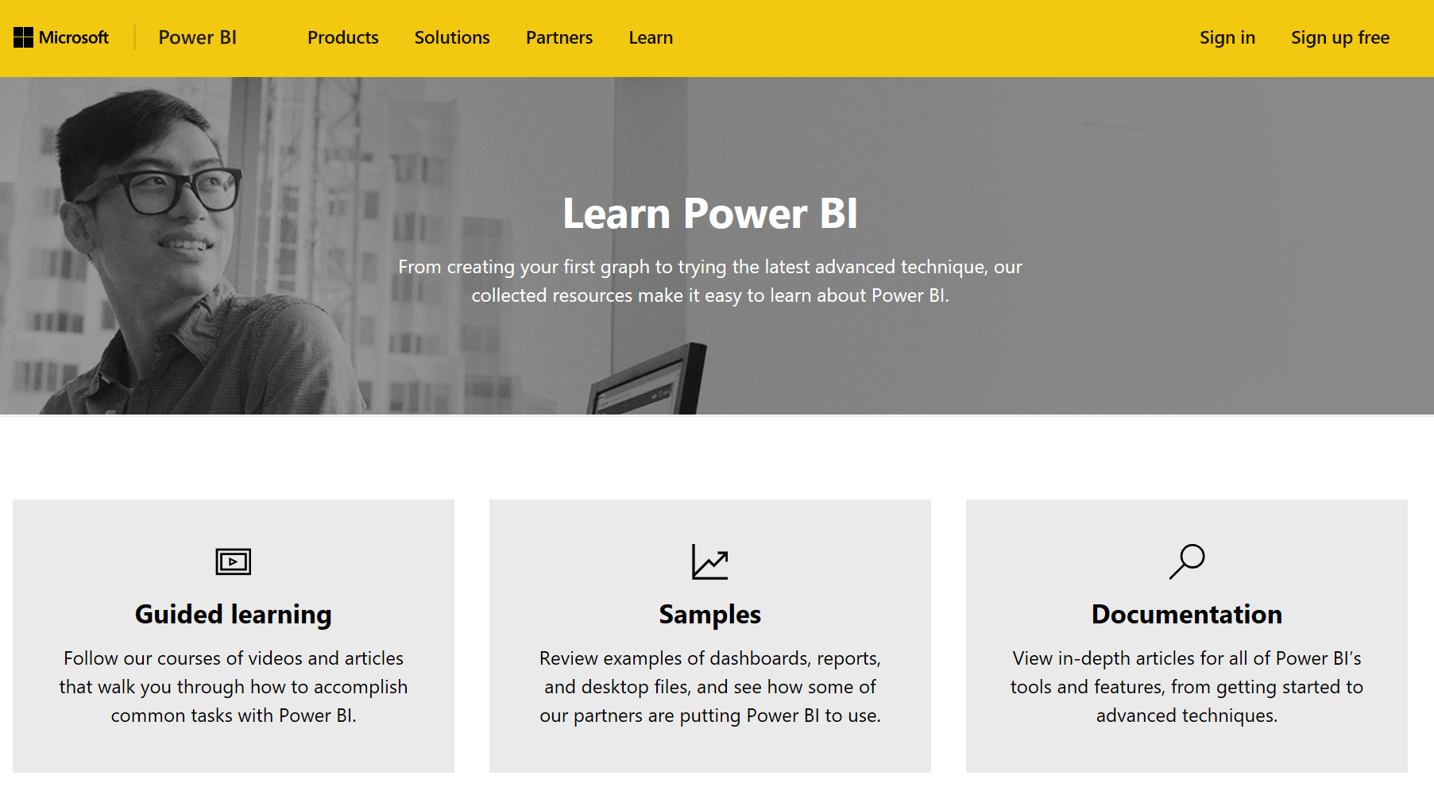
Learn More
https://powerbi.microsoft.com/en-us/learning/

Slide 6
Microsoft Dynamics SL Delivered
Microsoft Dynamics SL 2015
CU2
(cumulative update)
Released in 12/2016
Release
Hot Fixes for the SL rich client
since the last CU release
PLUS…

Slide 7
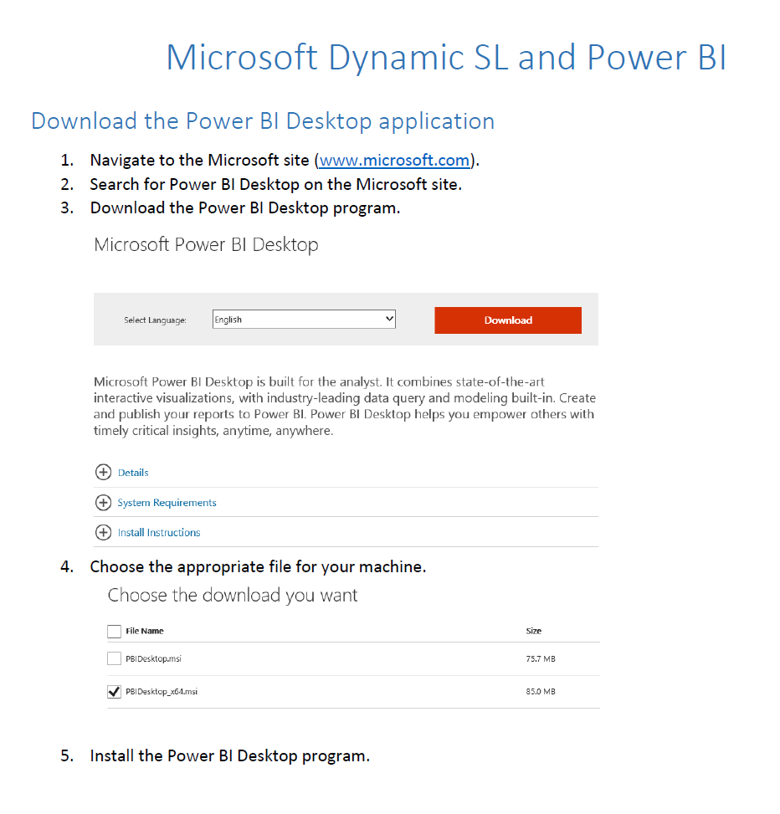
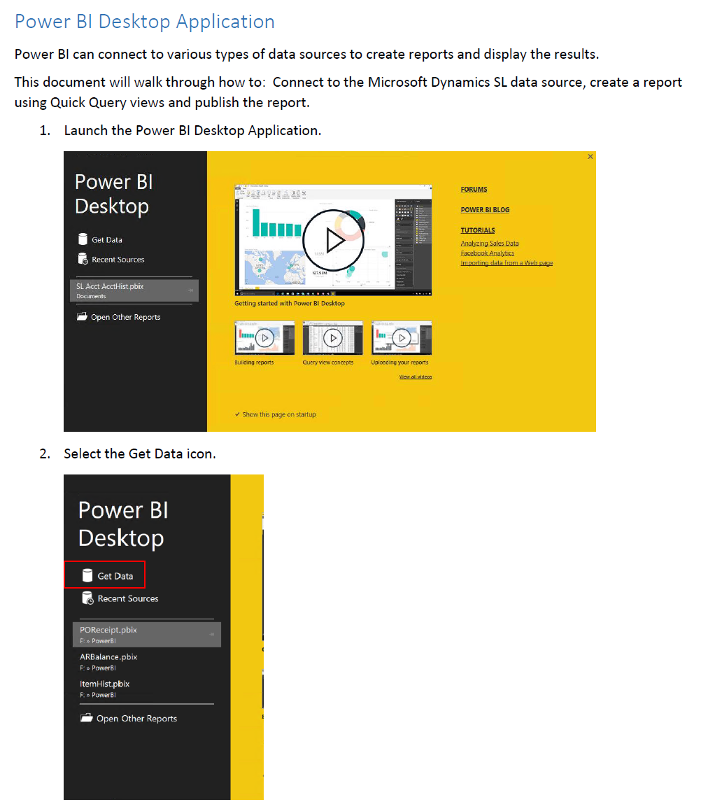
Power BI SL Project Dashboard example
CU2 release includes:
Connecting Power BI to Microsoft Dynamics SL
Document walking through basic connection

Slide 8
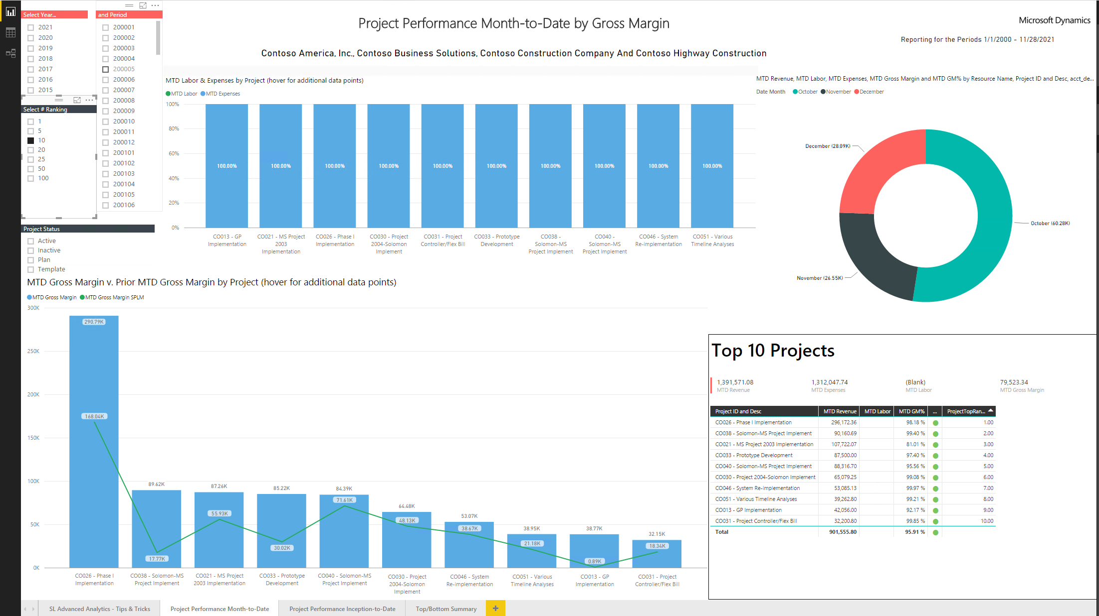
Power BI SL Project Dashboard example
CU2 release includes:
SL Project Power BI Dashboards

Slide 9
Power BI Dashboard update as of 3/2017
Users without Web Apps can still use file shipped with CU2
For Web Apps users…
Update available through support
Addresses a change to the existing view and function made in Web Apps
Results in adding a new view and function to database
Requires an Administrator to install

Slide 10
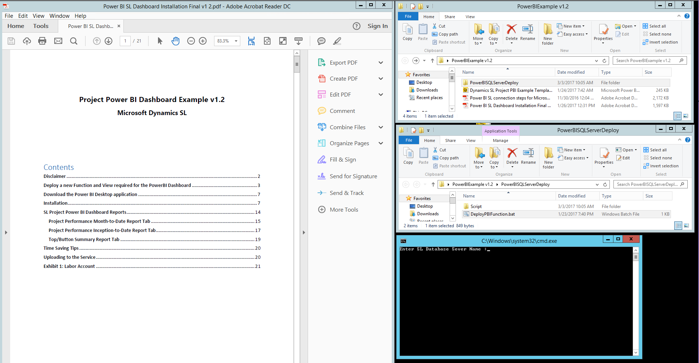
Installation demonstration

Slide 11
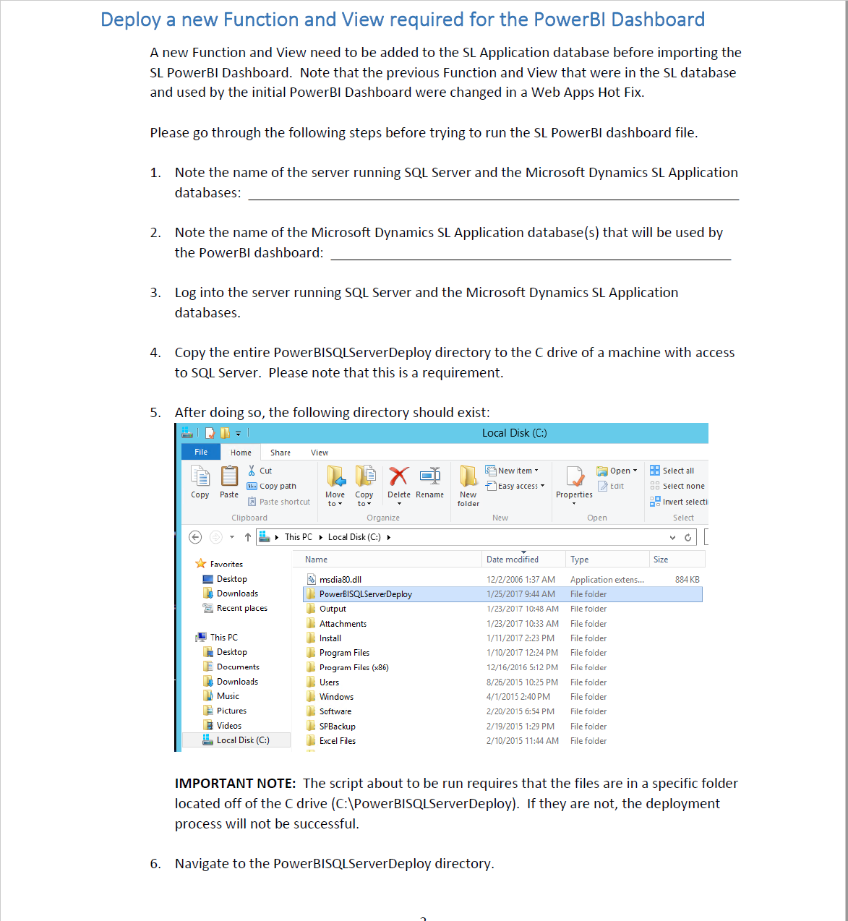
Deploy function
Administrators Only
Recommend to do while
users are out of SL
SQL Server
SL Application Database
Copy Files to C drive

Slide 12
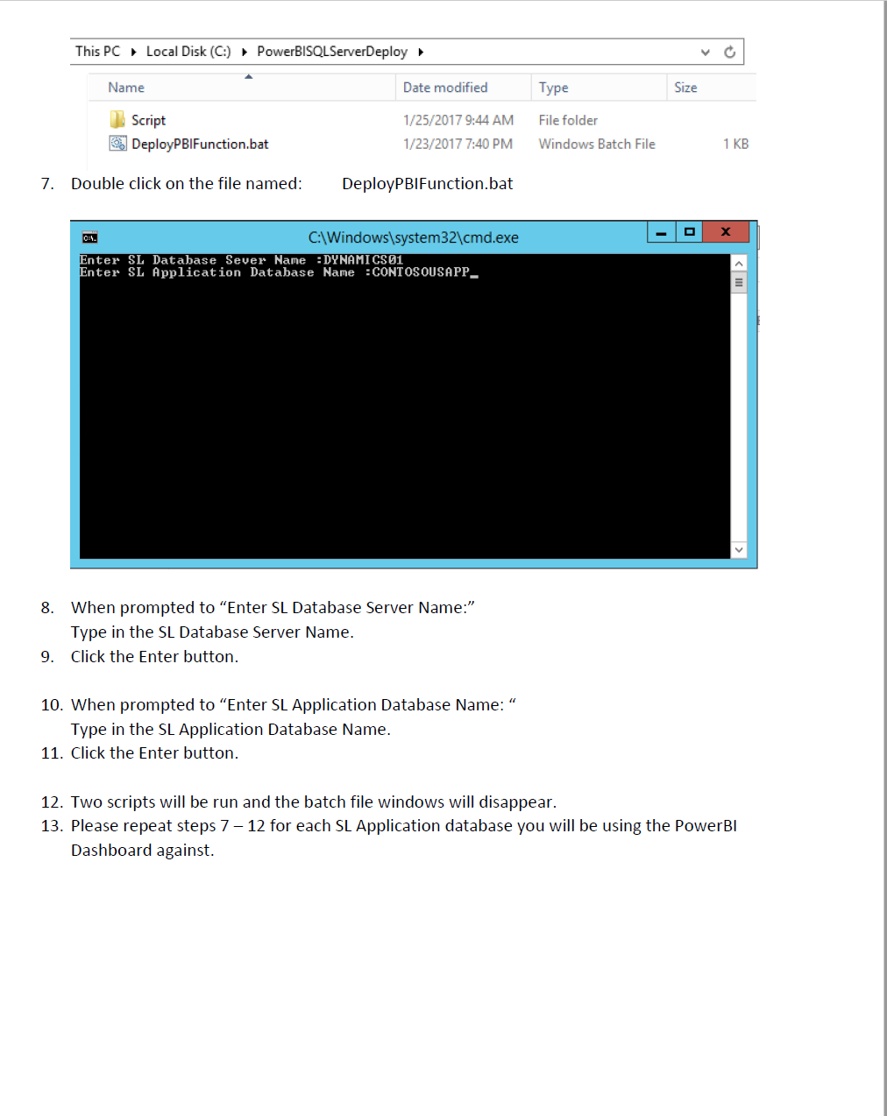
Deploy function
Run DeployPBIFunction.bat
Enter
SQL Server Name
SL Application Database Name
Click Enter and function is deployed
Verify installation
Steps included to verify install

Slide 13
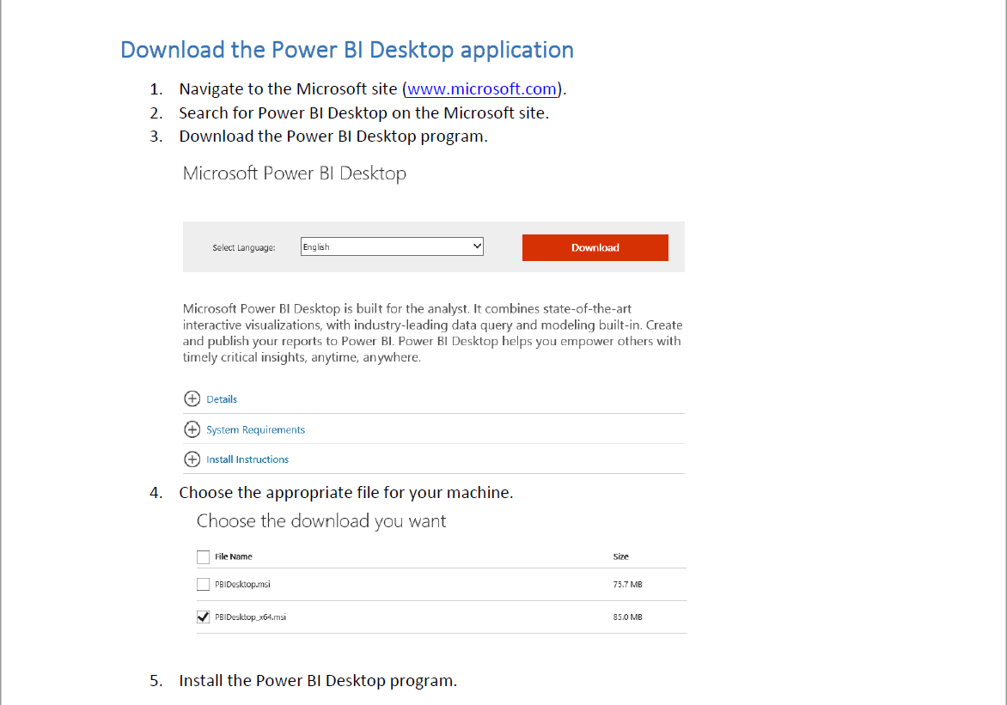
Download
Install on machine with
access to Dynamics SL &
SQL Server
Download Power BI
PBDesktop file
32 bit – (PBDesktop.msi)
64 bit – (PBDesktop_x64.msi)

Slide 14
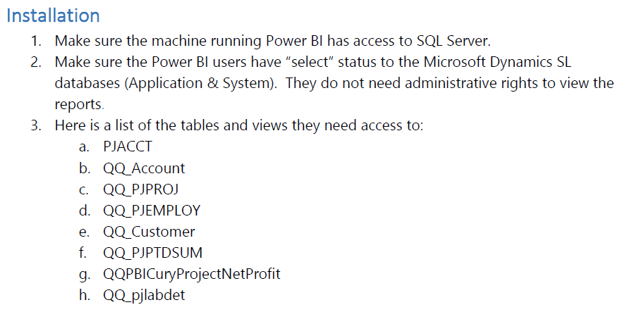
Access
Power BI User
Need access
to the following:

Slide 15
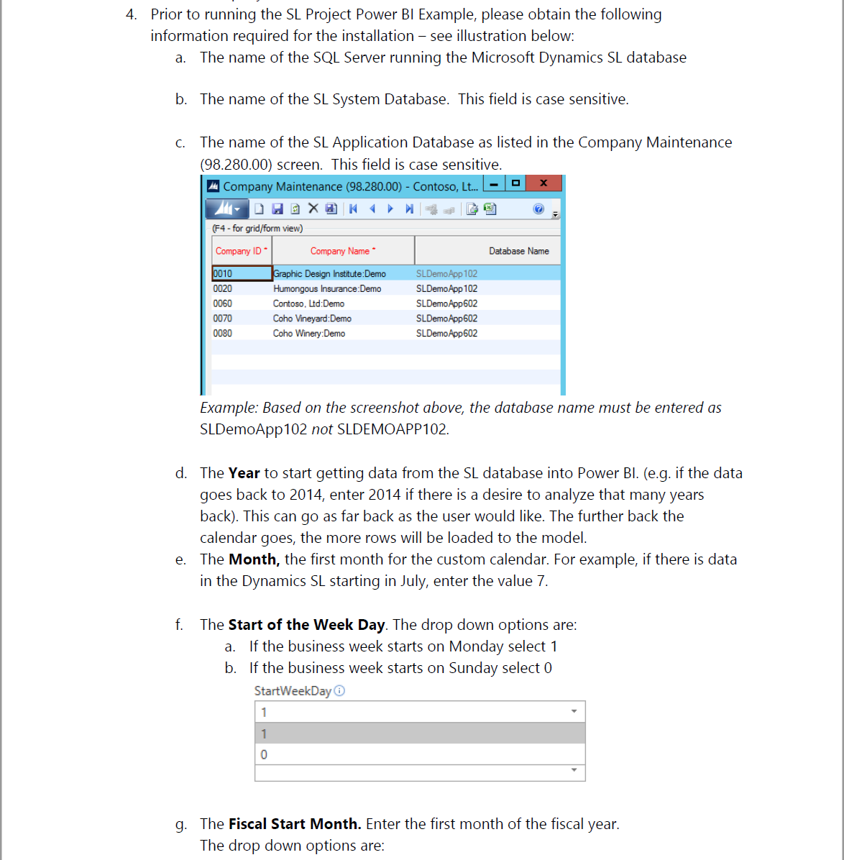
Important information
SQL Server name
SL System database name
SL Application database name
Year – to start getting data
Month – first month to pull
data
Start of the week day
1 – Monday
0 – Sunday

Slide 16
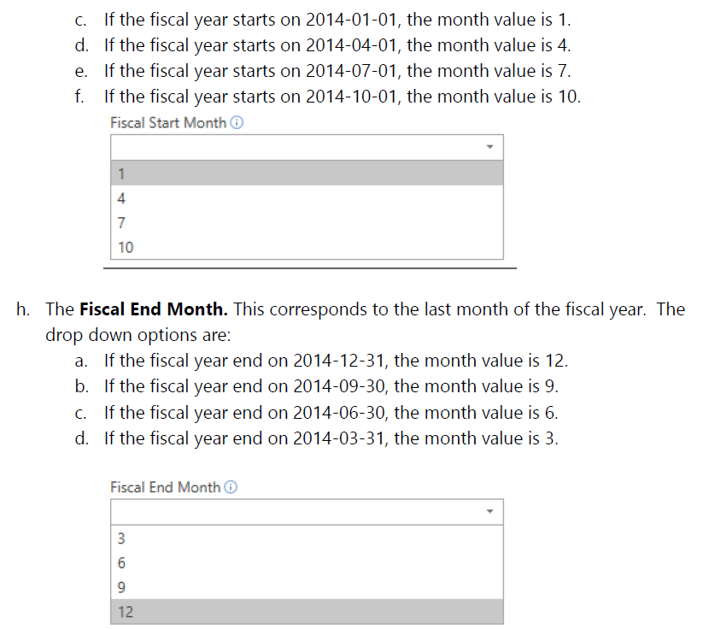
Important information
Fiscal Start Month
1 – January
4 – April
7 – July
10 – October
Fiscal End Month
12 – December
9 – September
6 – June
3 – March

Slide 17
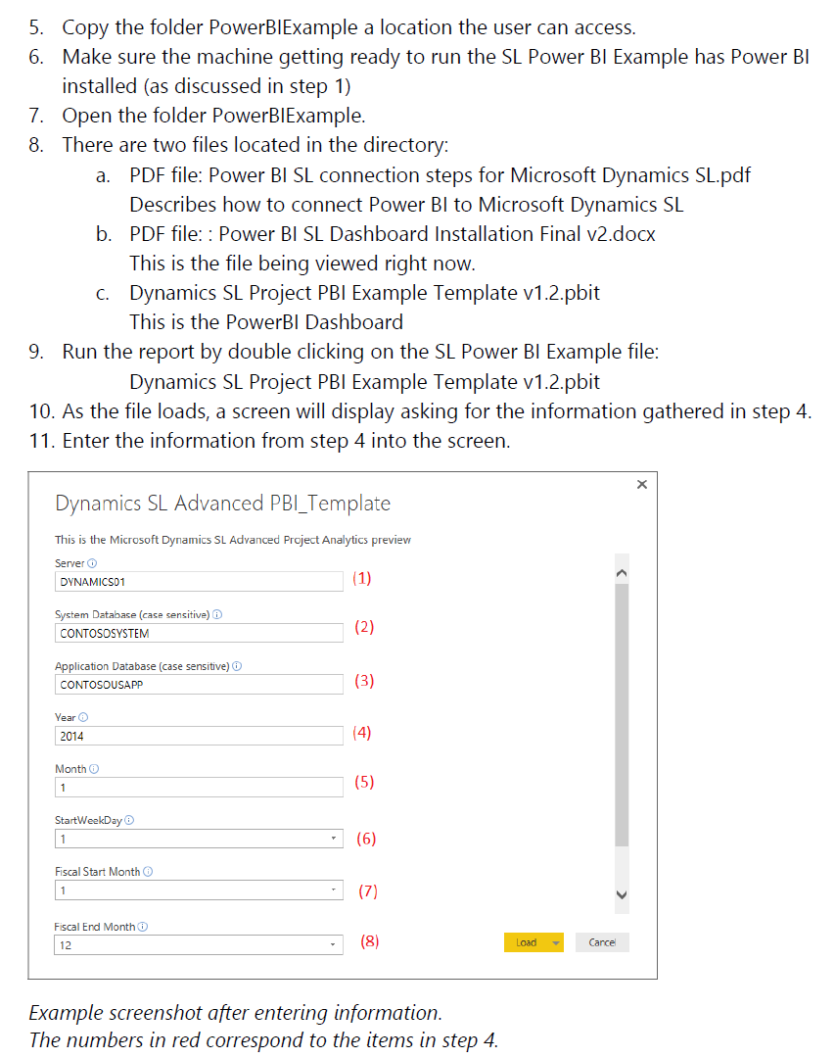
Installation
Copy PowerBIExample folder
Run file:
Dynamics SL Project PBI Example Template
Dynamics SL Project PBI Example Template v1.2
Answer question with previous information
Click load button

Slide 18
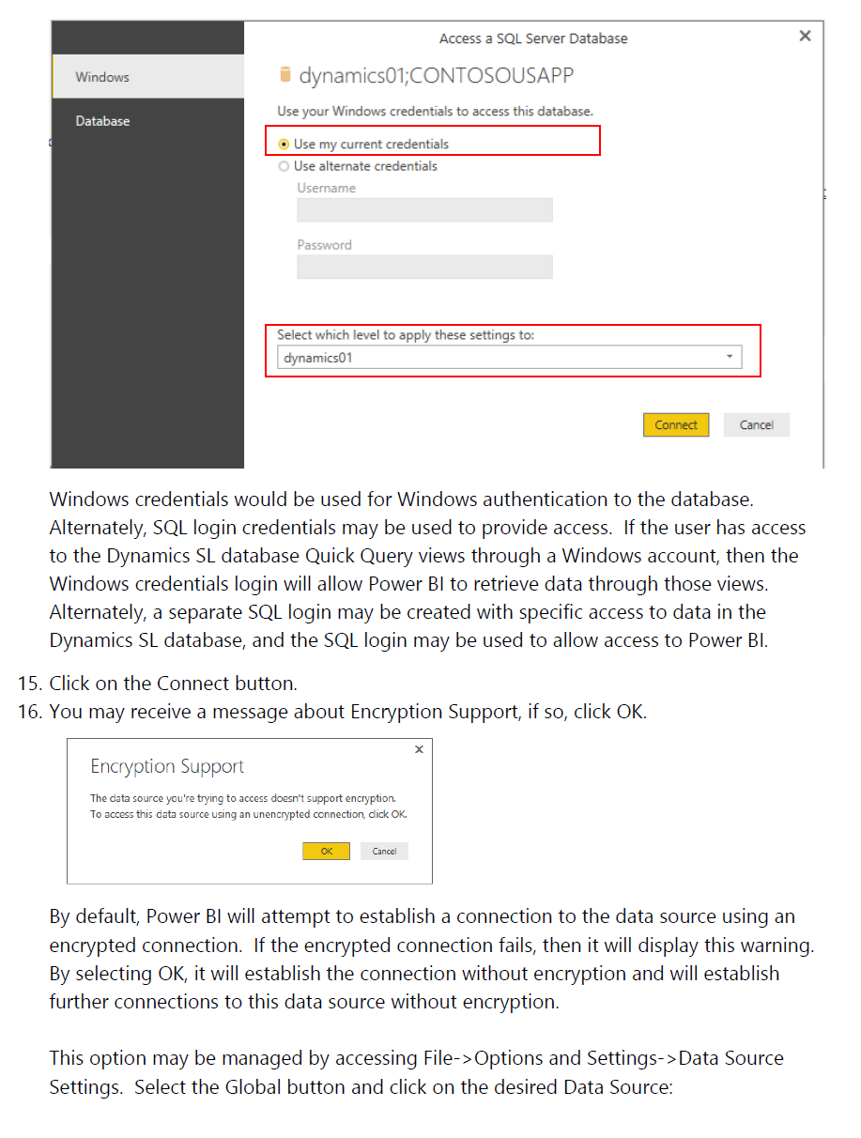
Accessing SQL Server
Window credentials
SQL Server name
Encryption Support option

Slide 19
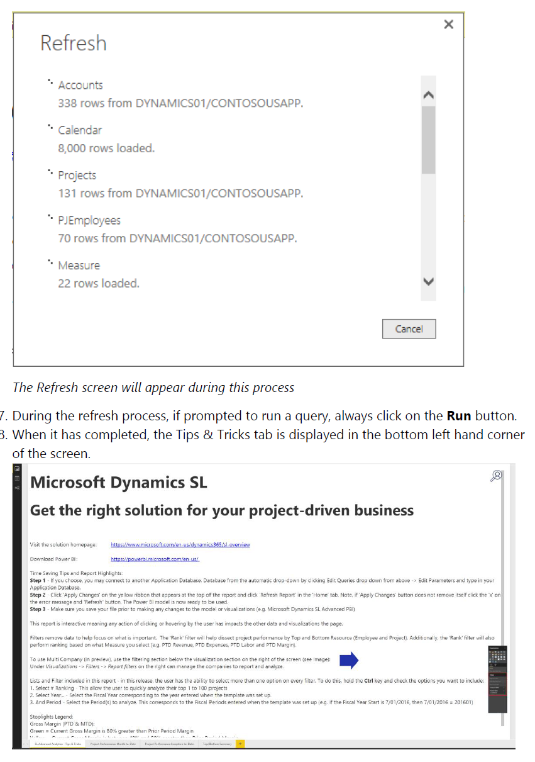
Loading
Refresh will appear
If prompted, choose to run query

Slide 20
Refresh

Slide 21
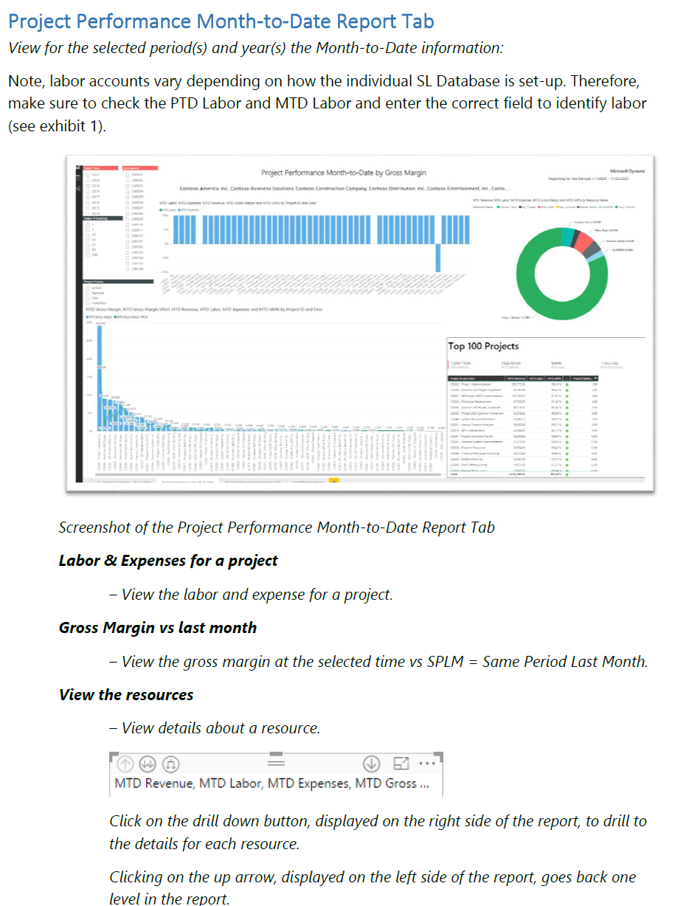
Overview of Dashboards
The documentation provides
high level view of dashboards

Slide 22
Power BI SL Project Dashboard example

Slide 23
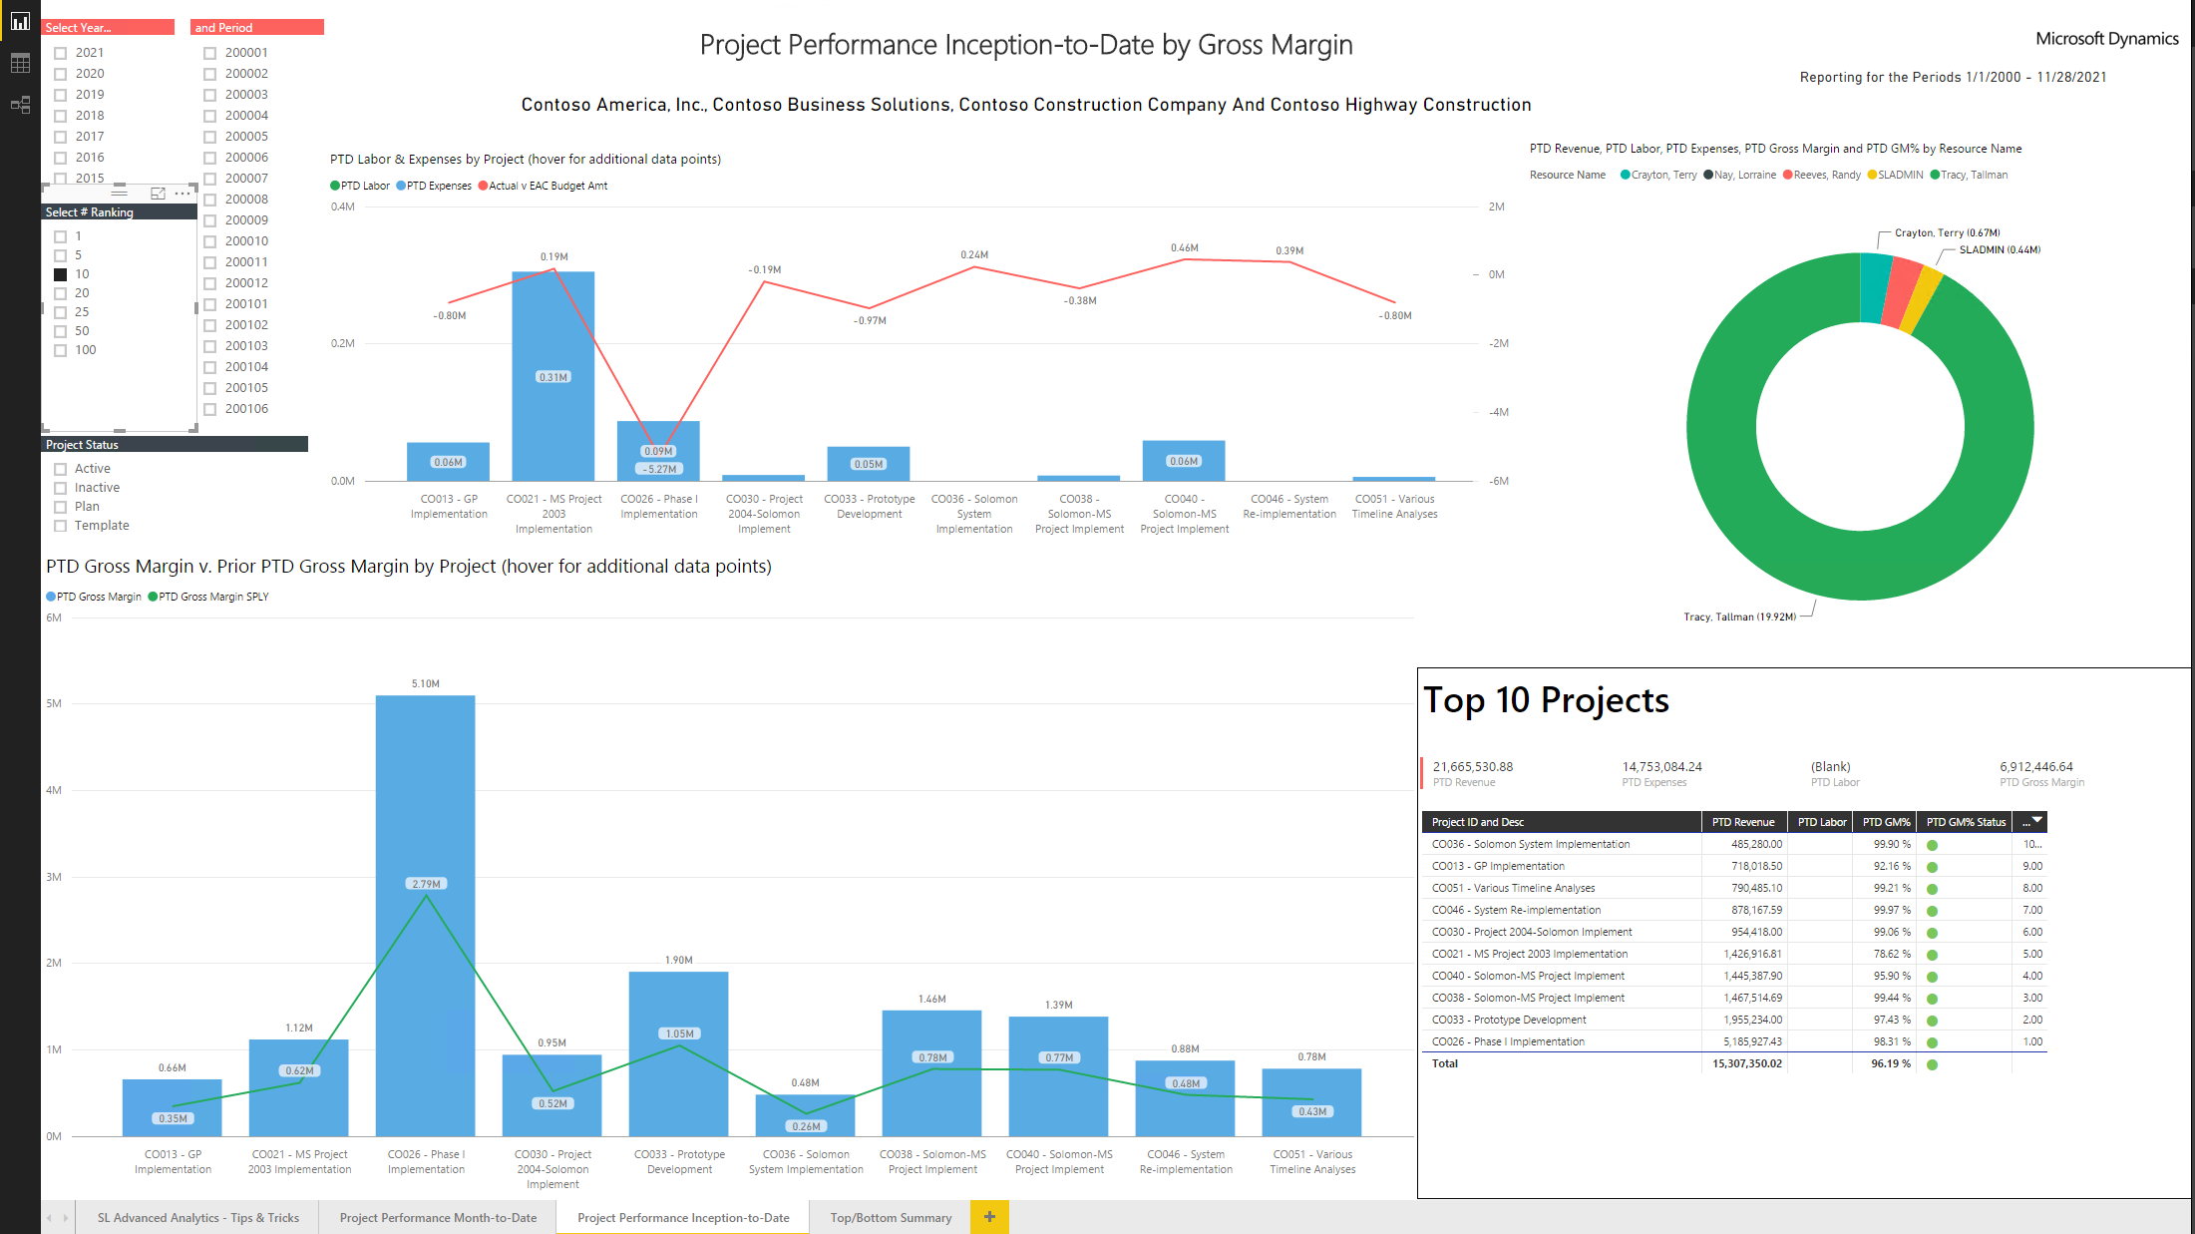
Power BI SL Project Dashboard example

Slide 24
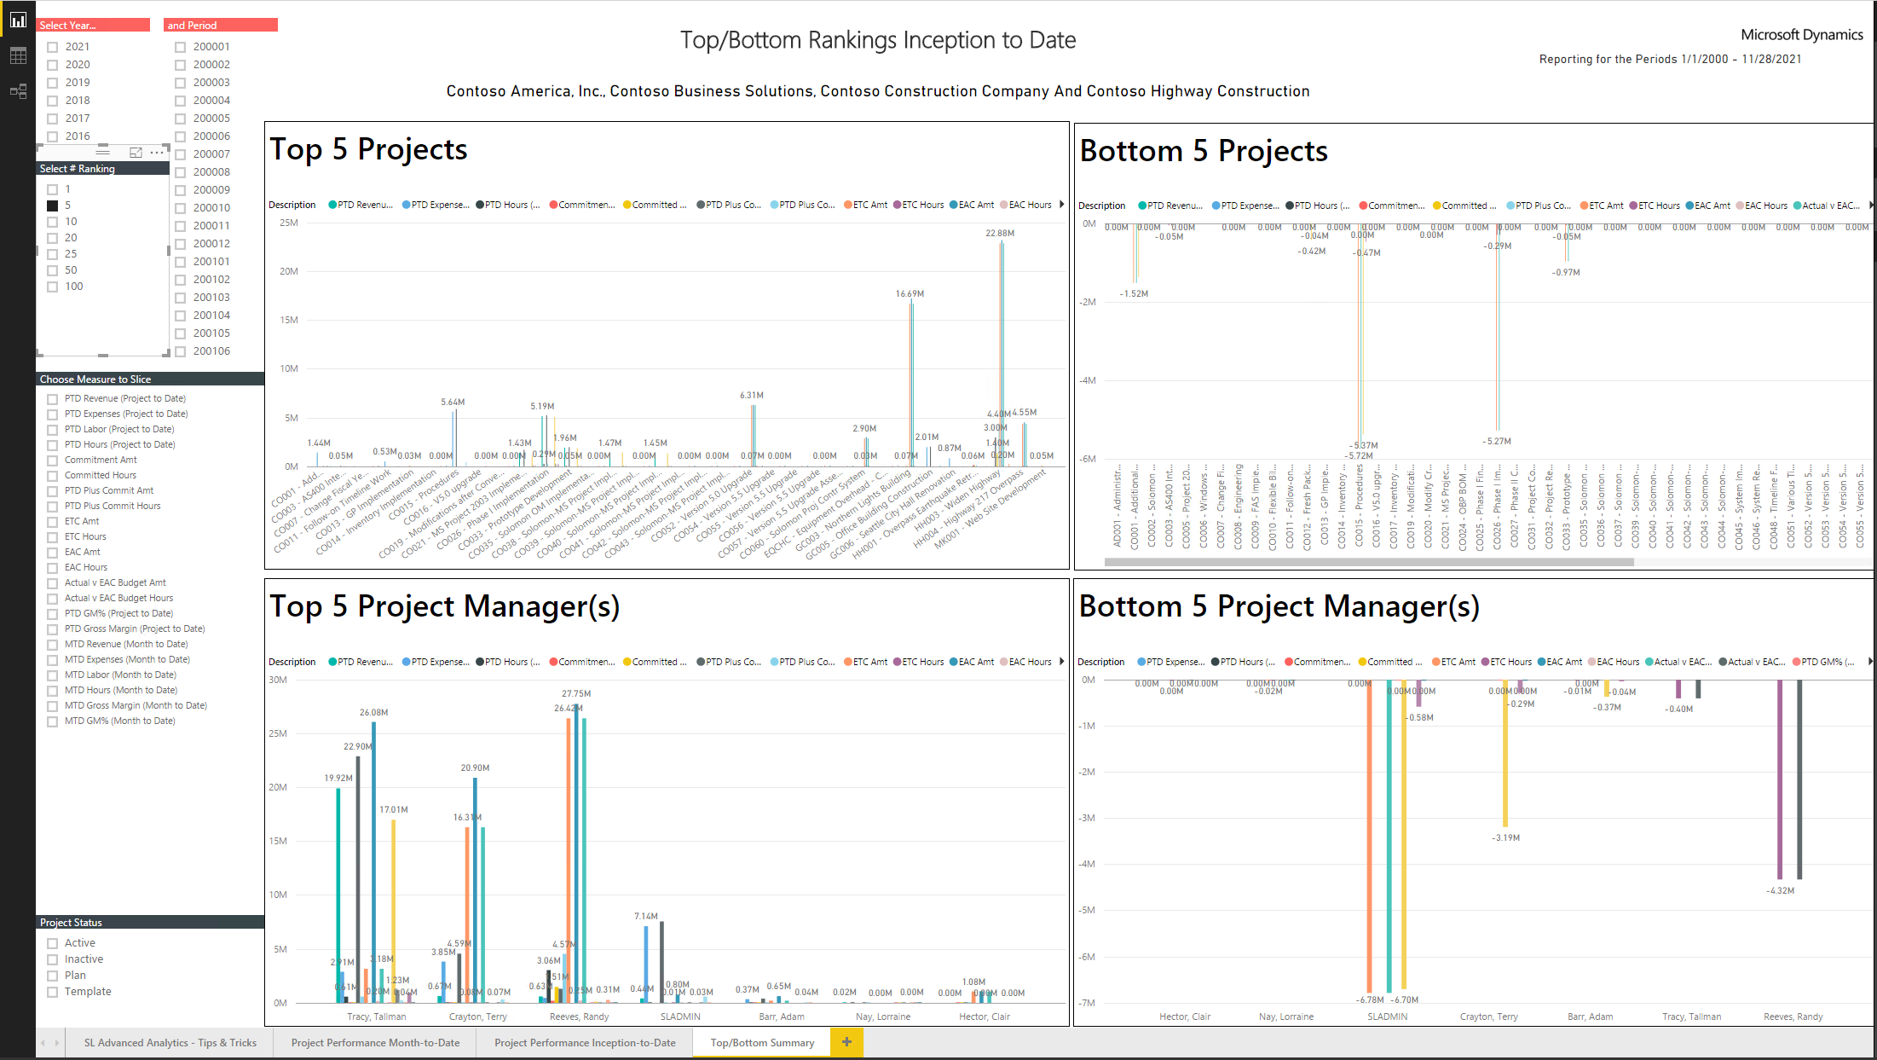
Power BI SL Project Dashboard example

Slide 25
Power BI SL Project Dashboard demo

Slide 26
Recap
Available today!
Document on connecting SL to Power BI
Project Power BI Dashboard
New Power BI Dashboards coming with SL 2018 releases

Slide 27
V-jsuwyn@Microsoft.com

