Slide 1
Power Apps & Flow for Microsoft Dynamics SL

Slide 2
Agenda
What are Power Apps & Flow
SL 2018 Power Apps & Flow preview
How to get started with Power Apps & Flow

Slide 3
The drivers for PowerApps and Flow
Build modern business apps fast Compose analytics, user experiences, and automation using an integrated set of services from Microsoft
MEASURE
ACT
AUTOMATE
Empower power users People who understand their business needs best can now build apps quickly without writing code
Power BI
PowerApps
Microsoft Flow
Azure Data analytics
Azure Internet of Things
SQL Server BI
…
Azure AppServices
Azure Service Fabric
Azure Functions
…
Azure Logic Apps
Azure API Management
BizTalk
…
More efficient developers(*) Seamlessly extend capabilities for power users and leverage powerful Azure platform services
Easily connect data across apps Whether built on the Common Data Model or integrated with existing systems, get more value from your data
Common Data Model
Connectors & Gateways

Slide 4
when you’re building business apps
it’s hard to keep everyone happy

Slide 5
Secure Scalable Managed Integrated Compliant
Fast Iterative
Cross-platform
Beautiful Easy
VS

Slide 6
Only a handful of business apps merit the time and cost of traditional custom software development…
…and only so many problems can be solved with off-the-shelf SaaS.
What about every other need your business faces?

Slide 7
Let’s change the way we build business apps

Slide 8
Power apps

Slide 9
Microsoft PowerApps is a service for creating and using custom business apps across platforms
Connect to data & systems you’re already using; create the data you need
Create apps, forms, and workflows without writing code
Use apps on web and mobile

Slide 10
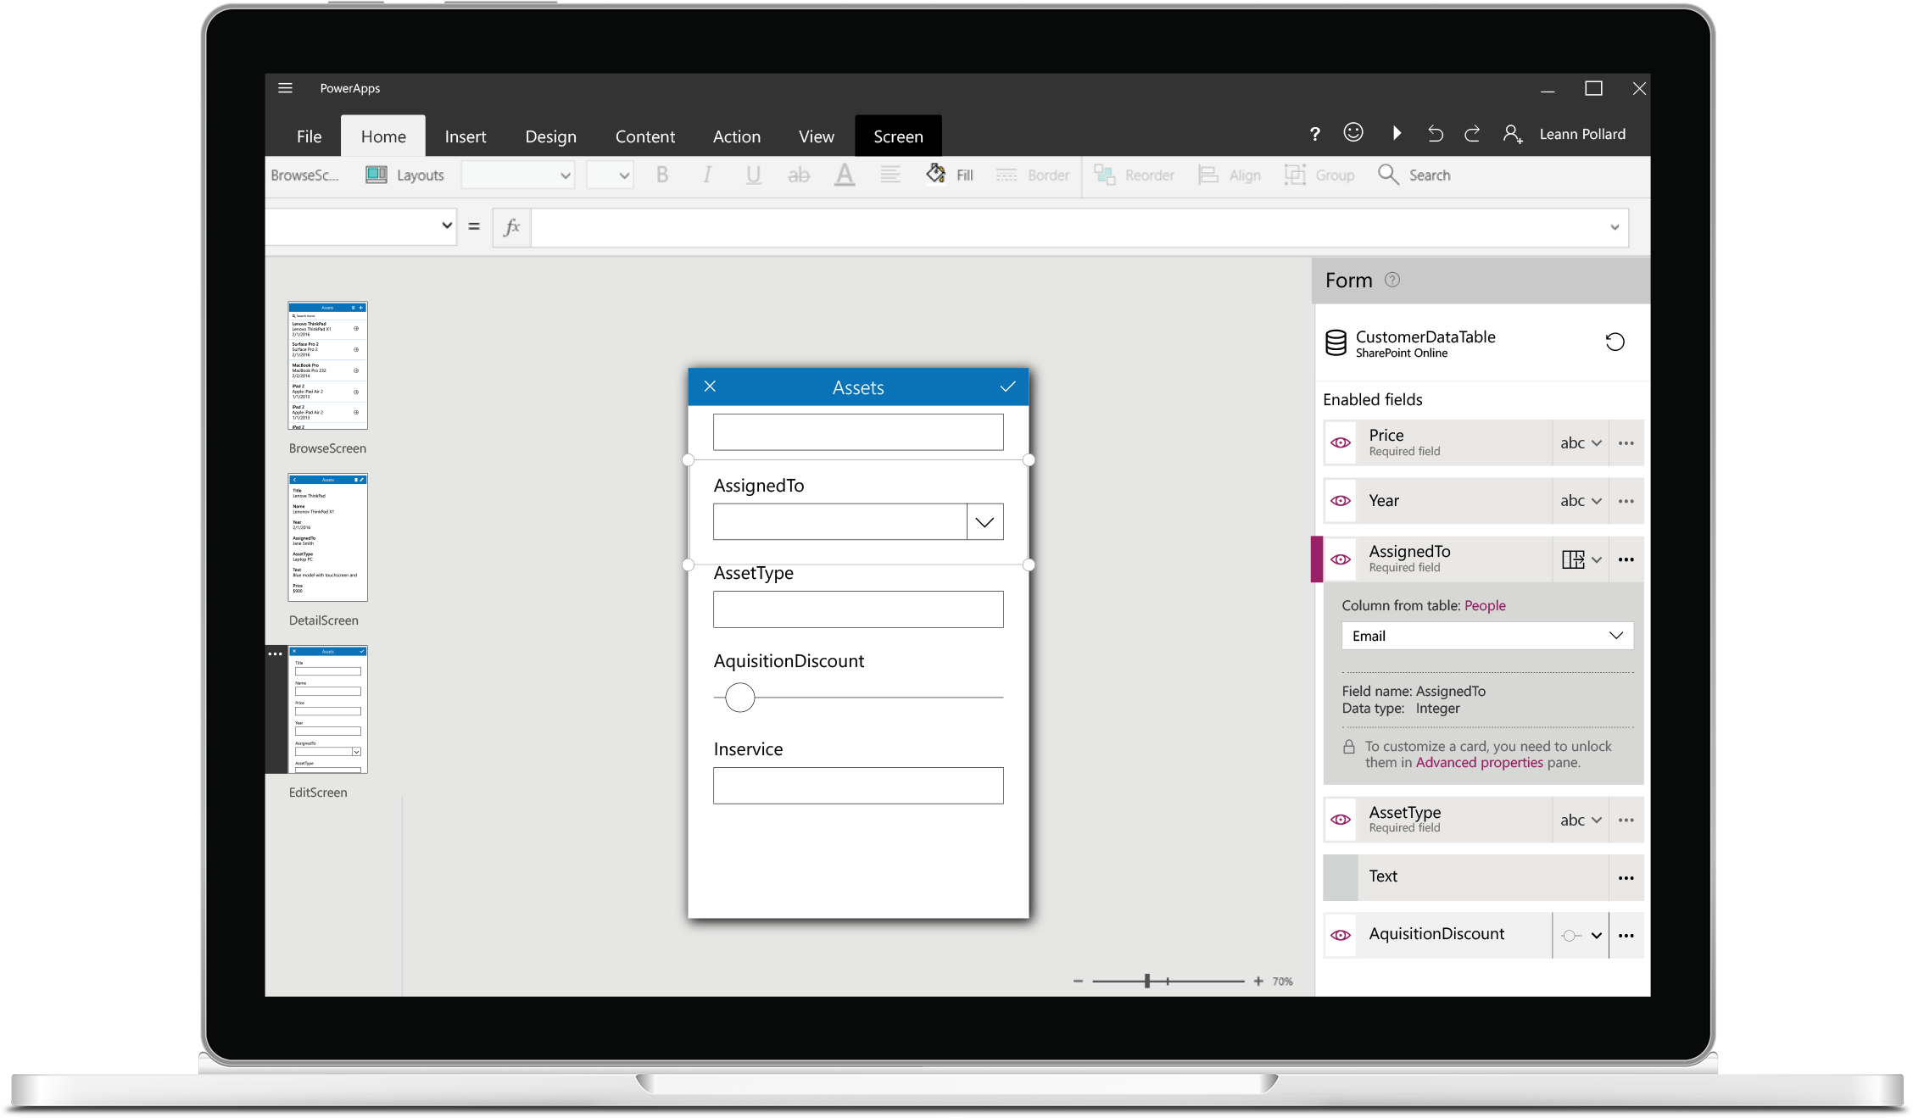
Build useful apps without writing code
Craft forms and screens in a visual designer that helps you see exactly what you’ll get
Build business logic into your apps with an Excel-inspired expression language
Take advantage of device capabilities like cameras, GPS, and pen controls
Extend the capabilities of connected data sources, or focus just on the bits you need

Slide 11
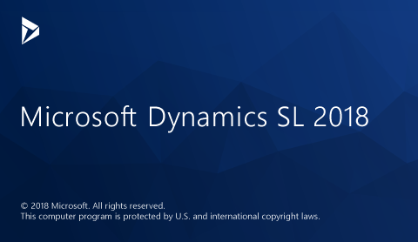
Connect to the systems you’re already using
Quickly generate and customize apps based on Excel files, SharePoint Online lists, Salesforce records and more. You can even connect custom APIs.
Even connecting to data in your on premise systems through a common Data Gateway.
Your apps will be able to fully interact with underlying sources and will respect the permissions you’ve already established in them.

Slide 12
Publish apps instantly for web and mobile
Get apps to your team when and where they’re needed, whether that’s on the web, Windows, iOS or Android—no app store required.
web.powerapps.com

Slide 13
Flow

Slide 14
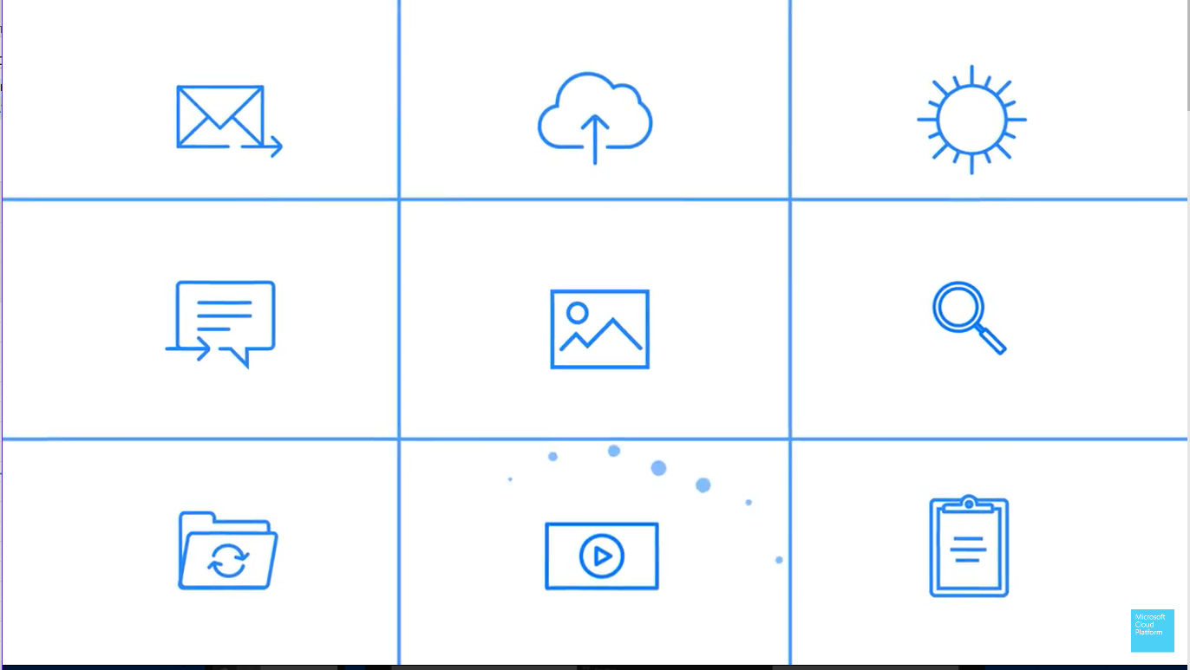
A way to monitor, notify and take action

Slide 15
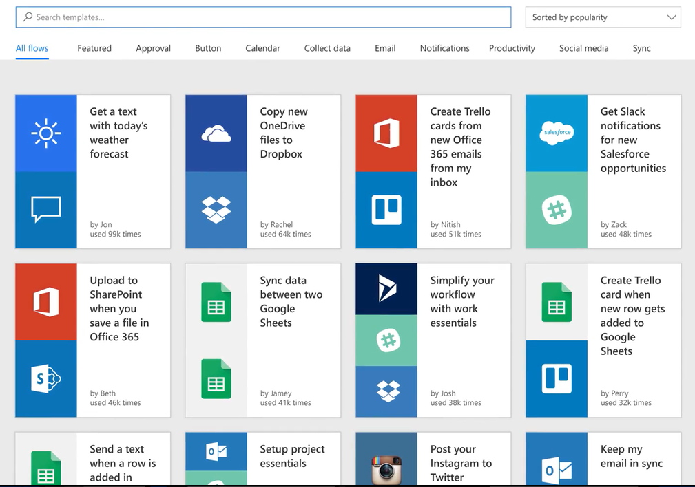
Microsoft Flow
Prebuilt Templates

Slide 16
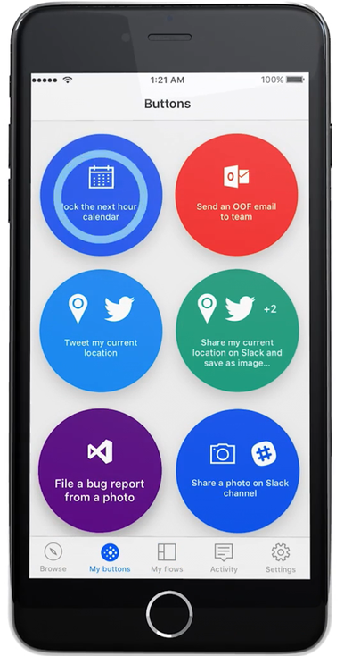
Flow Available On
Web
Phone/Tablet/PC
Inbox
Preset Flows…

Slide 17
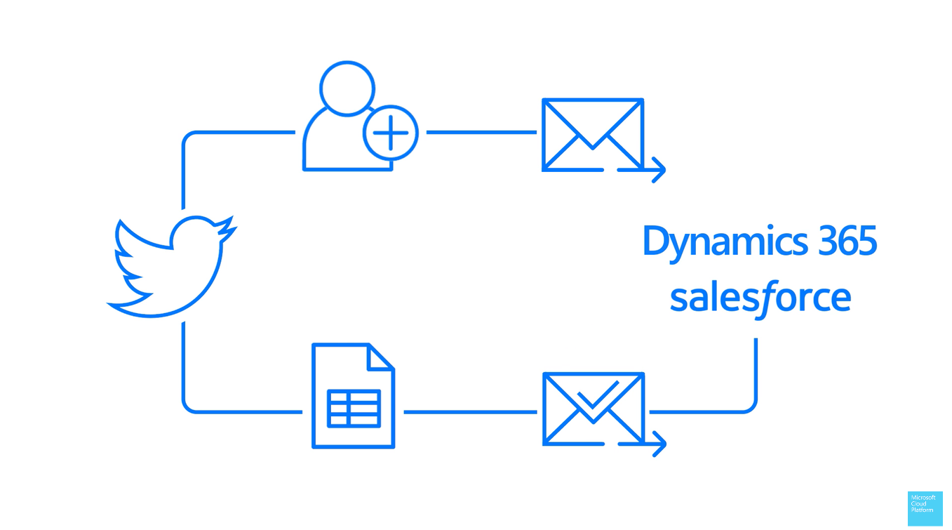
Microsoft Flow Example
Notes:
Someone Tweets about your company
Setup a Flow to automatically follow them
Sends them a nice reply
Puts them to a Spreadsheet that is emailed to you for your review and approval
If approved then the contact information is added to Dynamics CRM or Dynamics SL

Slide 18
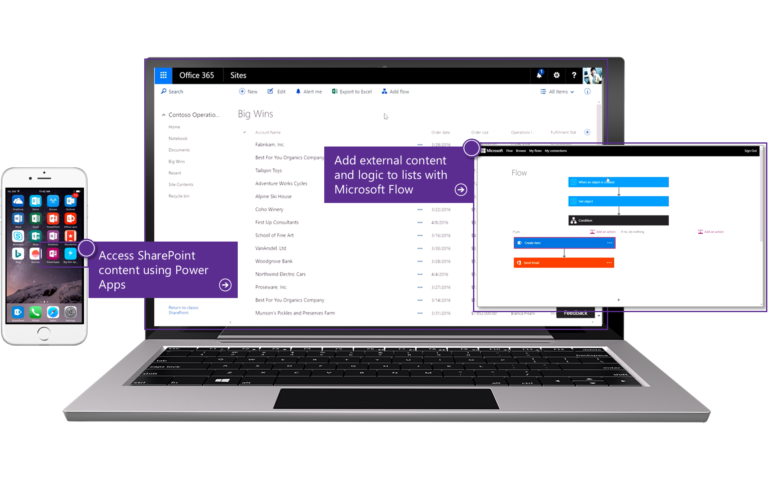
Office 365 extensibility
SharePoint Modern List integration with PowerApps and Microsoft Flow

Slide 19
Power Apps & Flow SL Demo for Phone & Tablet

Slide 20
Accounts Receivables Power App & Flow
View Customer Receivables Due
Contact customers
Run Aging
Email Aging Results

Slide 21
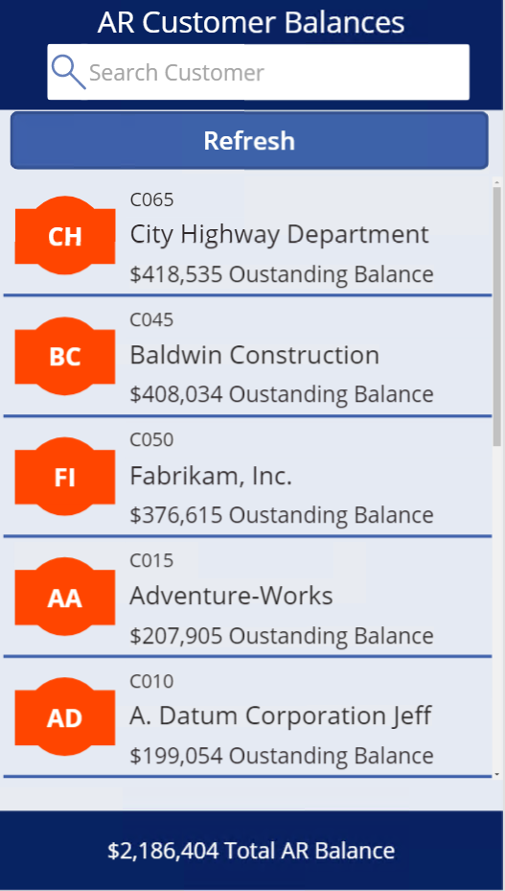

Slide 22
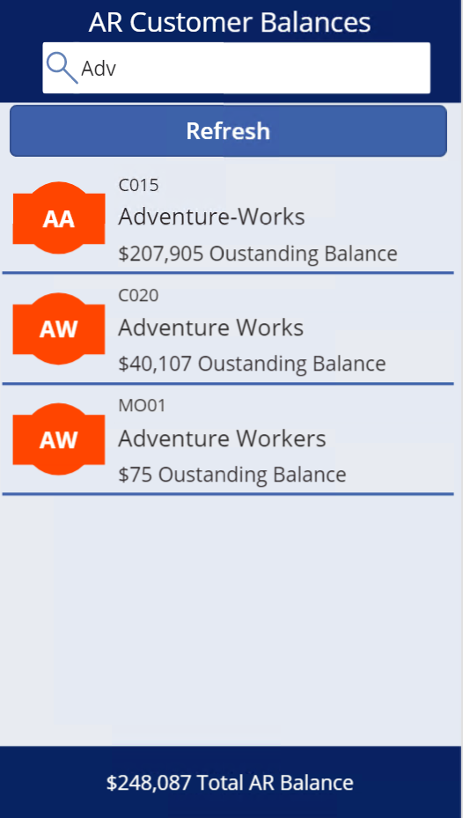

Slide 24
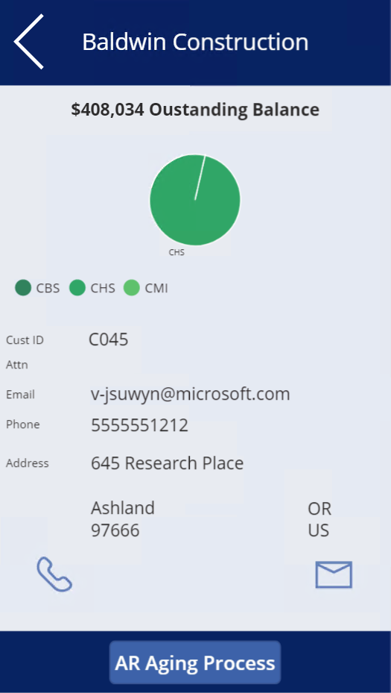

Slide 25
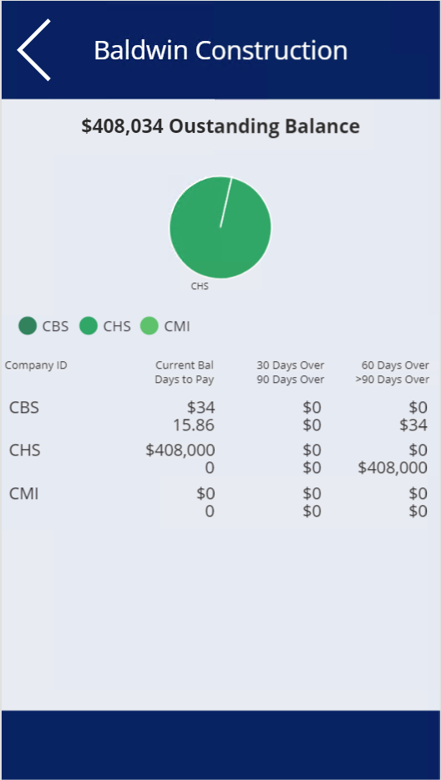

Slide 28
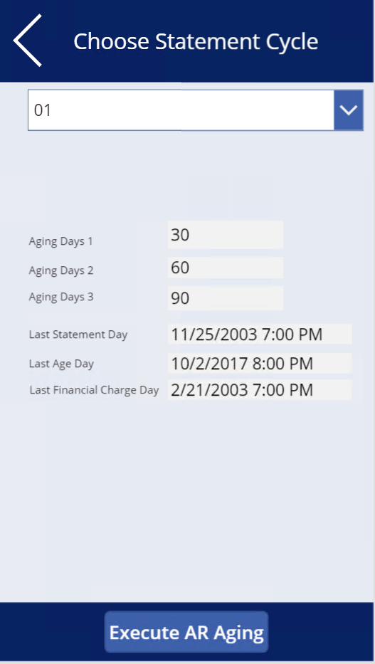

Slide 29
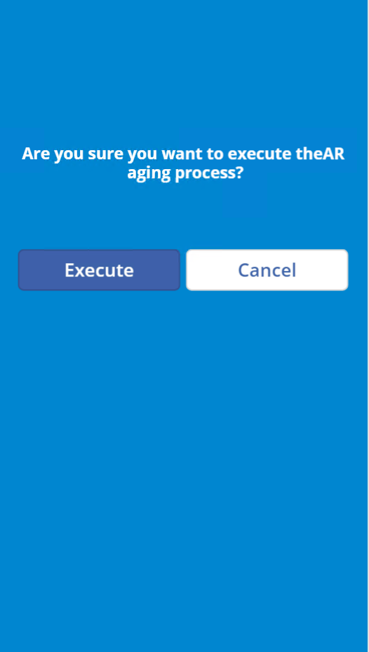

Slide 30
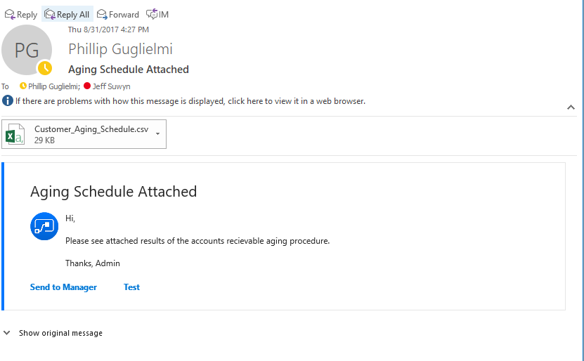

Slide 31
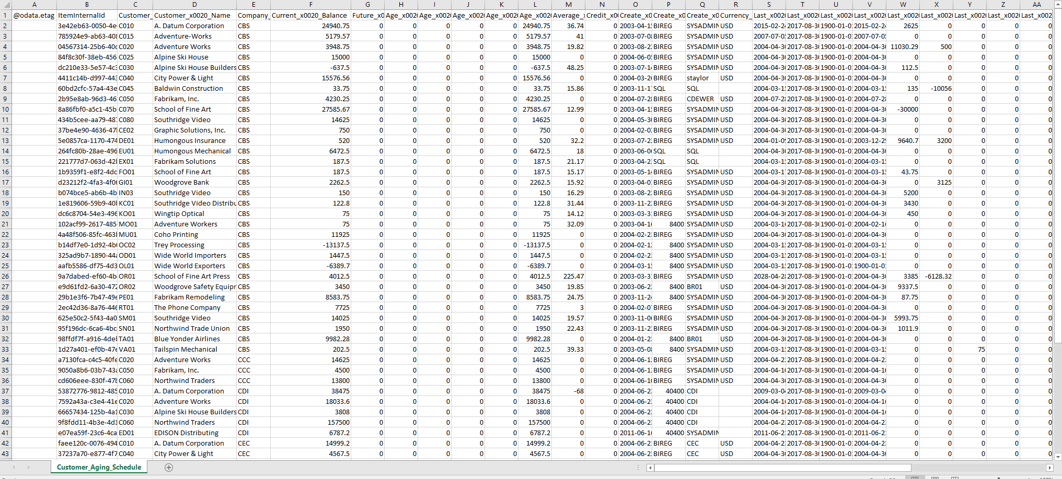

Slide 33
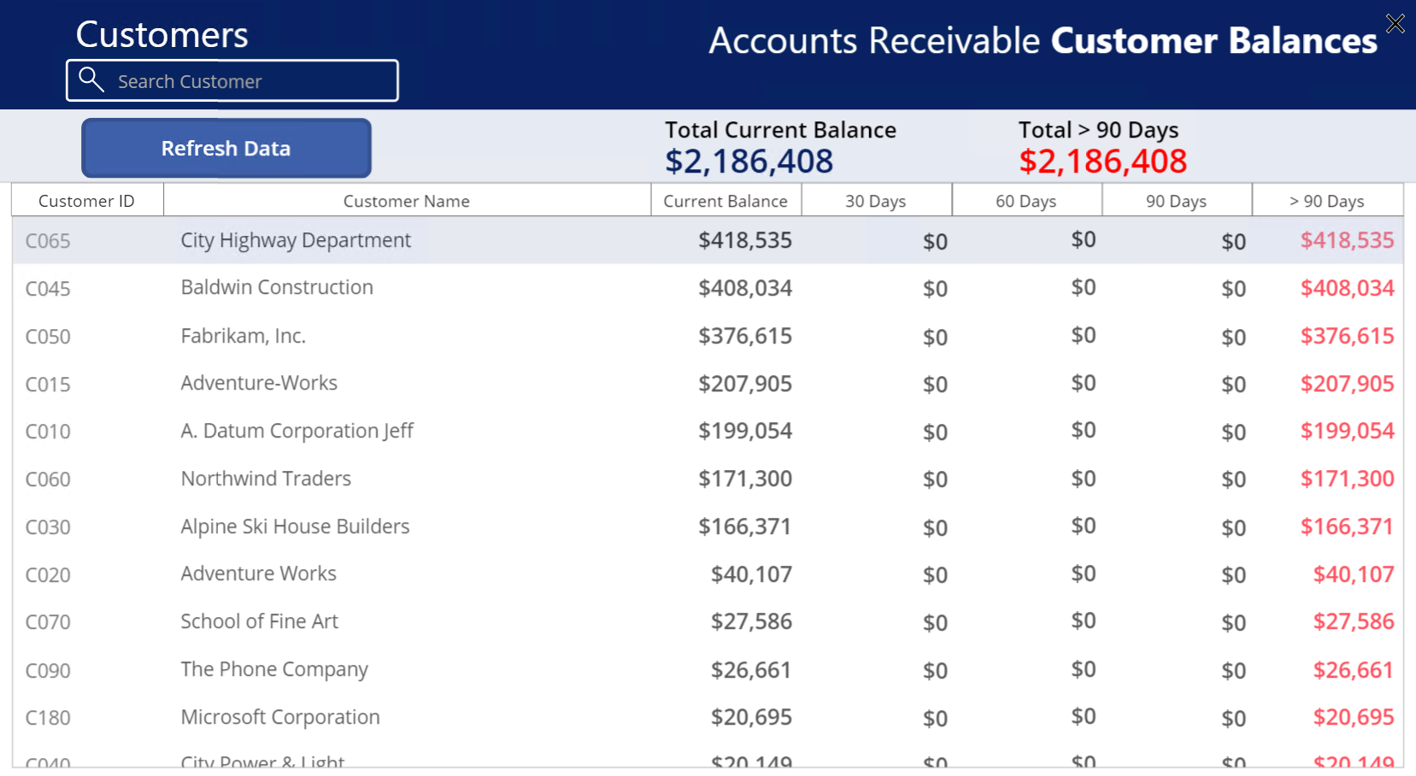

Slide 34
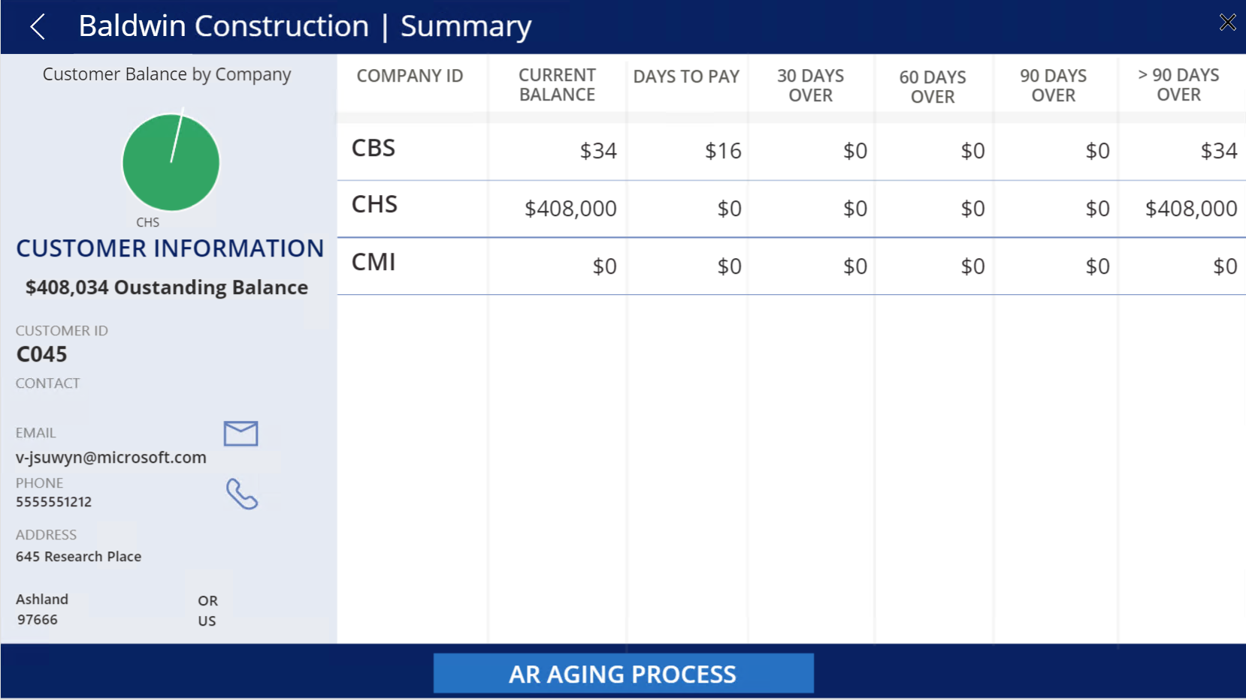

Slide 35
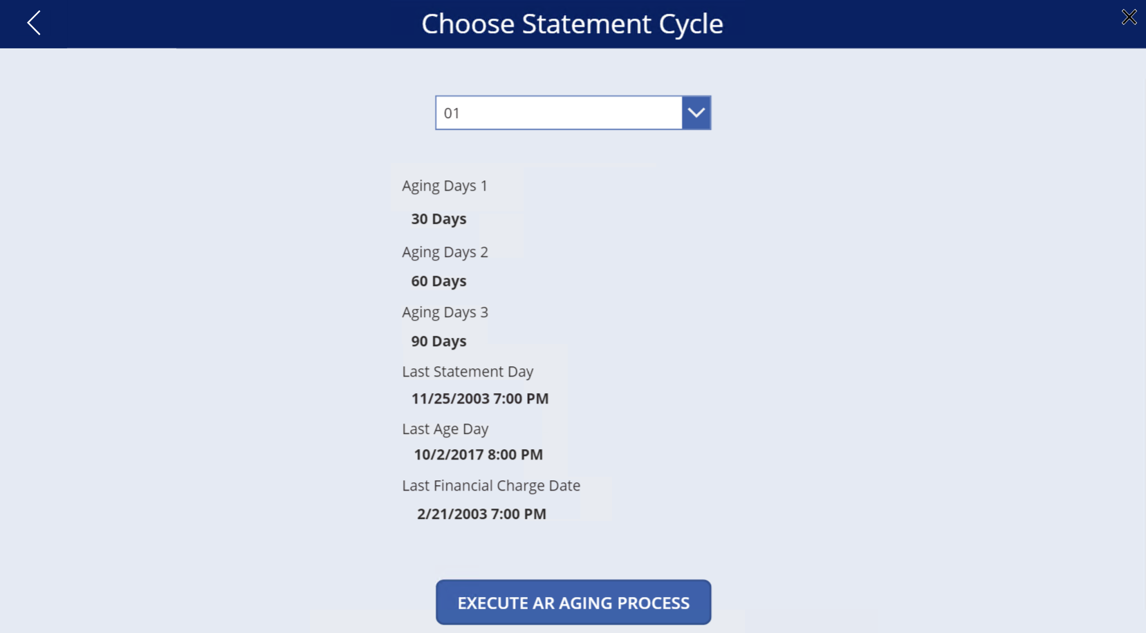

Slide 36
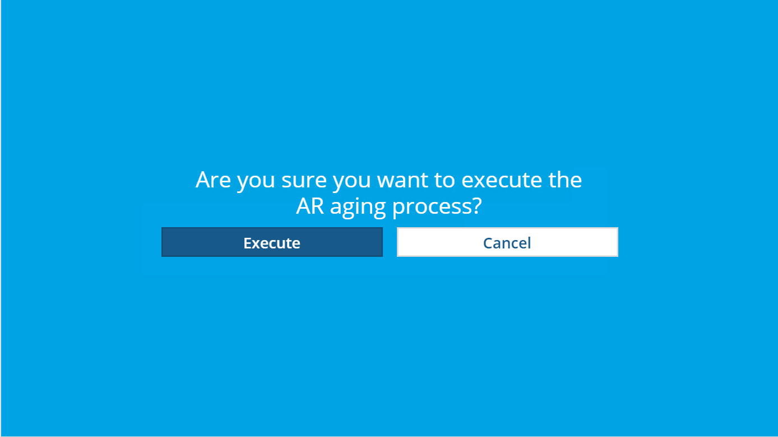

Slide 37
Getting started with PowerApps

Slide 38
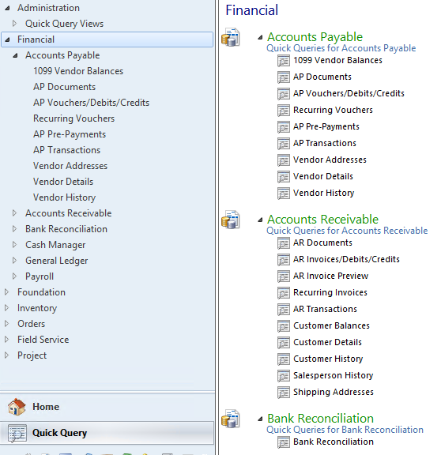
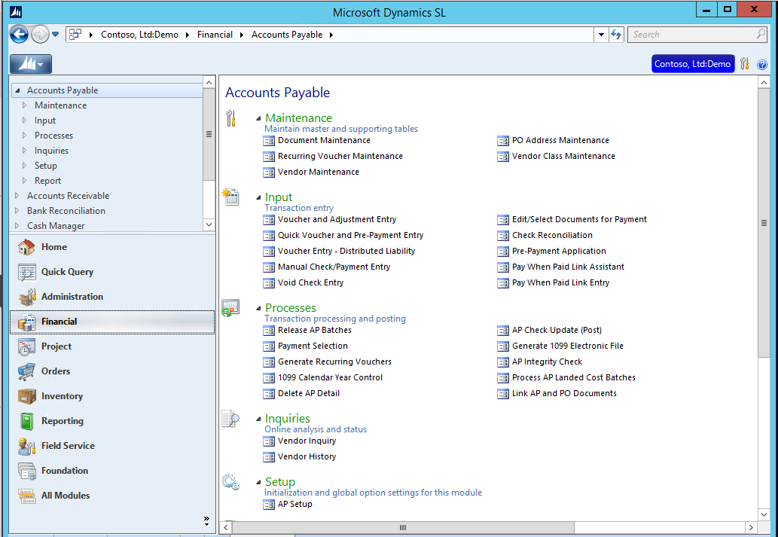
How to find data for an App …examples
Find screens or Quick Queries that have the data you need

Slide 39
How to find data for an App …examples
Screen
Use Customization mode to verify the tables
Quick Query
Use the Quick Query maintenance screen to verify the underlying SQL view

Slide 40
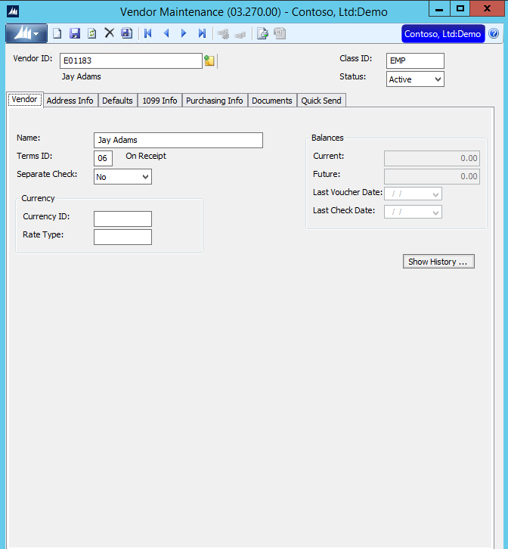
Open a Dynamics SL screen

Slide 41
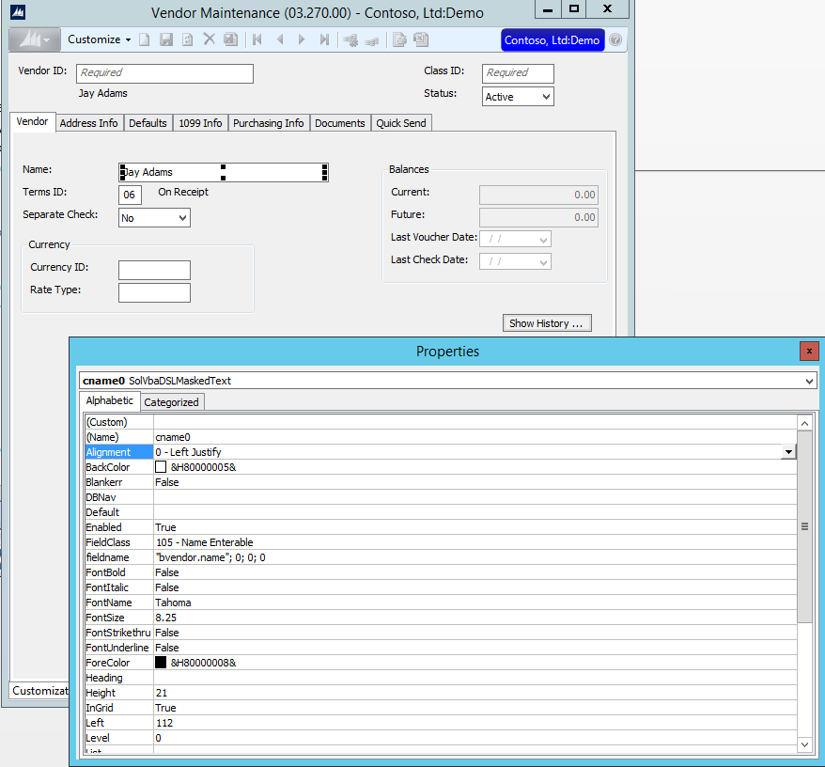
Go into customize mode

Slide 42
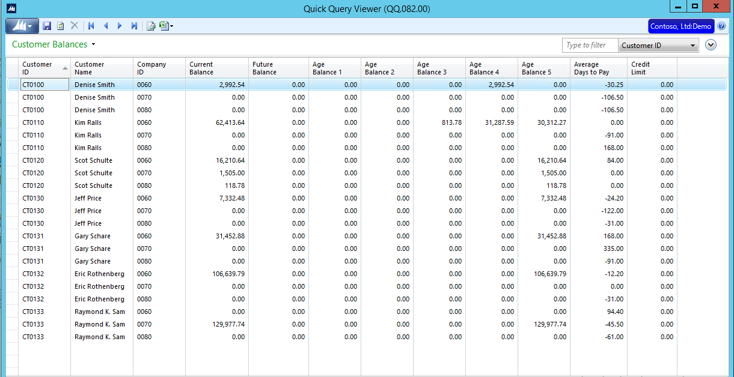
Review quick queries

Slide 43
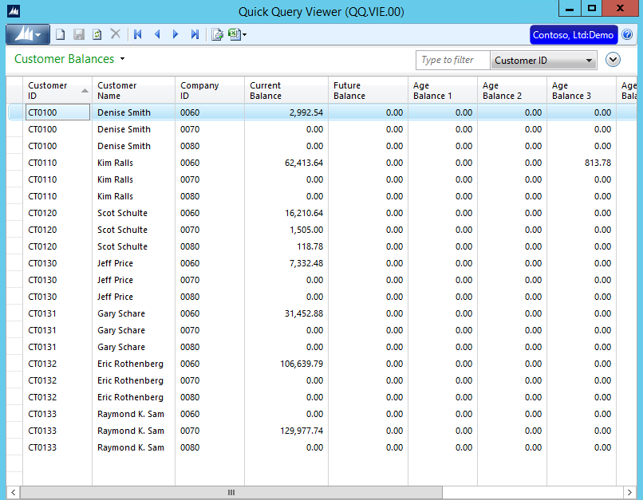
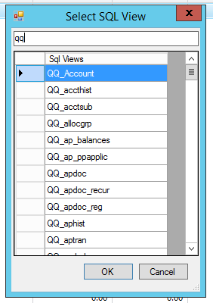
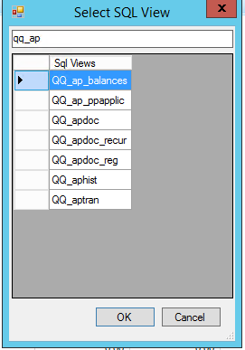
Admin – Quick Query Viewer
SQL: select * from QVCatalog

Slide 44
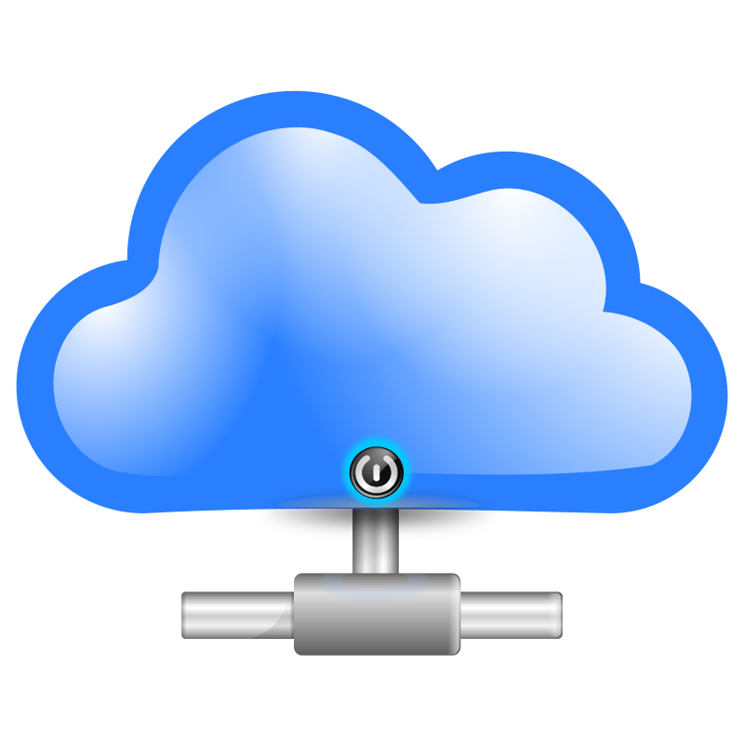
Connecting the Cloud to your data
Power Apps
Flow
Power BI
==Gateway==
SL
other

Slide 45
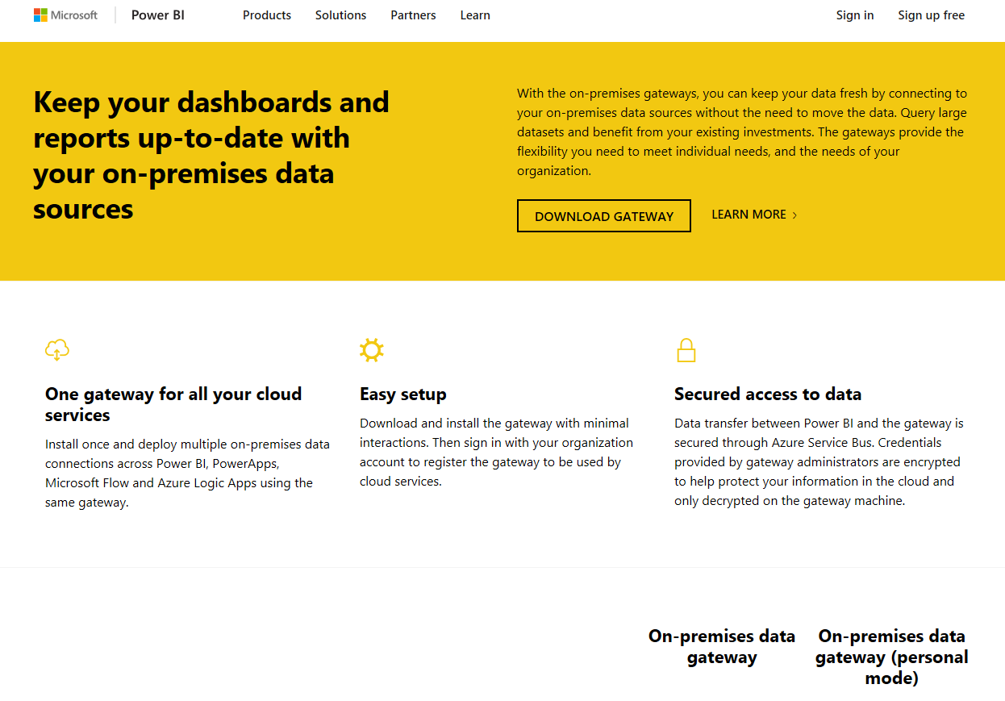
Download Gateway
https://powerbi.microsoft.com/en-us/gateway/
Connect to your SL database

Slide 46
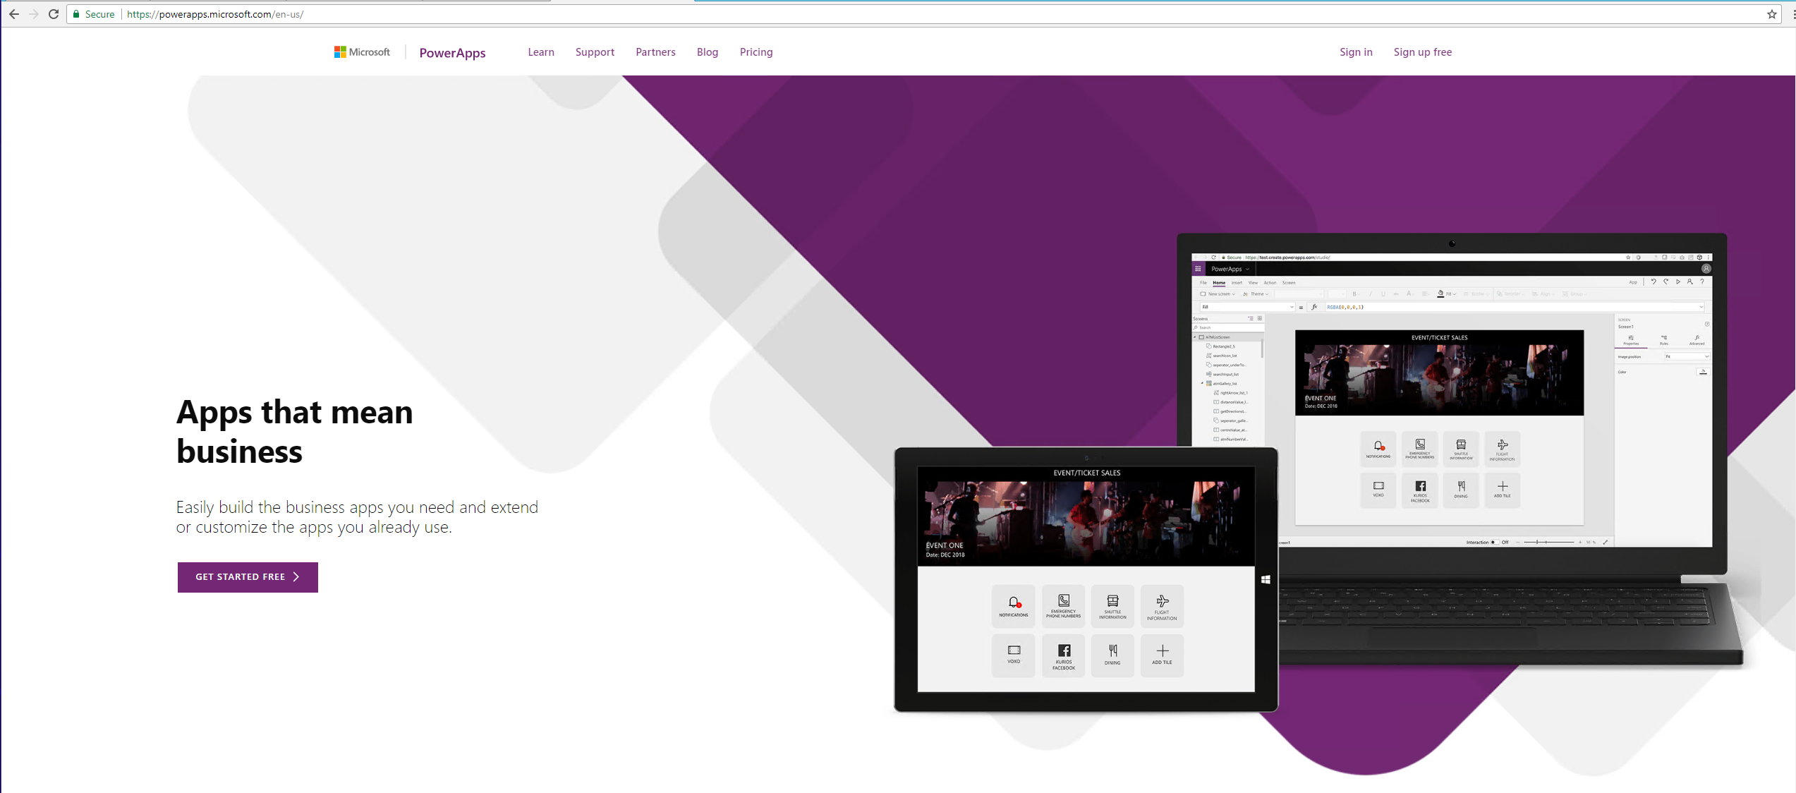
Setup PowerApps
https://powerapps.microsoft.com/en-us/
Cloud Tool
Download the App

Slide 47
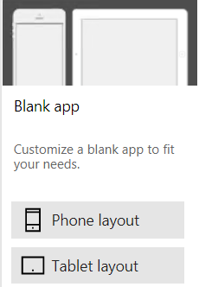
Start a Blank App

Slide 48
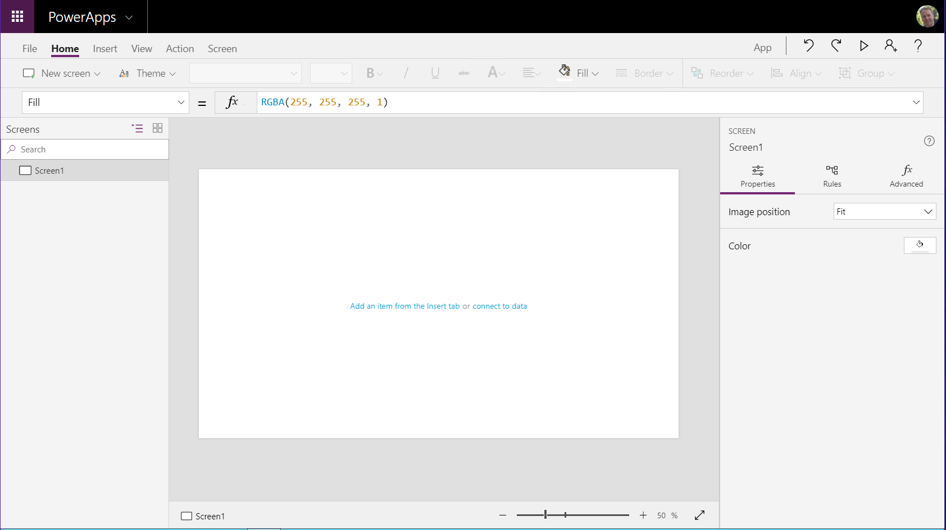

Slide 49
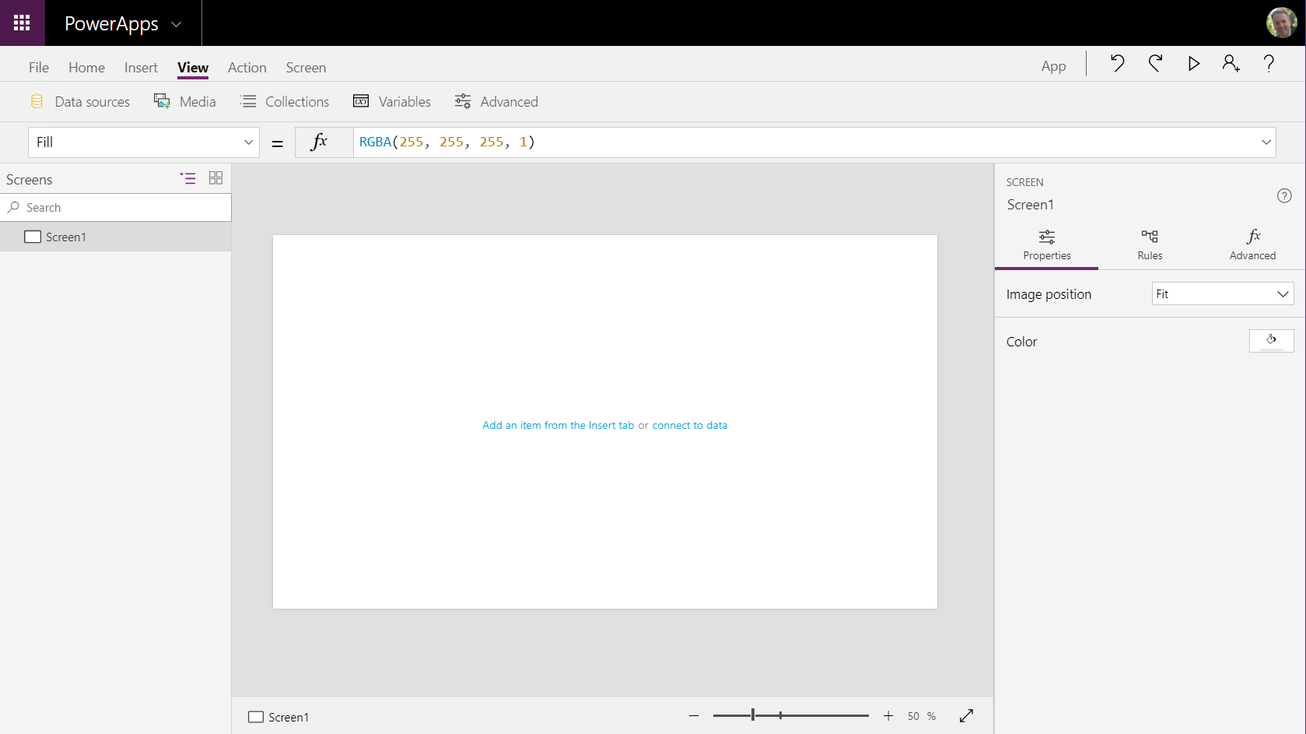

Slide 50
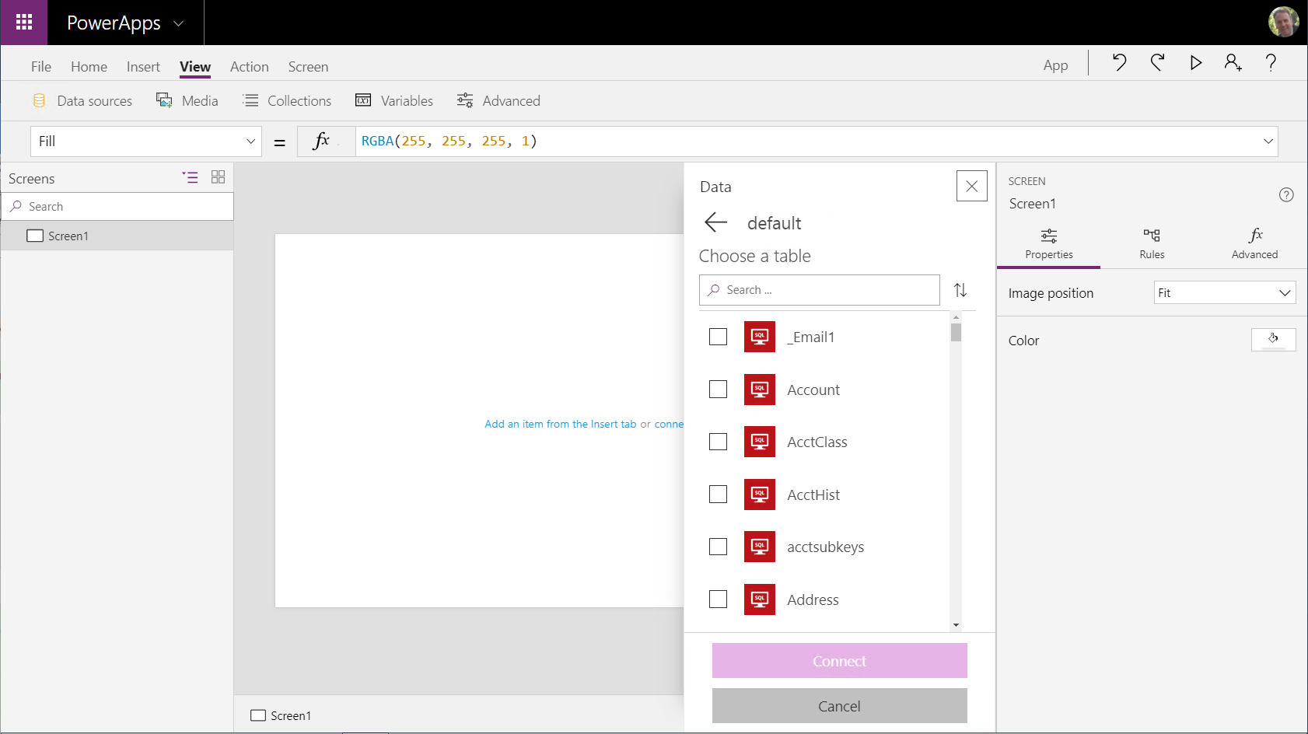
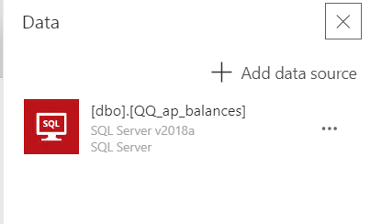

Slide 52
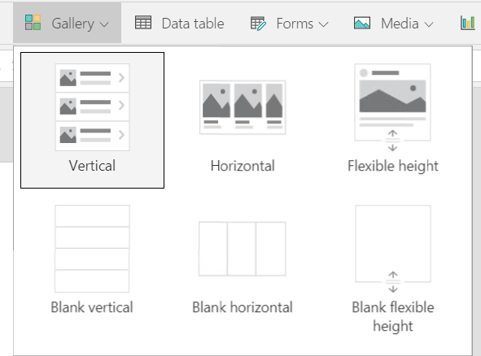
Gallery

Slide 53
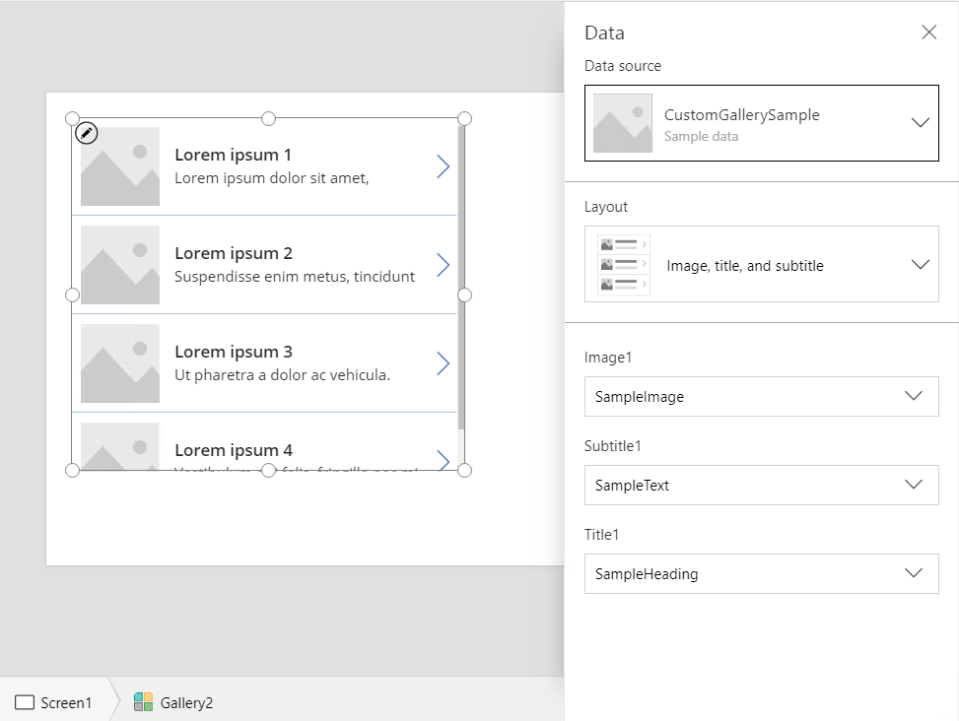
Choose QQ_AP_Balances

Slide 54
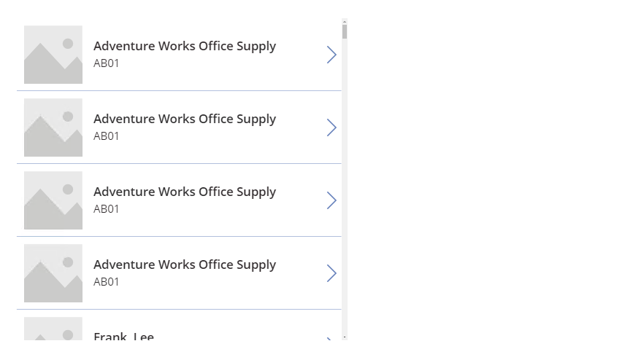
Gallery

Slide 55
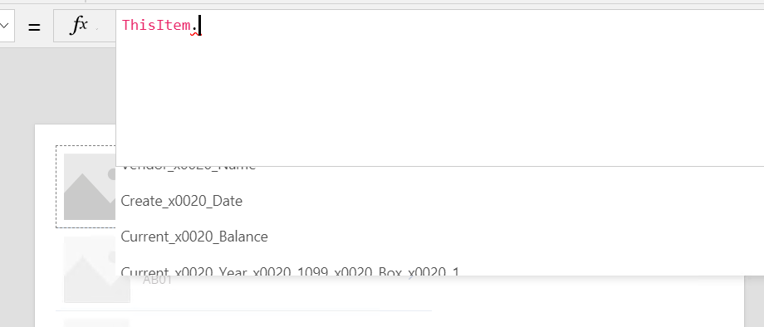
How to select field from query

Slide 56
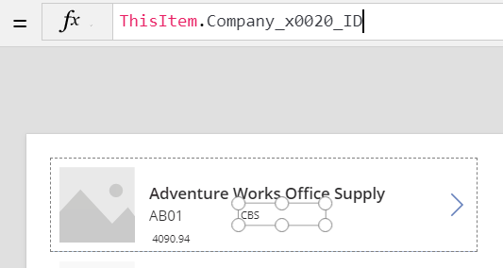
How to select field from query

Slide 57
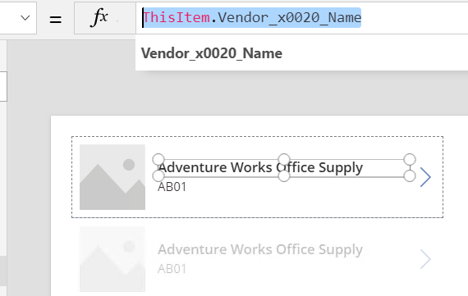
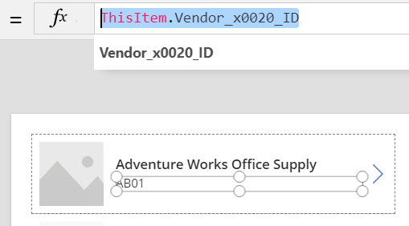
How to select field from query

Slide 58
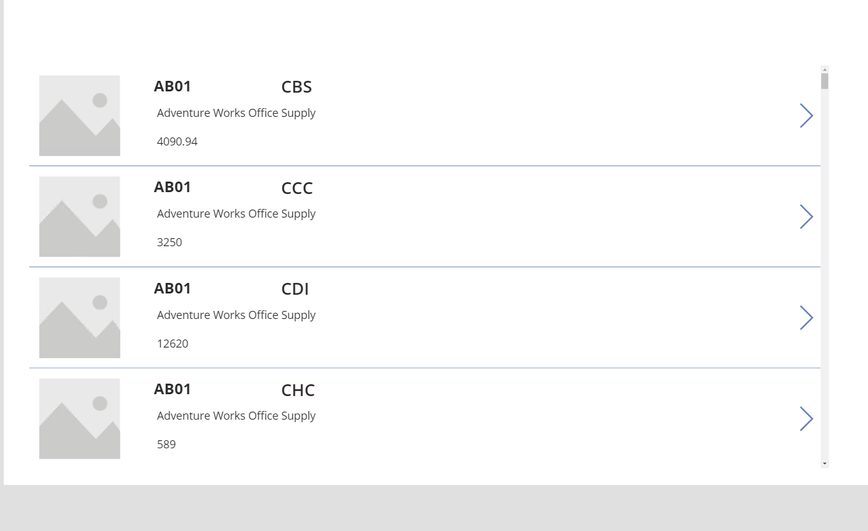

Slide 59
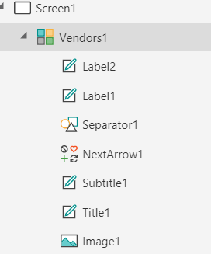
Rename Gallery

Slide 60
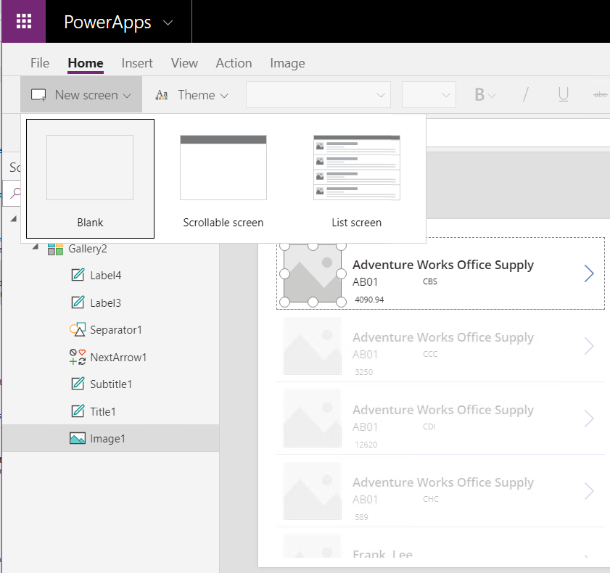
Create a new screen

Slide 61
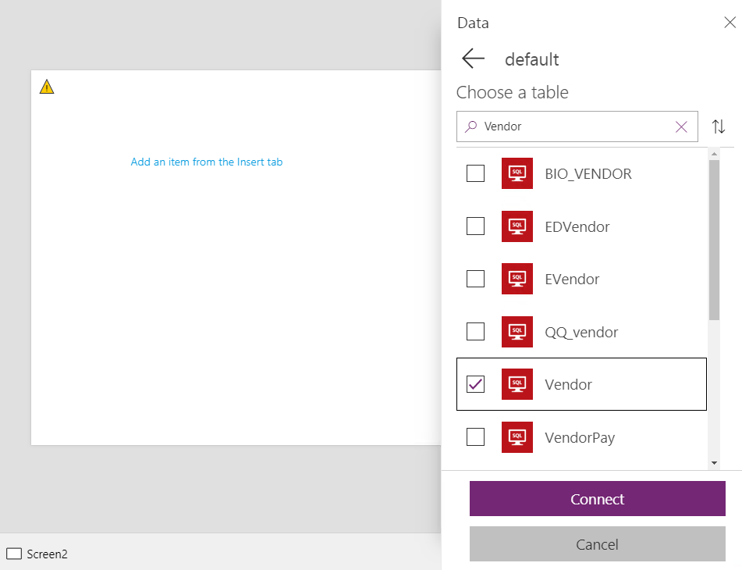
Adding a new table

Slide 62
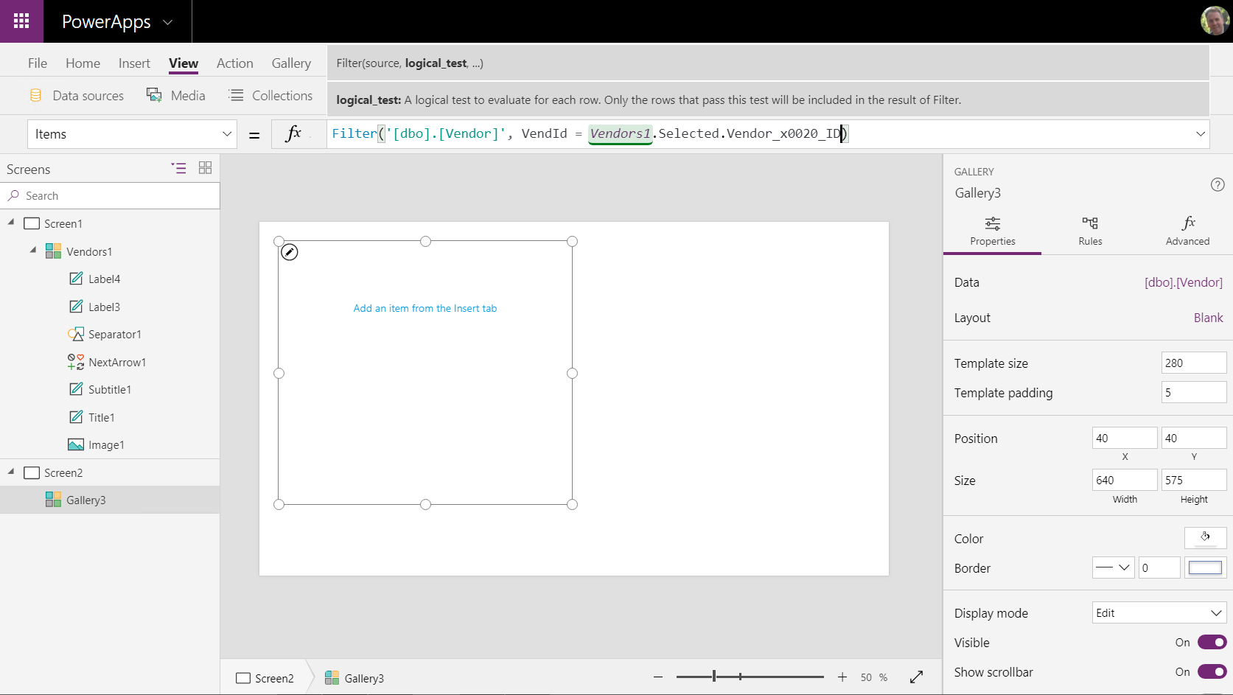

Slide 63
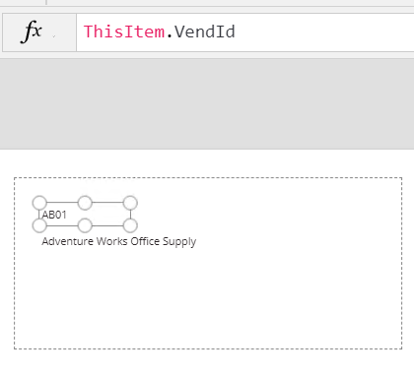
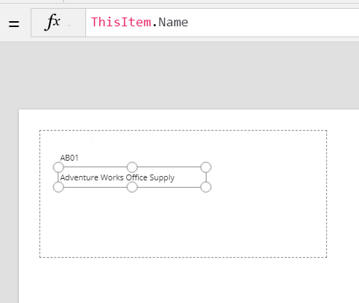
Adding Vendor Details

Slide 64
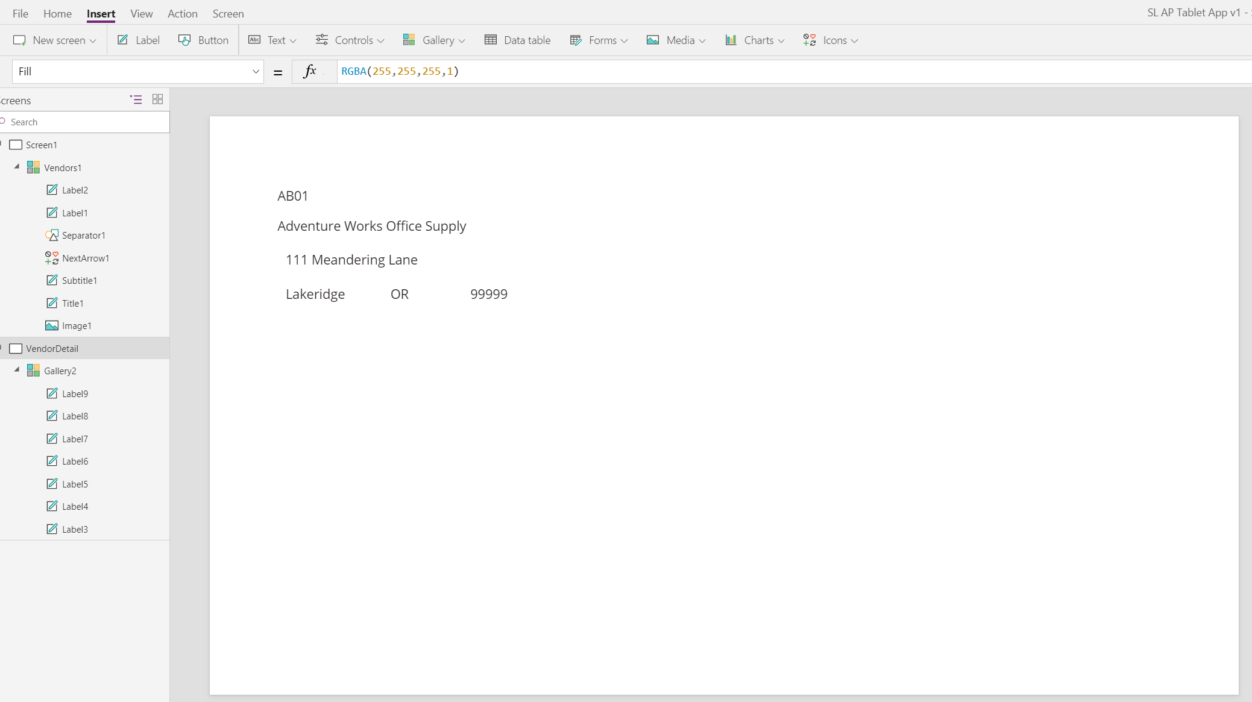

Slide 65
Rename Gallery and Label fields

Slide 66
Connect screens

Slide 67
Getting started with Flow

Slide 68
Setup Flow
https://us.flow.microsoft.com/en-us/

Slide 69
Receive email with daily customer balances

Slide 70
Recurrence

Slide 71
Get Rows – From a Quick Query (SQL view)

Slide 72
Place Value from Get Rows into a CSV file

Slide 73
Create an email and Attach the CSV file
Important to add .CSV to file name

Slide 75
Resulting Email and Attachment

Slide 76
PowerApps and Flow
Build modern business apps fast Compose analytics, user experiences, and automation using an integrated set of services from Microsoft
MEASURE
ACT
AUTOMATE
Empower power users People who understand their business needs best can now build apps quickly without writing code
Power BI
PowerApps
Microsoft Flow
Azure Data analytics
Azure Internet of Things
SQL Server BI
…
Azure AppServices
Azure Service Fabric
Azure Functions
…
Azure Logic Apps
Azure API Management
BizTalk
…
More efficient developers(*) Seamlessly extend capabilities for power users and leverage powerful Azure platform services
Easily connect data across apps Whether built on the Common Data Model or integrated with existing systems, get more value from your data
Common Data Model
Connectors & Gateways

Slide 77
V-jsuwyn@Microsoft.com

