Slide 1
Microsoft Dynamics SL 2018

Slide 2
Session Agenda
Lifecycle
SL 2018 Theme & Release cycle
Power BI
Power Apps
Flow
Web Apps
Early list of rich client features

Slide 3
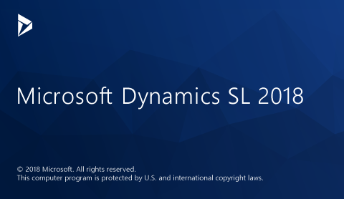

Slide 4
Microsoft Dynamics SL Lifecycle
Mainstream
Support
Mainstream
Support
Extended
Support
Support Ended
Hot Fixes &
Year End Updates
Hot Fixes &
Year End Updates
No Hot Fixes &
No Year End Updates
+ No Support Calls
Microsoft Dynamics SL 2018
Microsoft Dynamics SL 2015
CU2
Microsoft Dynamics SL 2011
SP3
Microsoft Dynamics SL 7
Mainstream through 2023
Extended through 2028
Mainstream through 1/14/2020
Extended through 1/14/2025
Extended through 7/13/2021

Slide 5
Announcing Quarterly Release
Microsoft Dynamics SL 2018
Release scheduled for May 1, 2018
Agile Methodology
Starts scheduled quarterly release cycle

Slide 6
Microsoft Dynamics SL 2018 Release Themes
Bringing two worlds together
Enhancing the core application and platform
Bringing two worlds together
Enhancing the core application and platform
One Microsoft
Enhanced Query & Preview
Query & Preview interface added across multiple modules
New views and drill back capabilities
+ more
Approvals
Adding approval process to key Dynamics SL areas
Web Apps
Monthly release cycle
New enhancements scheduled for every release
New Web Apps
+ more
Optimize Financials
General Ledger enhancements
Payables enhancements
Receivables enhancements
+ more
Project
Project feature enhancements
Invoice preliminary & print enhancements
Time related enhancements
+ more
Power Suite Evolution
Odata Service
SL Power BI Content Pack
Power Apps for SL
Flow for SL
+ more

Slide 7
Microsoft Power BI

Slide 8
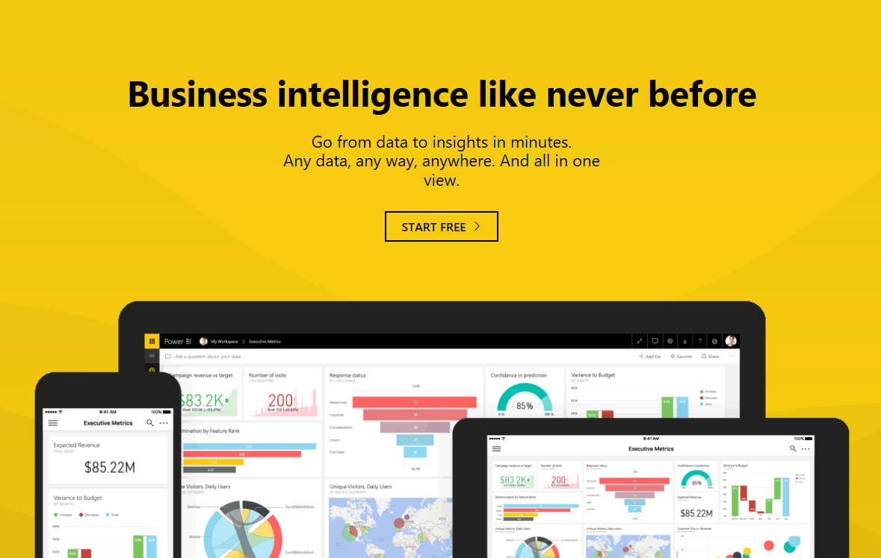
Microsoft Power BI
Power BI is a suite of business analytics tools to
analyze data and share insights

Slide 9
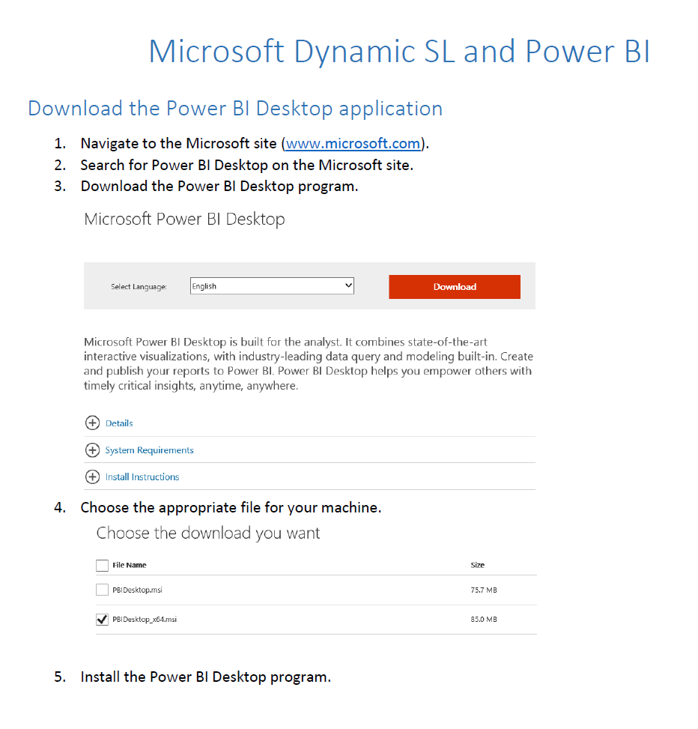
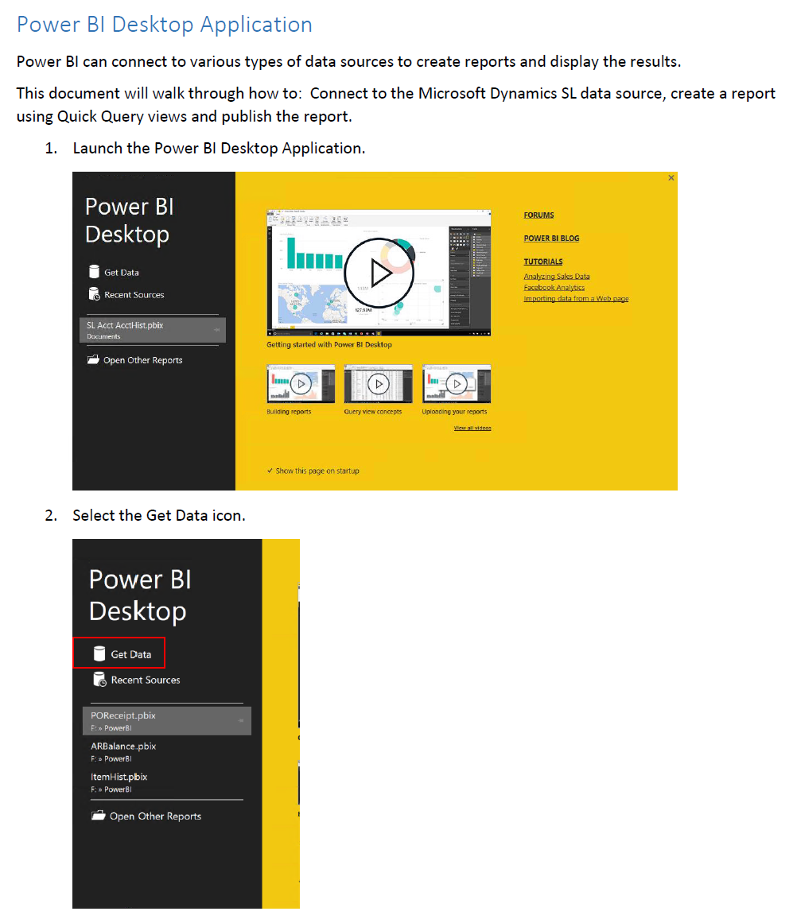
Power BI SL Project installation
SL 2015 CU2 release includes:
Connecting Power BI to Microsoft Dynamics SL
Document walking through basic connection

Slide 10
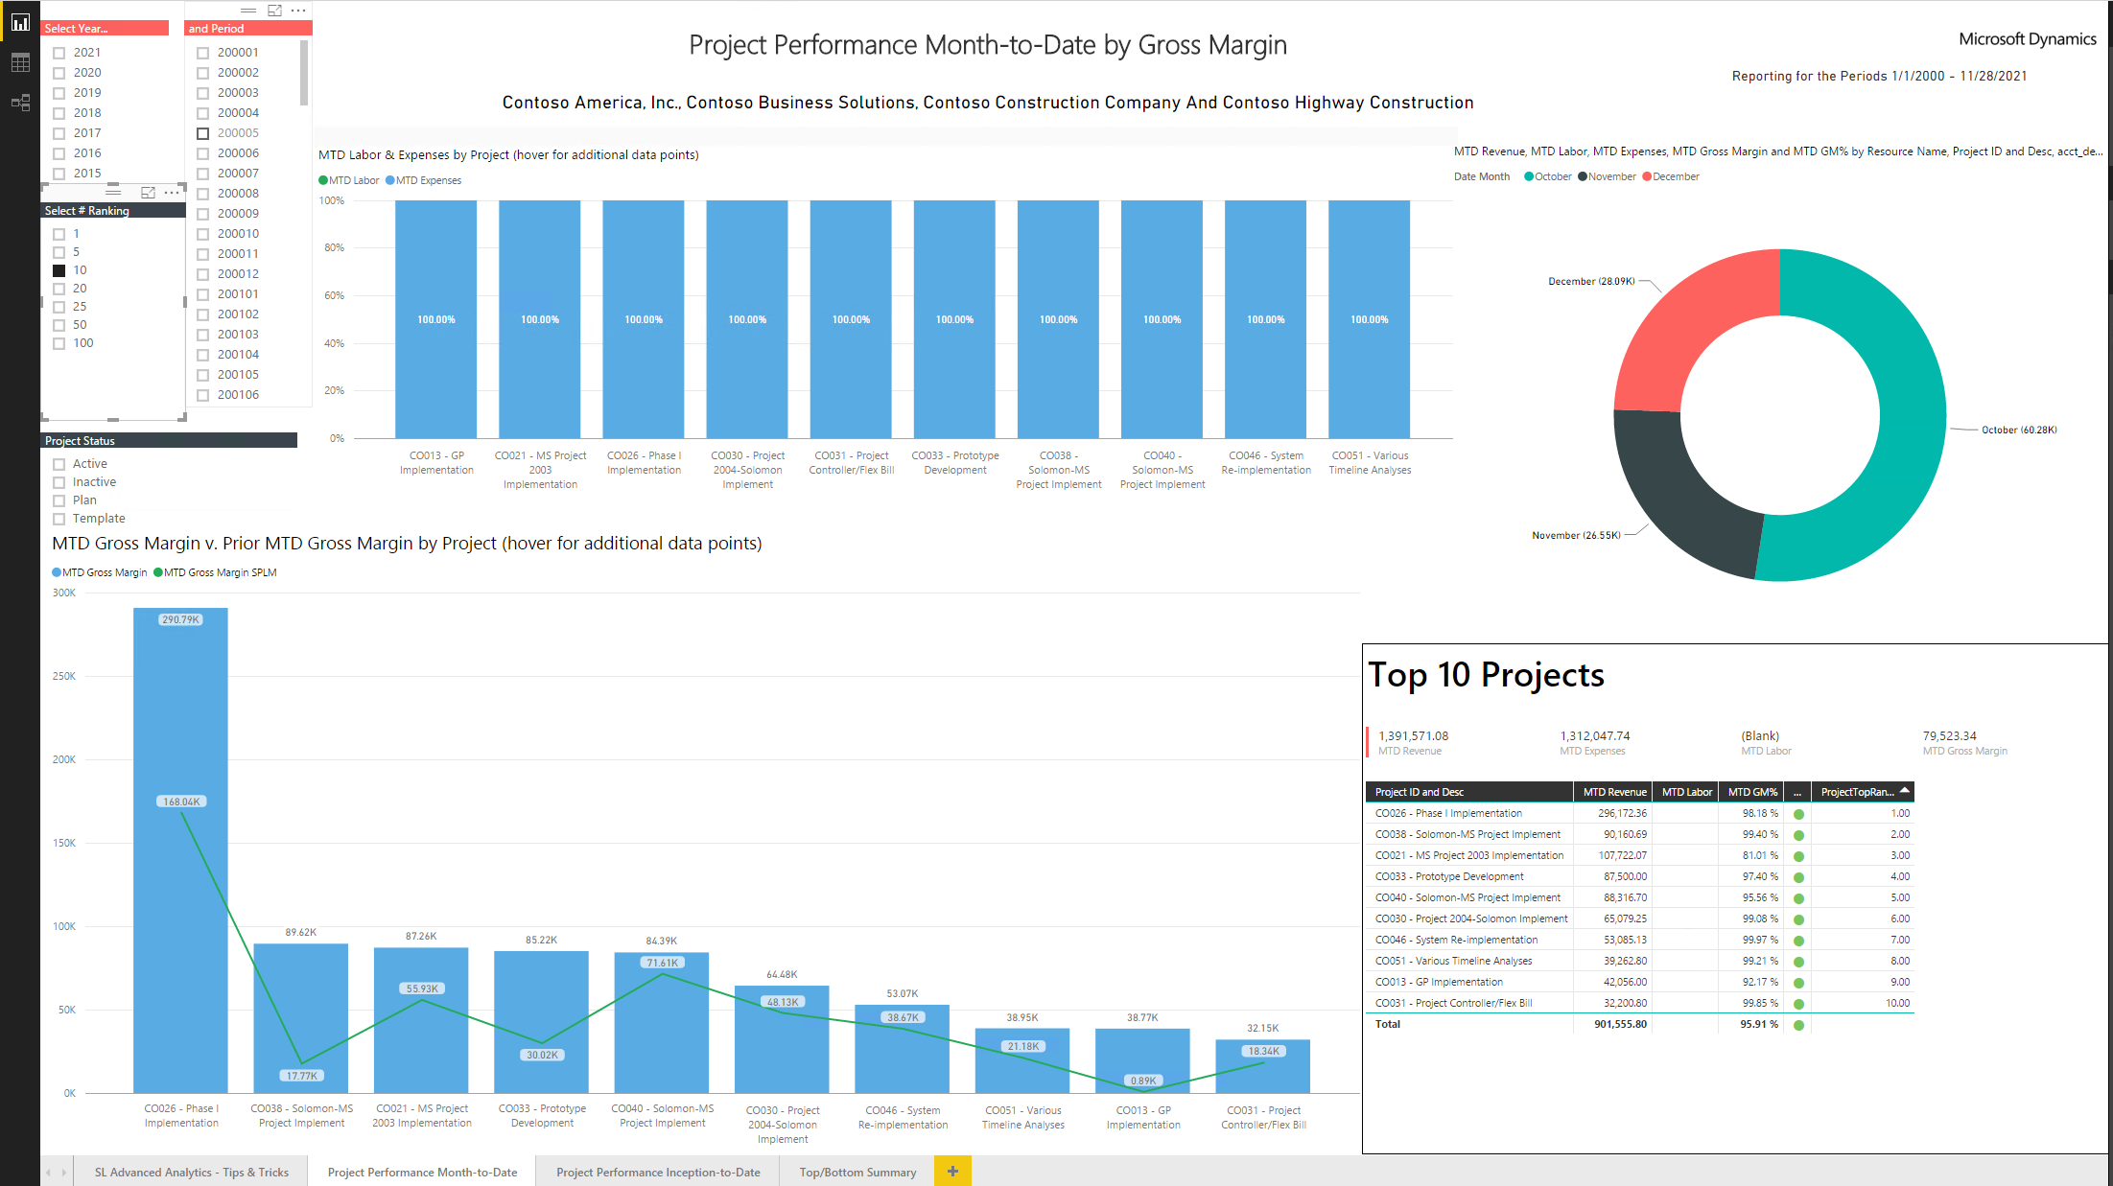
Power BI SL Project Dashboard example
Labor & Expenses
Revenue, Labor, Expense
Gross Margin

Slide 11
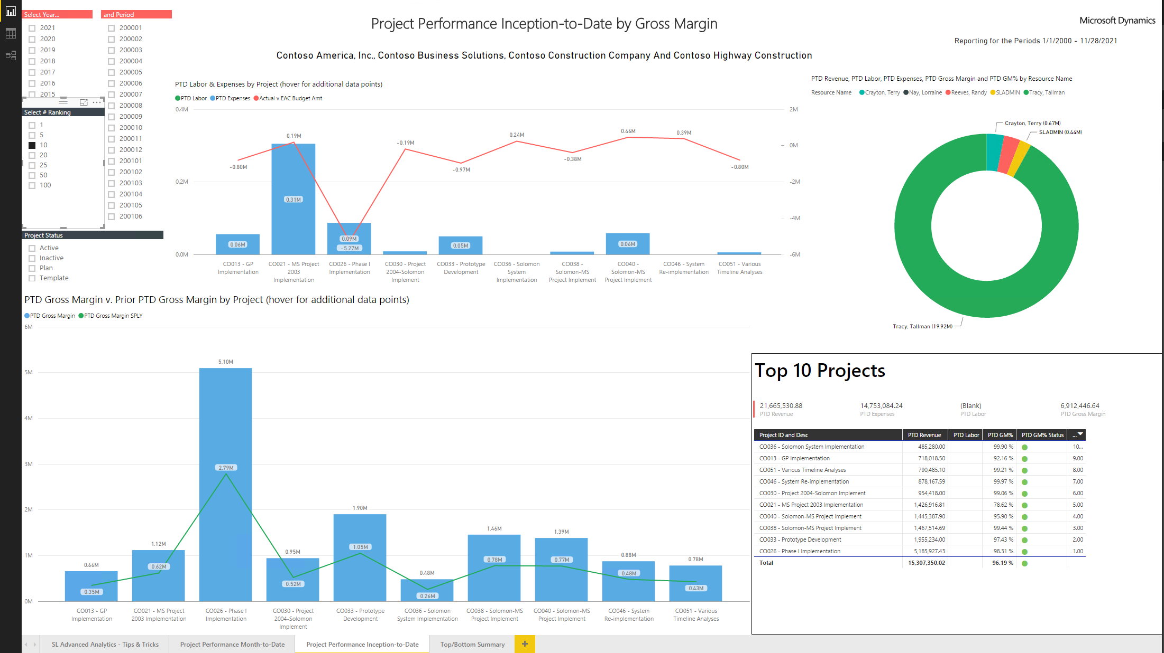
Power BI SL Project Dashboard example

Slide 12
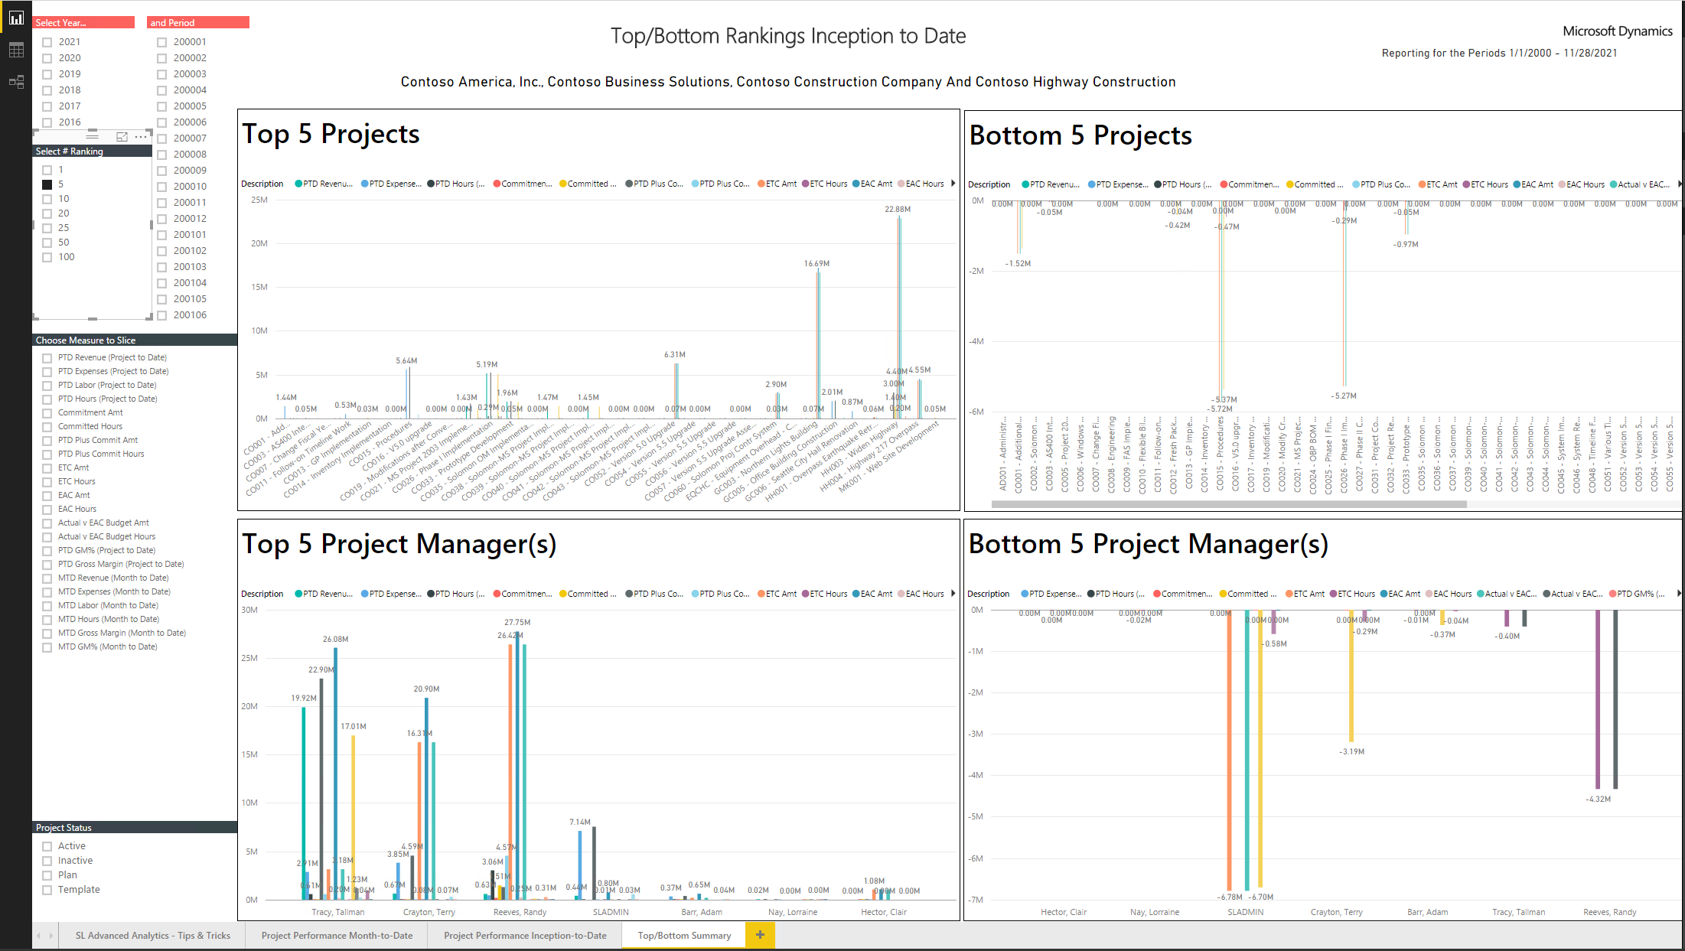
Power BI SL Project Dashboard example

Slide 13
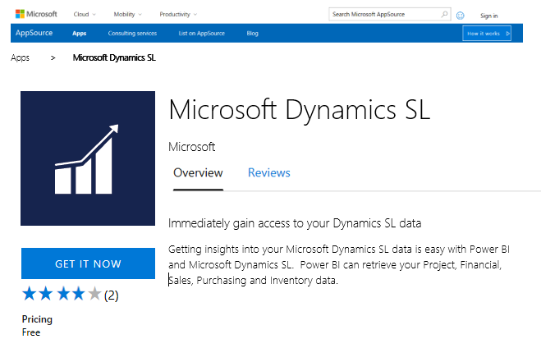
Creating Odata Service
OData services
Provides a way to deliver installable package to deliver PowerBI reports

Slide 14
Microsoft Power Apps

Slide 15
Microsoft Power Apps

Slide 16
Microsoft PowerApps is a service for creating and using custom business apps across platforms
Connect to data & systems you’re already using; create the data you need
Create apps, forms, and workflows without writing code
Use apps on web and mobile

Slide 17
Publish apps instantly for web and mobile
Get apps to your team when and where they’re needed, whether that’s on the web, Windows, iOS or Android—no app store required.
web.powerapps.com

Slide 18
Microsoft Flow

Slide 19
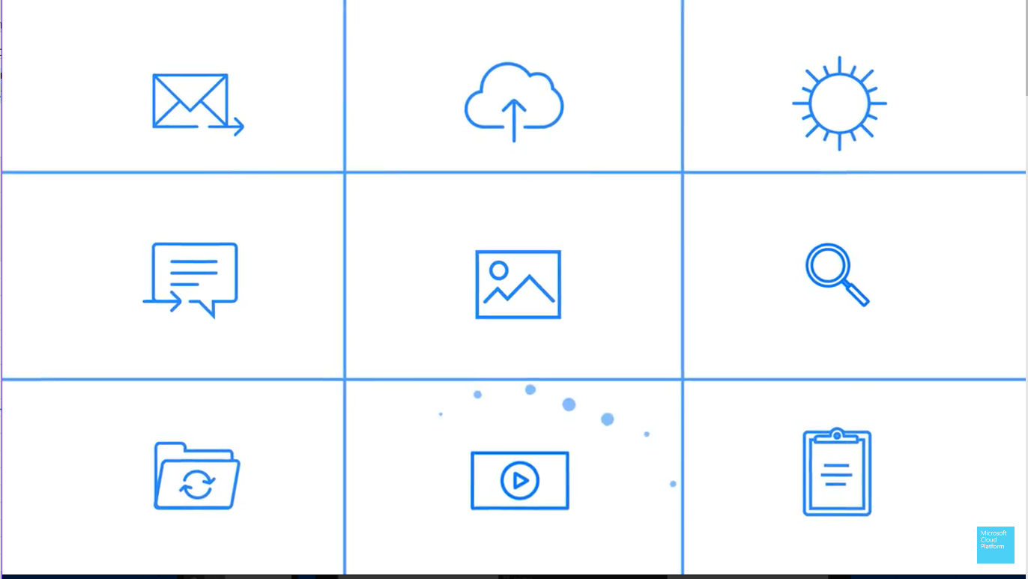
A way to monitor, notify and take action

Slide 20
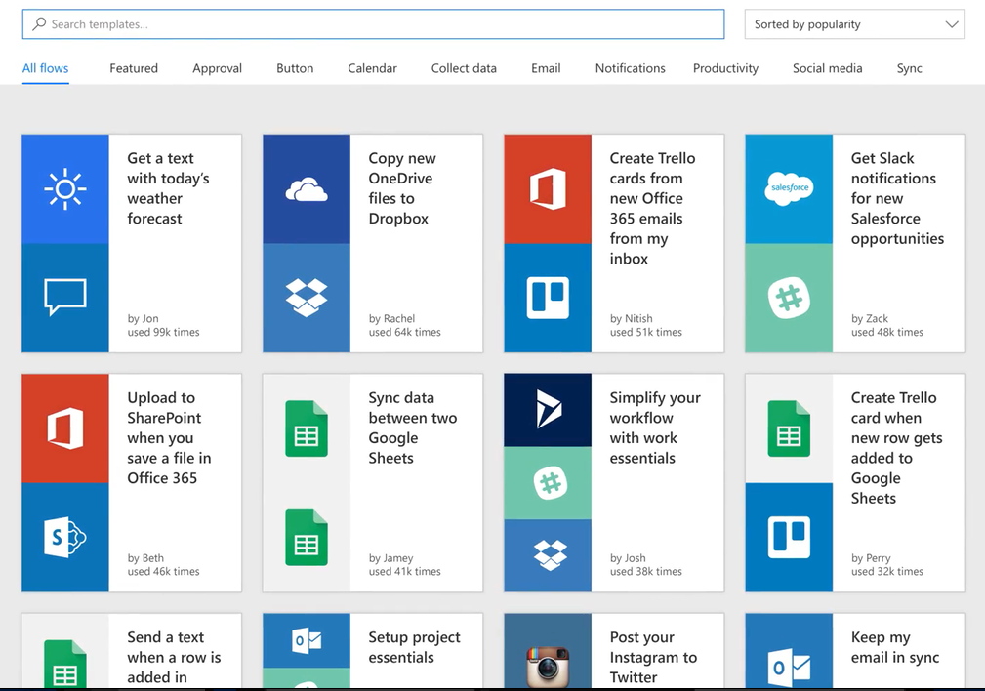
Prebuilt Templates

Slide 21
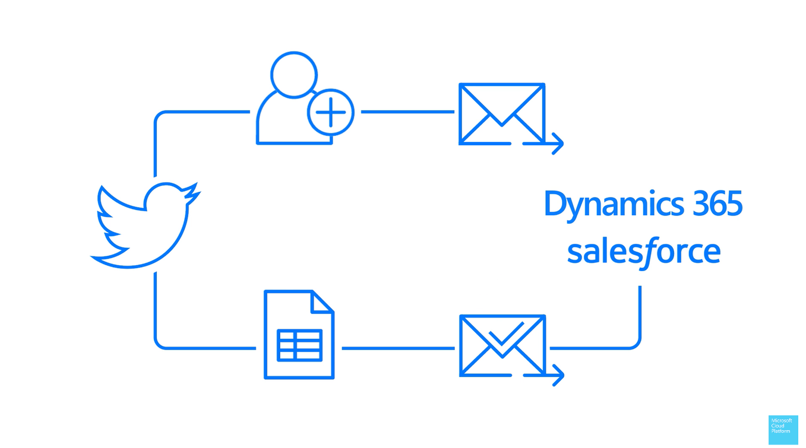
Microsoft Flow Example
Notes:
Someone Tweets about your company
Setup a Flow to automatically follow them
Sends them a nice reply
Puts them to a Spreadsheet that is emailed to you for your review and approval
If approved then the contact information is added to Dynamics CRM or Dynamics SL

Slide 22
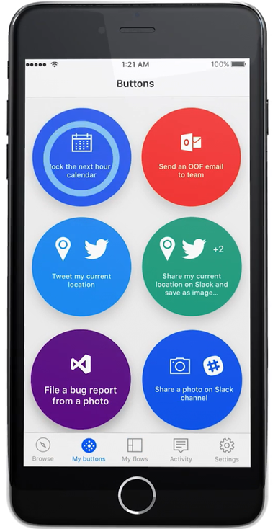
Flow Available On
Web
Phone/Tablet/PC
Inbox
Preset Flows…

Slide 23
Power Apps & Flow demo for SL 2018 Phone & Tablet

Slide 24
Accounts Receivables Power App & Flow
View Customer Receivables Due
Contact customers
Run Aging
Email Aging Results

Slide 25
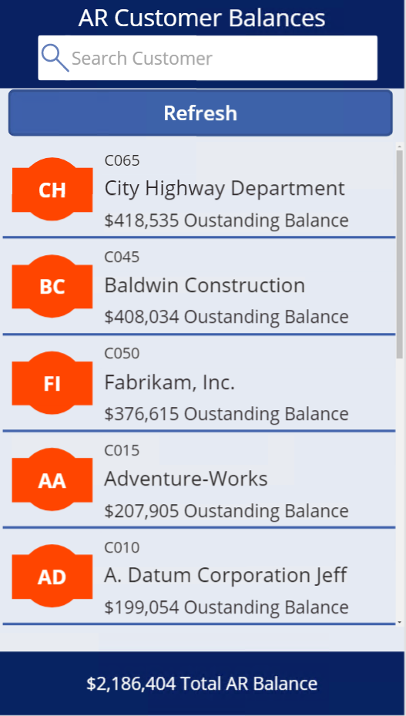

Slide 26
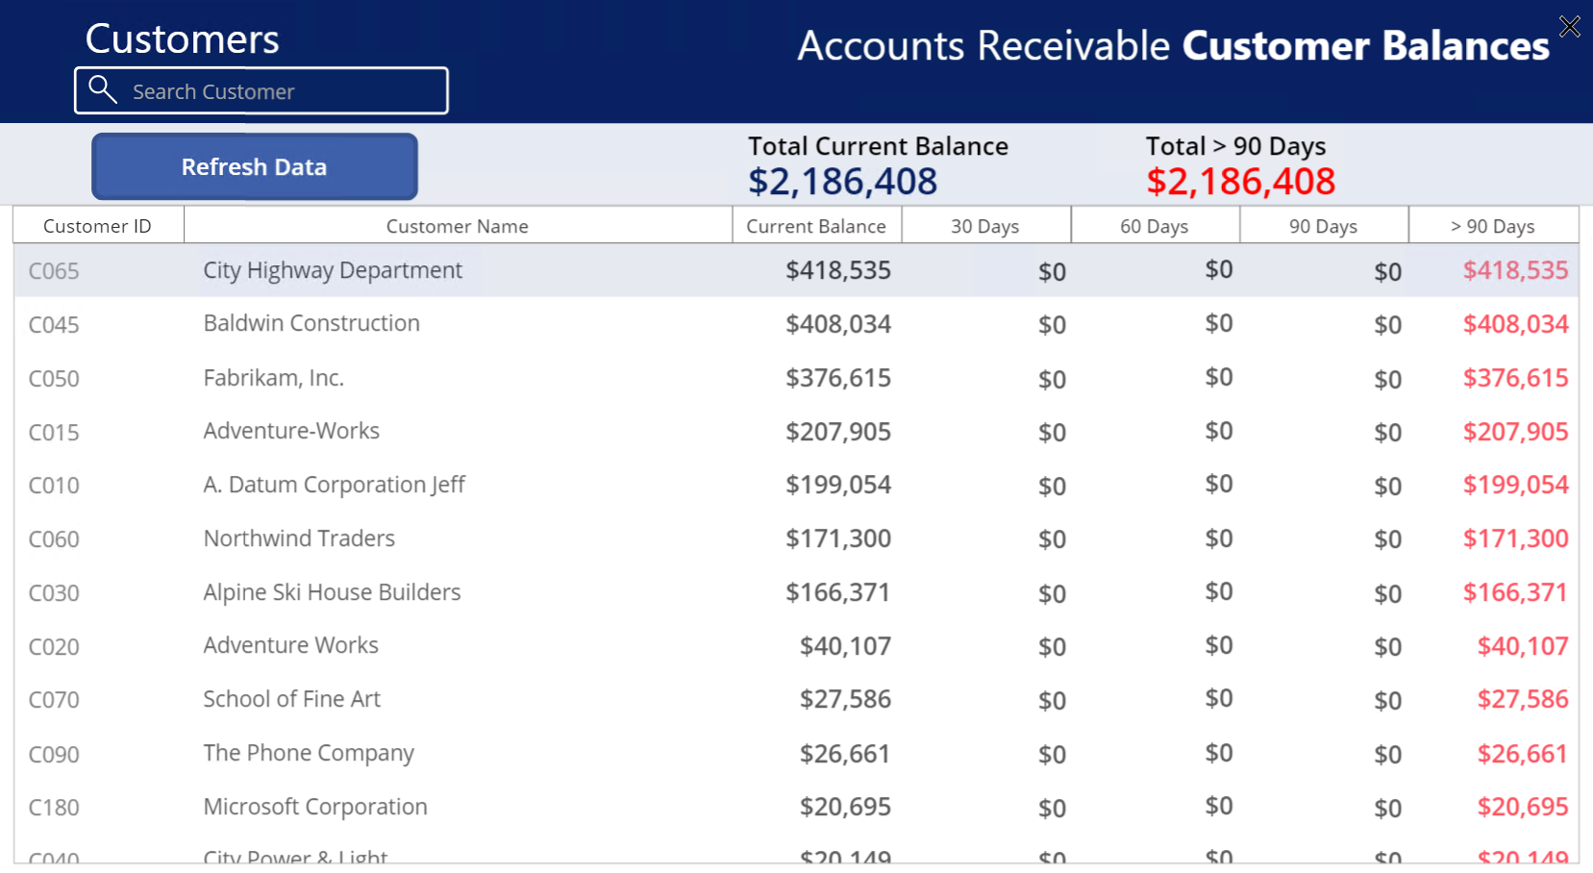

Slide 27
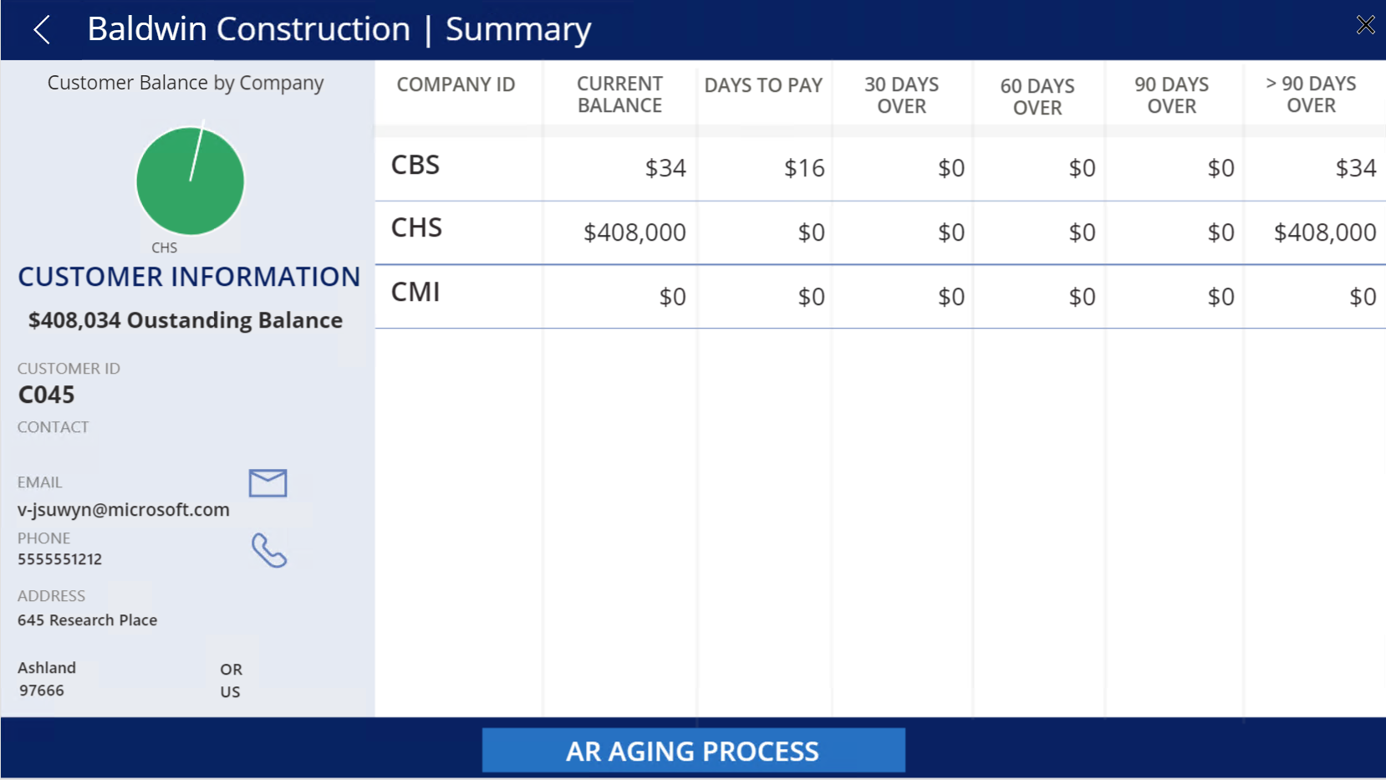

Slide 28
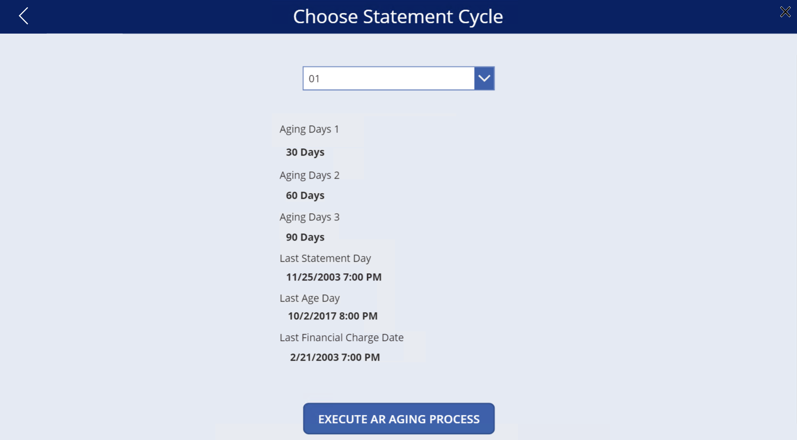

Slide 29
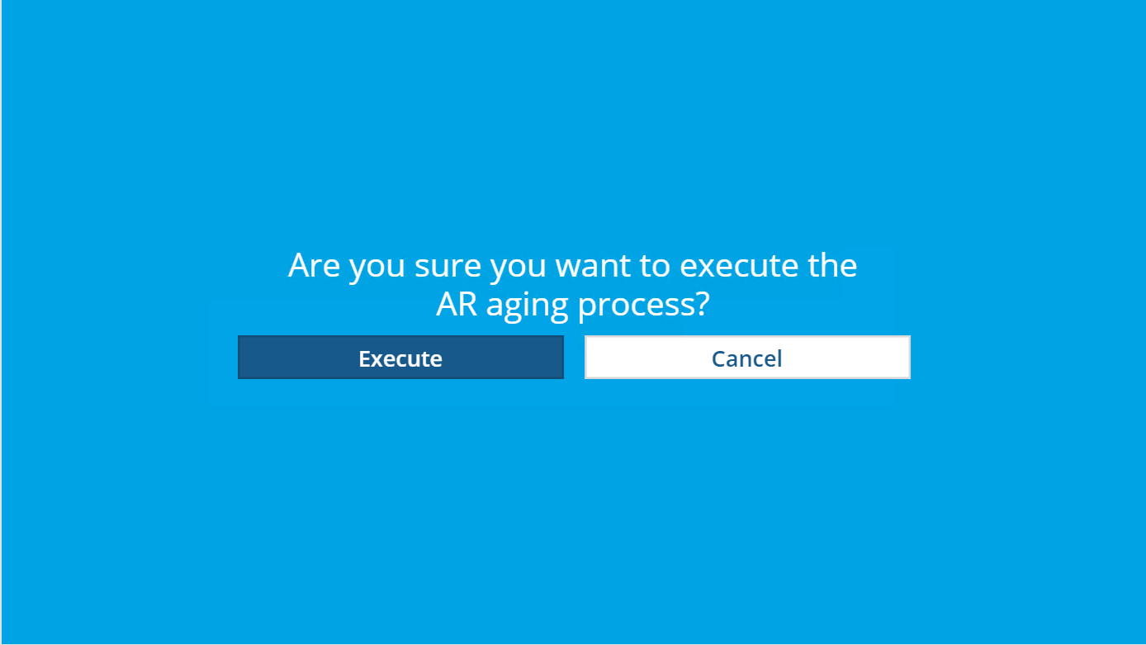

Slide 30
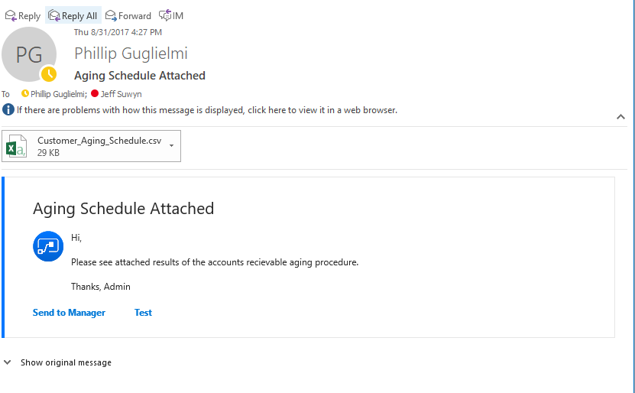

Slide 31
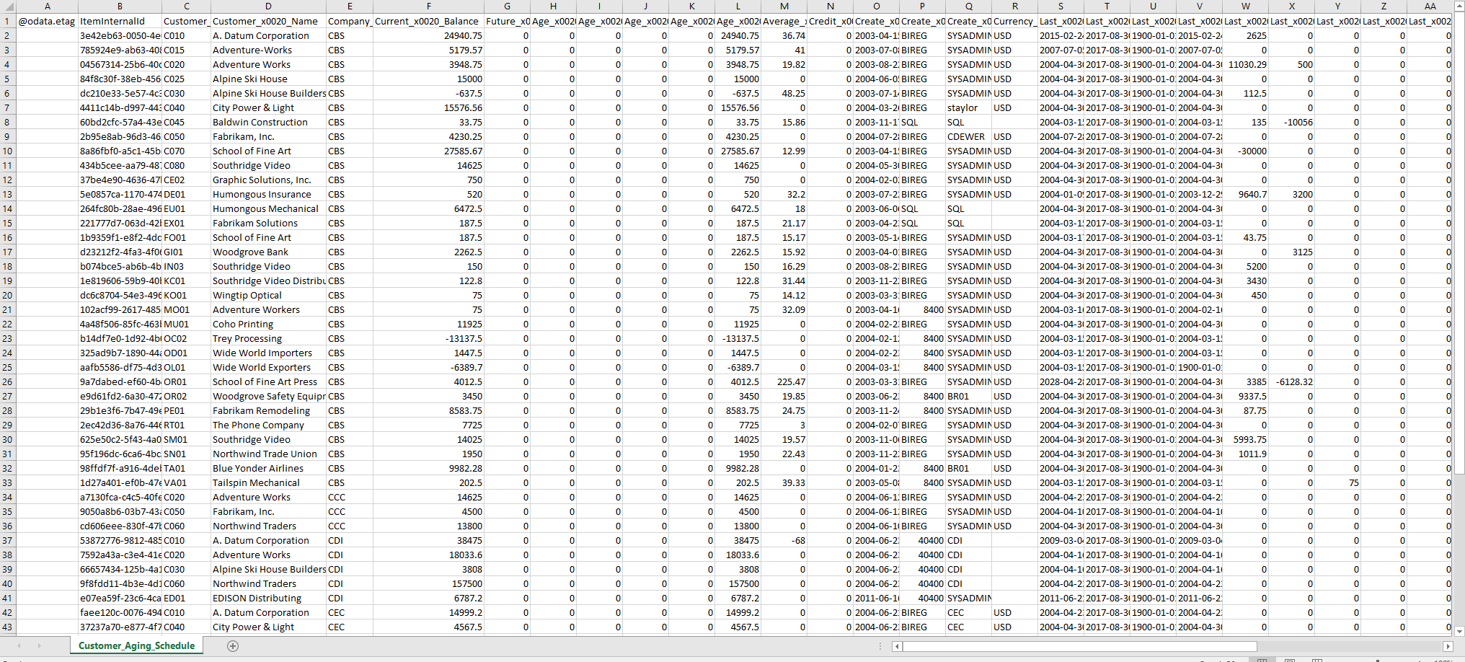

Slide 33
Microsoft Dynamics SL 2018 Web Apps

Slide 34
Microsoft Dynamics SL Web Apps
Hot Fixes
&
New Features
Releasing approximately
once a month

Slide 35
Microsoft Dynamics SL 2018 Web Apps
Project Time Entry
Project Maintenance
Employee Utilization Module
Reporting
(Web SL reporting)
Project Timesheet Entry
Employee and Resource Maintenance
Resource Planning
by Project &
by Resource
Quick Query
ad-hoc query
Project Expense Entry
Employee Position/Rate
Maintenance
Vendor, Customer & Payroll employee Maintenance
Item Request Entry & Approval
Project Approvals & Delegation: T&E, Invoice, Budget
Project Analyst
Inventory Lookup
Payroll & Advanced Payroll Timecard Entry
Timecard Status
Project Charge Entry
Project Charge Order
External Links to Websites

Slide 36
Web Apps 2018
New
Web Apps enhancements
3 new Web Apps
Timesheet Status
Project Charge Entry
Project Change Order

Slide 37
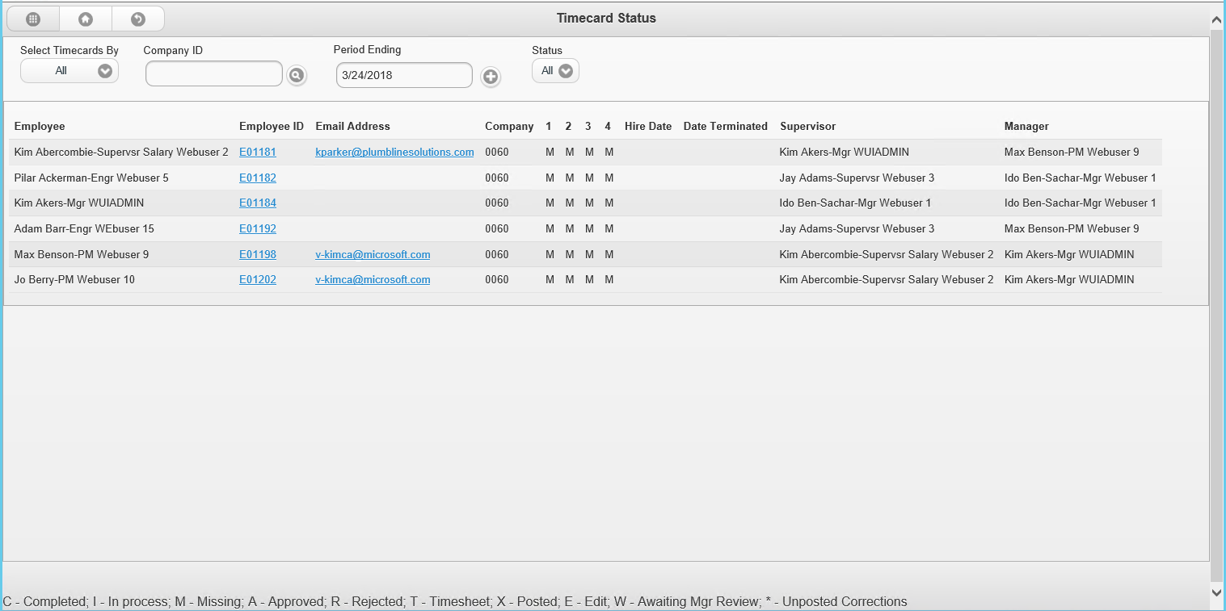
Timecard Status
Communicator
Message
Email
Message

Slide 38
Web Apps
Microsoft Dynamics
SL Web Apps
New Web Apps &
Enhancements
Hot Fixes
MONTHLY RELEASES

Slide 39
SL 2018 Product Enhancements

Slide 40
System Requirements
Windows Server 2012 Standard Edition R2,
Windows Server 2016 Standard or Data Center Edition
SQL Server 2014 Standard or Enterprise Edition **
SQL Server 2016 Standard or Enterprise Edition
Microsoft Windows 10
Microsoft Office 2013, Microsoft Office 2016, Microsoft Office 365 Enterprise Edition E3 and E5
Microsoft SharePoint 2013, Microsoft SharePoint 2016
Notes:
**- SL database will be upgraded to SQL 2014

Slide 41
Microsoft Dynamics SL 2018

Slide 42
Approvals

Slide 43
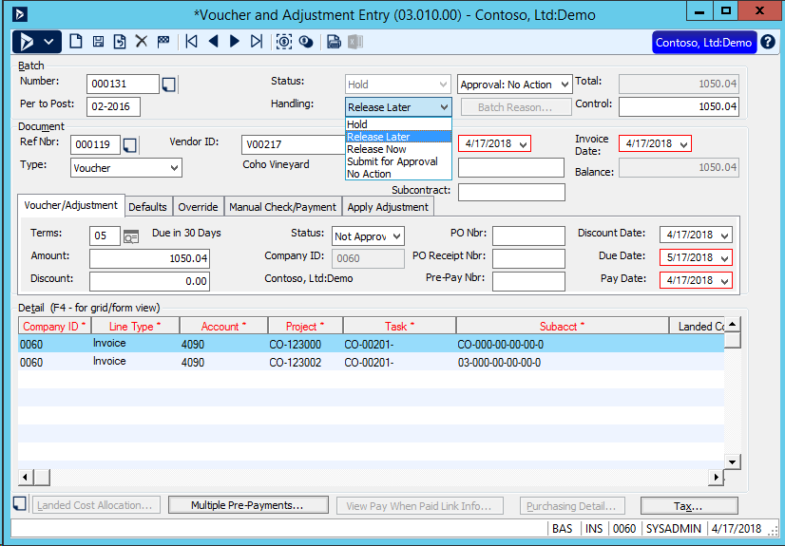
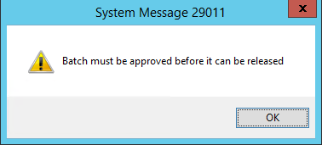
Approval

Slide 44
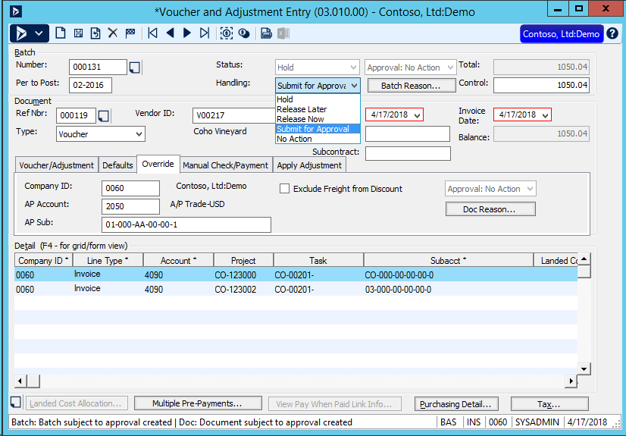
Approval

Slide 45
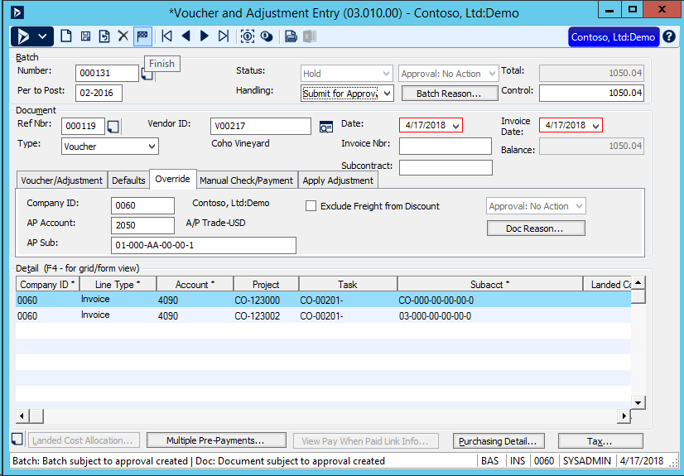
Approval

Slide 46
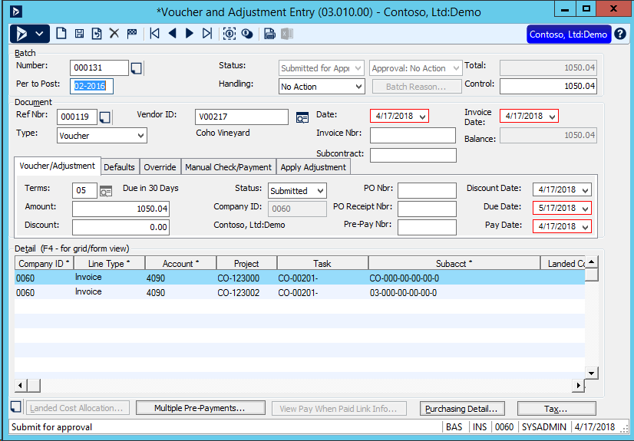
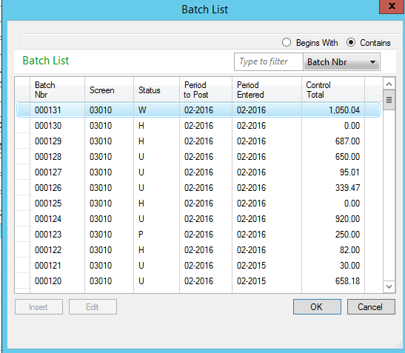
Approval

Slide 47
Approval

Slide 48
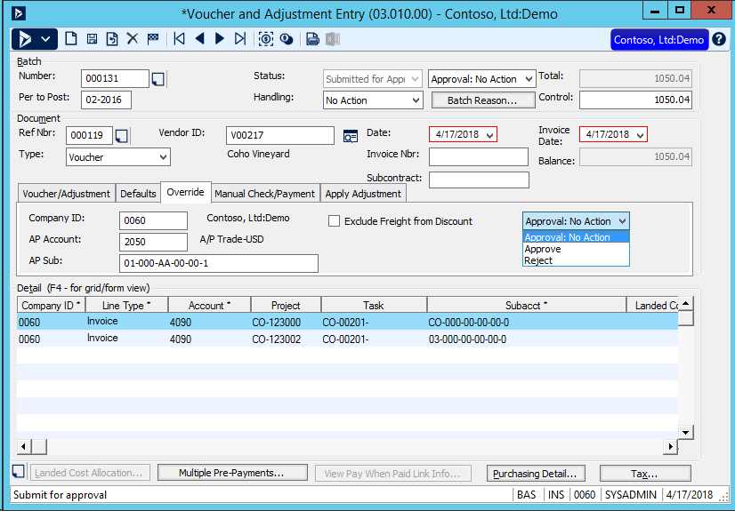
Approver

Slide 49
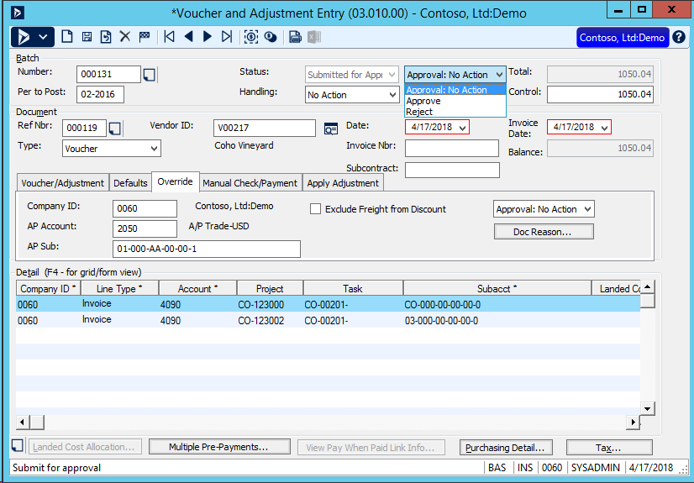
Approver

Slide 50
Approval

Slide 51
Approval

Slide 52
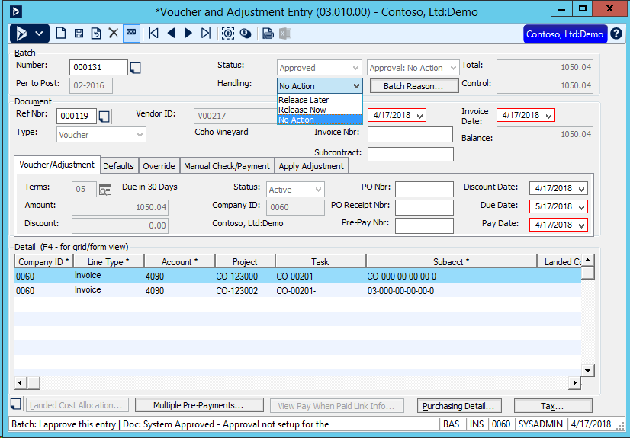
Approval

Slide 53
Approval Maintenance
1 or 2 levels of approval
User or Group
By Company or All company

Slide 54
Approvals
Flow notification
Power Apps Approval
Web Apps Approval

Slide 55
Create Approval History
Latest history available on screen
Approval records can be viewed in a
Report
Power App
Web App

Slide 56
Next Approval
GL – Journal Transactions
PO – Purchase Orders
Anywhere a batch can be released

Slide 57
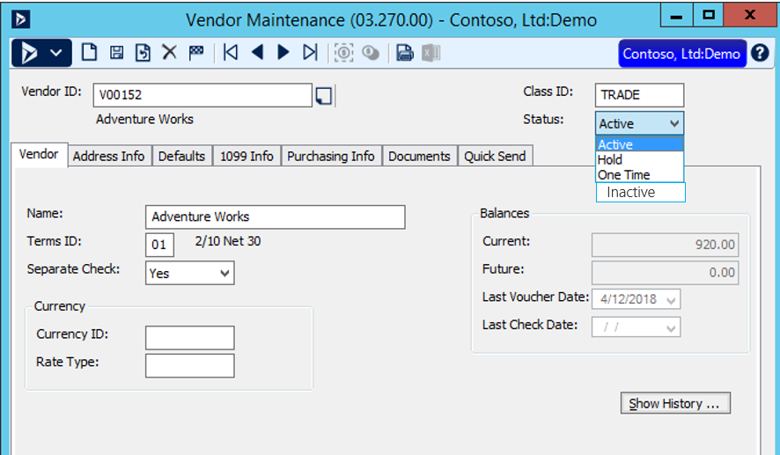
Vendor Inactive

Slide 58
Vendor Inactive
Purchase Order Screen
No new Purchase Orders
Accounts Payable
No new Voucher and Adjustments entries
No checks if inactive

Slide 59
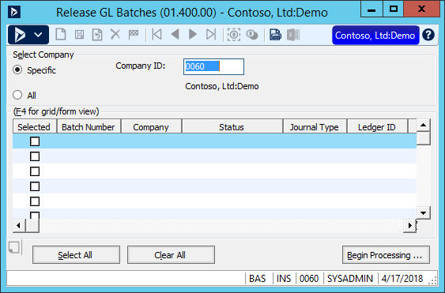
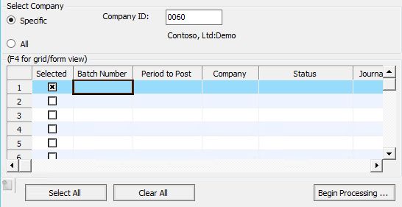
GL - Release GL Batches screen
Add the Period to Post field to the grid
Make the Period to Post field enabled if the screen is in initialize mode

Slide 60
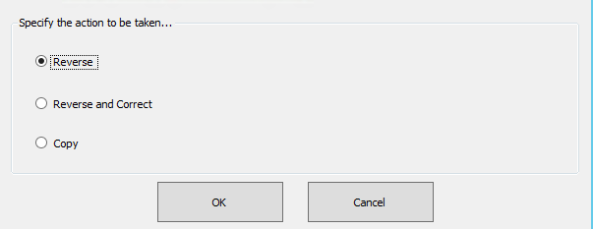
GL - Enhance Reversals with Projects
Example: When Projects are involved:
Flip sign on units qty to –ve quantity and
negative debit
instead of a +ve quantity and
positive credit

Slide 61
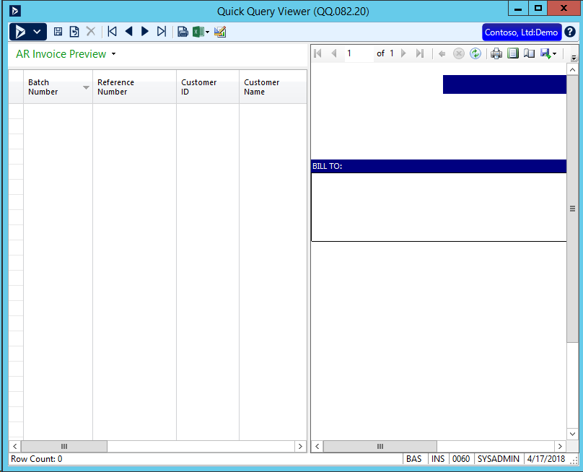
Quick Query & Preview

Slide 62
Quick Query & Preview
GL – Journal Transactions
AP – Check Preview
AP – Vouchers and Adjustments Batch Preview
PO – Receipt Preview
PO – Purchase Order Preview
IN – Inventory Batch Preview
OM – Sales Order Preview
RQ – Requisition Preview
Service – Invoice Preview
Your thoughts on the order…

Slide 63
Create Quick Query(s)
Adding more Quick Queries in
Financials
Project
and more

Slide 64
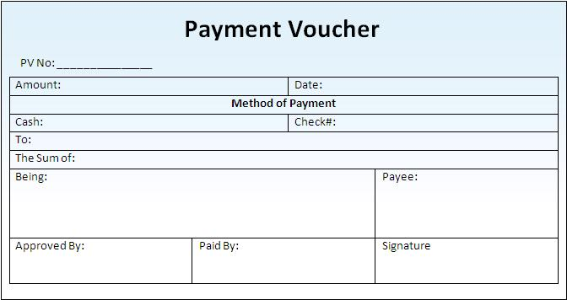
AP - Void Check & Voucher at same time

Slide 65
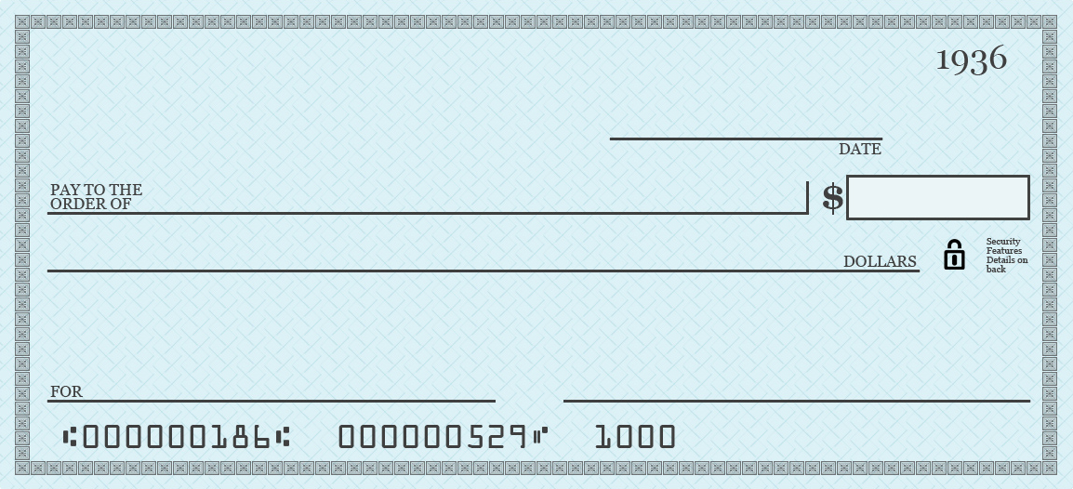
AP - Zero Check processing
Remove the need to print zero checks
0.00

Slide 66
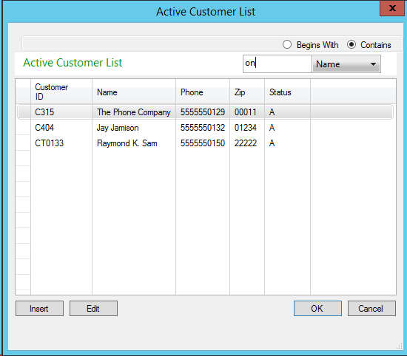
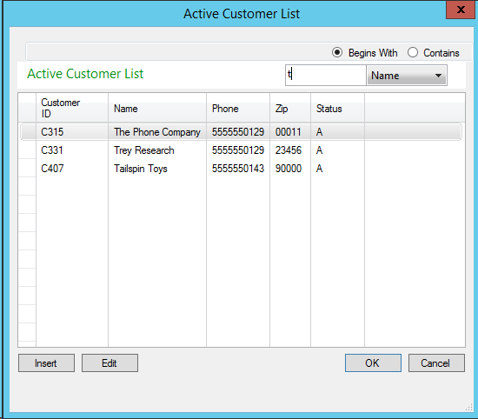
Update Possible Value filtering

Slide 67
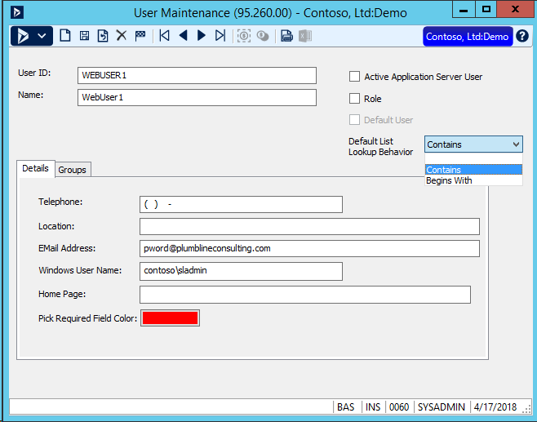
Update Possible Value filtering
Default List Lookup Behavior

Slide 68
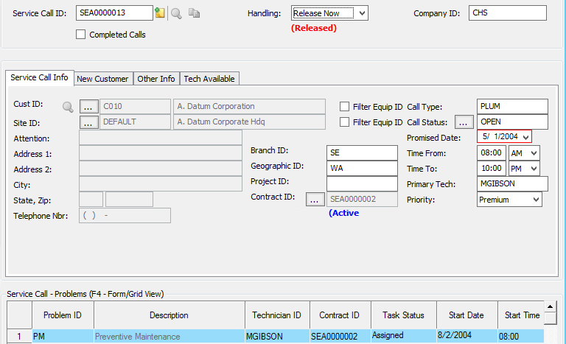
Service - Enable changing Site ID

Slide 69
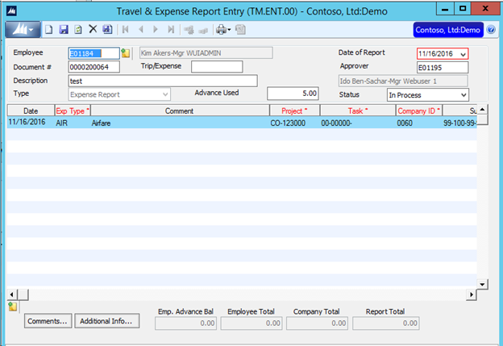
Project – Travel & Expense Report Entry
Project Travel & Expense Report Entry (TM.ENT.00)
Enable note/attachment icons NEW SS

Slide 70
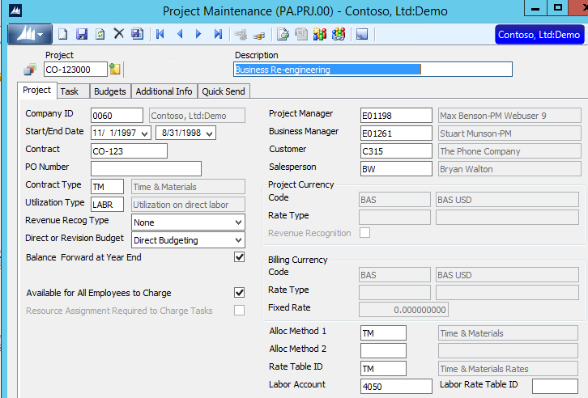
Project Maintenance - End Date

Slide 71
Project Maintenance - End Date
Turn on the ability to NOT allow:
Time entry
Expense entry
for projects that have past the end date
The Project lookup list will not show Projects that have end dates past the current business date.

Slide 72
Project Timesheet screen
Enhancements to the screen to support Web Apps Line Item Approval
Updating fields from the rich client screen used for online

Slide 73
Project - Calculate Retention by line item
Construction billing supports retention by line item
Add the ability for the billing rule to calculate retention by line item (option) rather than always "total"
Currently BI.BAM.00 will calculate retention on the total invoice amount, not by line item.
New feature will add retention by line item

Slide 74
Project - Week Maintenance
Provide a way to auto generate week maintenance information
The Week maintenance screen must be setup
before Project Time can be entered
Currently this is a manual setup process
Create a way to setup week maintenance by:
Date range
Beginning of the week day
Ending day of the week day
Define frequency (weekly, biweekly, semimonthly)

Slide 75
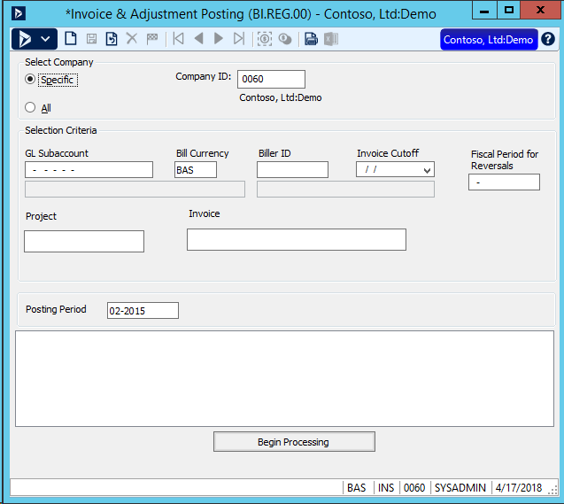
Invoice & Adjustment Posting post
Allow users the ability to select what project/projects or invoice numbers they want to post

Slide 76
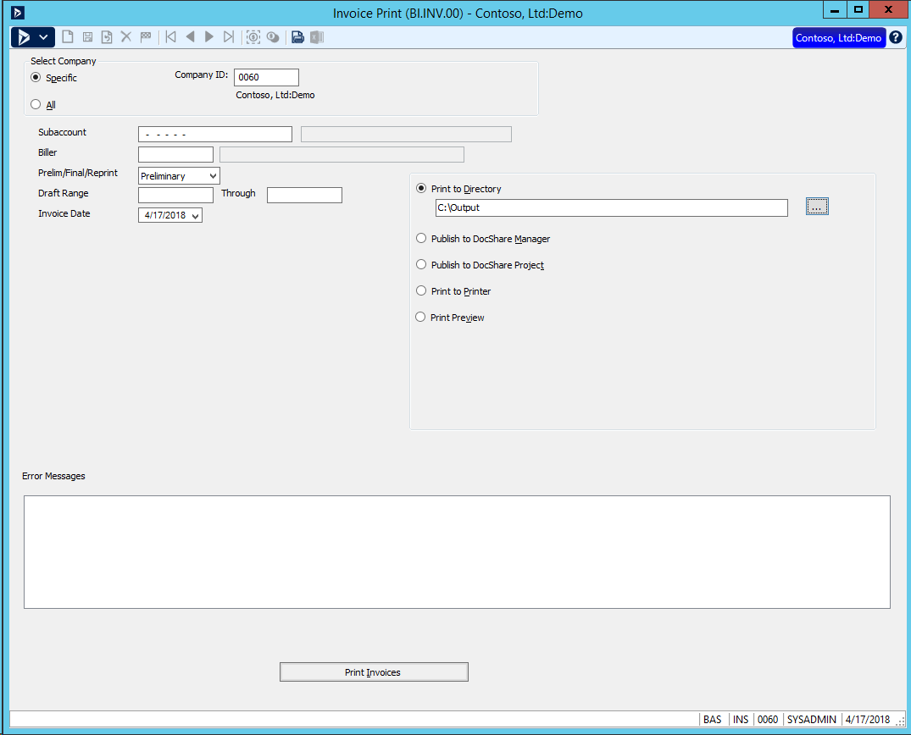
Project Invoice Printing - Preliminary
Notes:
Uses setup options for DocShare document type – PDF, Word, Excel, etc.

Slide 77
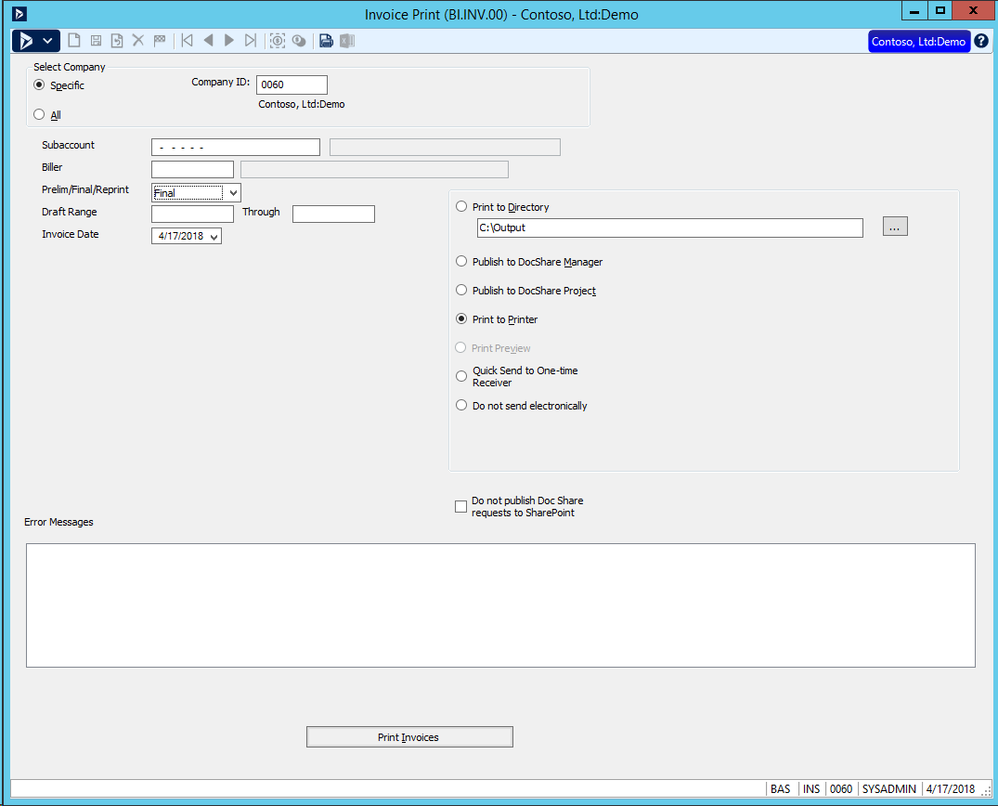
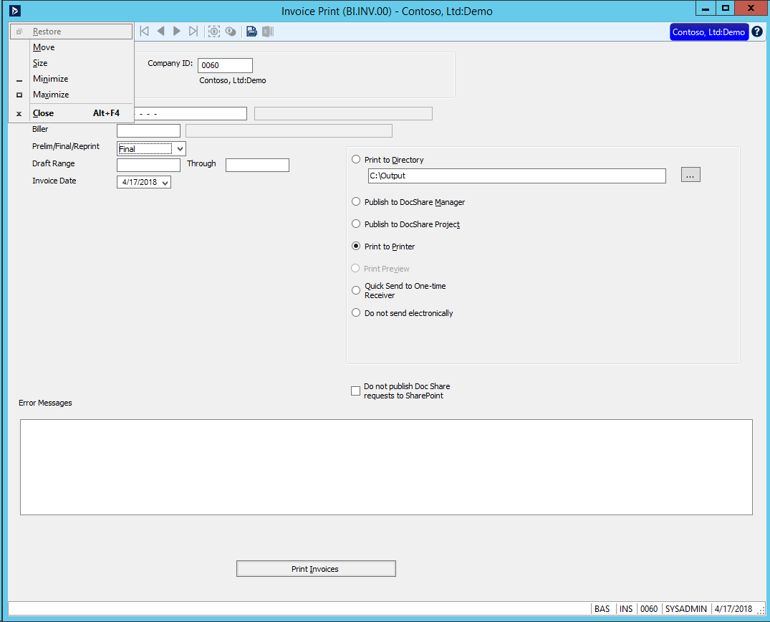
Project Invoice Printing - Final

Slide 78
Project - Allocator - Enhancement
Allocator can transfer costs from one project to another in pjtran
Usually one moving out and one moving it in to another project
Currently both entries made in the general ledger transaction contain the source project id
Enhance the general ledger posting to follow the post and offset project and task id's specified in the allocator method

Slide 79
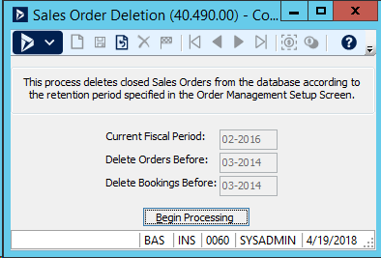
Sales Order
Add ability to remove canceled sales orders from the system
Deletion process will add ability to remove cancelled orders

Slide 80
Roadmap

Slide 81
Microsoft Dynamics SL Roadmap
2014 H1
2014 H2
2015
2016
2017
2018
2019+
Web Apps
SL 2015
SL 2015 CU1
SL 2015 CU2
Web Apps
SL 2018
SL Next
Initial Release
-Project Time
-Expense
-Approvals
-Project Analyzer
SL 2015 Release
Rich client features
-Reporting
-Financials
-Project
-Payroll
-System wide
Web Apps
Hot Fixes
Web Apps:
-Project Maint.
-Communicator
-Approvals
-Delegations
-Reporting
-Quick Query
Hot Fixes
Power BI
Web Apps:
-Customer
-Vendor
-Payroll
Employee
Monthly Releases
Hot Fixes
Enhancements
New Web Apps
Rich client Hot Fixes
SL 2018 Release
Top features requested by customers
Technology:
Power BI
Power Apps
Flow
Web Apps
Ongoing Development

